Slide 1
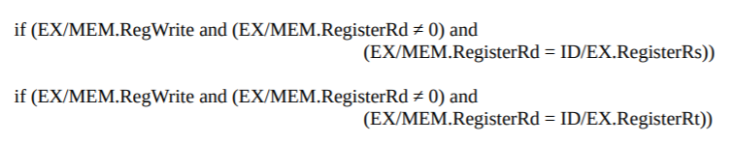
EXE hazard
WB
ME/WB
ME
EXE/ME
EXE
ADD R1, R5, R6
ID/EXE
ID
SUB R4, R1, R3
IF/ID
IF

Slide 2
EXE hazard
WB
ADD R1, R5, R6
ME/WB
First Solution:
Add 2 stalls until R1 is written back
ME
EXE/ME
EXE
ID/EXE
ID
SUB R4, R1, R3
IF/ID
IF

Slide 3
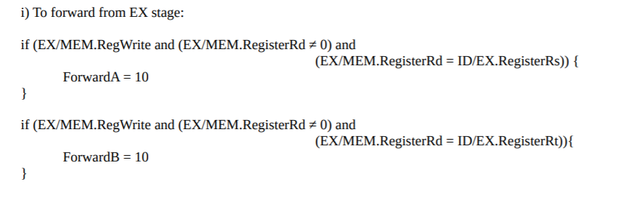
EXE hazard
WB
ME/WB
Second Solution:
Forwarding
ME
EXE/ME
EXE
ADD R1, R5, R6
ID/EXE
ID
SUB R4, R1, R3
IF/ID
IF

Slide 4
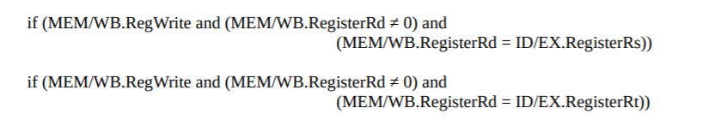
Memory hazard
WB
ME/WB
First Solution:
Add 1 stall until R1 is written back
ME
ADD R1, R5, R6
EXE/ME
EXE
AND R2, R9, R10
ID/EXE
ID
SUB R4, R1, R3
IF/ID
IF

Slide 5
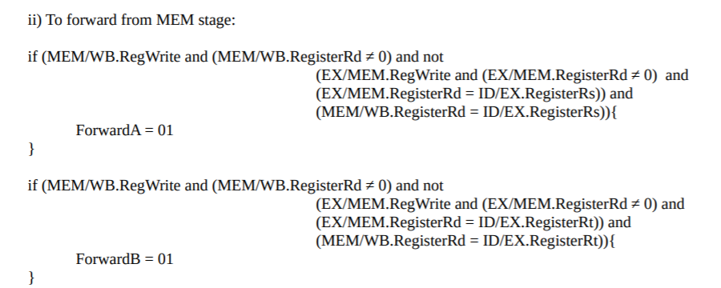
Memory hazard
WB
ME/WB
Second Solution:
Forwarding
ME
ADD R1, R5, R6
EXE/ME
EXE
AND R2, R9, R10
ID/EXE
ID
SUB R4, R1, R3
IF/ID
IF

Slide 6
Memory hazard
WB
ME/WB
Forwarding is not possible with data forwarding
ME
ADD R1, R5, R6
EXE/ME
EXE
AND R1, R9, R10
ID/EXE
ID
SUB R4, R1, R3
IF/ID
IF

Slide 7
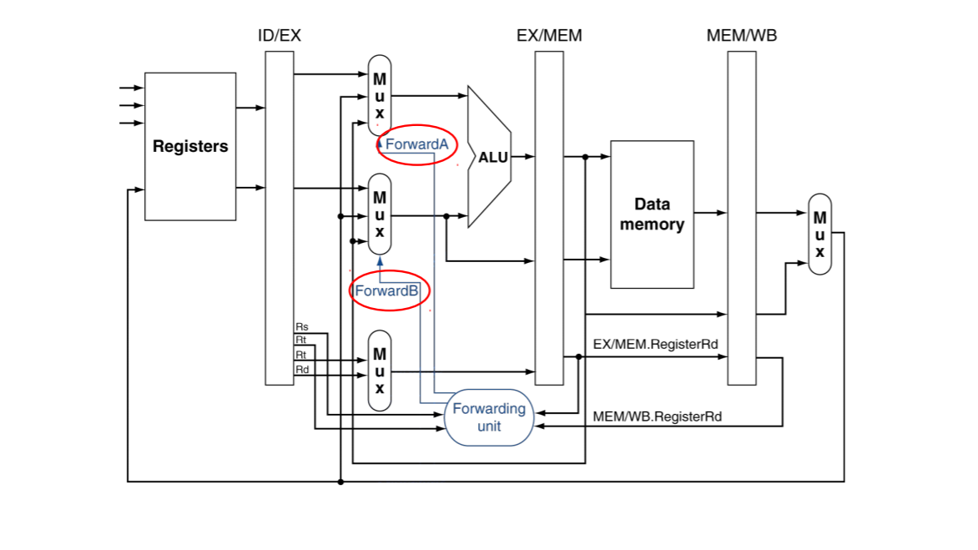

Slide 8
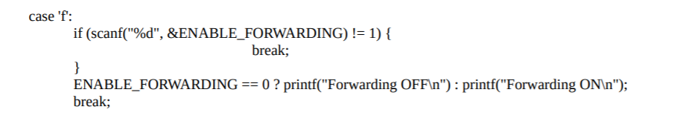

Slide 9
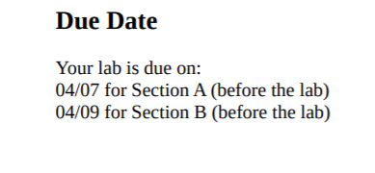
Note: Please rename the input file name as it may cause a problem since it is too long

