Slide 1
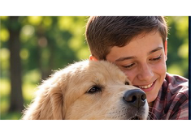
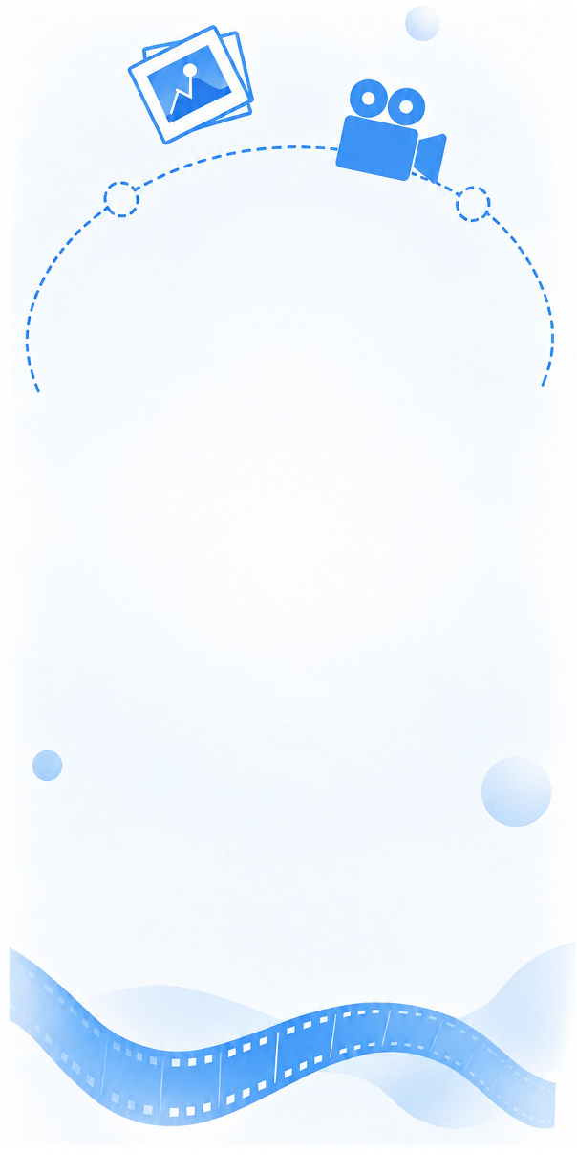

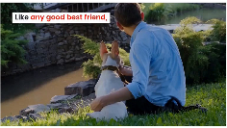
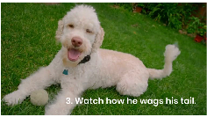
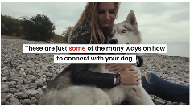

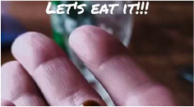
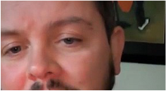
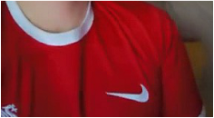
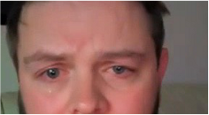



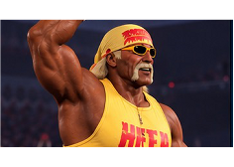
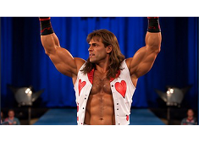
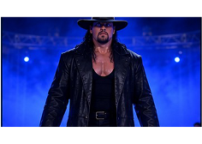
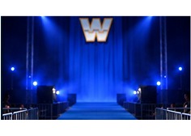

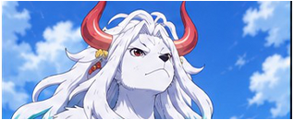
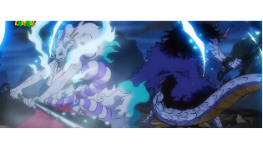
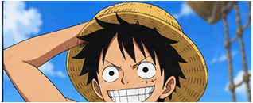





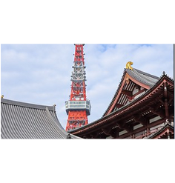
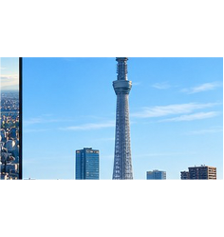

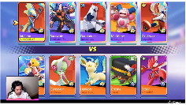
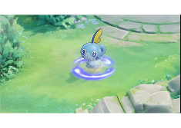
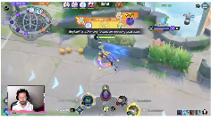
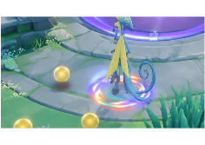


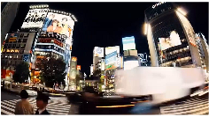
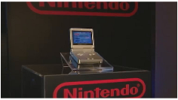

Single
-
anchor
Multi
-
hop
1
Lookup
1
Retrieval
VGEG:
1
Golden Retriever
native country
Scotland
VGEG:
1
Nike
designer
Carolyn
alma mater
Portland State
location
Downtown
Swoosh
Davidson
University
Portland
Q
What is the native country of the dog breed
hugged by the boy in a plaid shirt?
A
Scotland
Q
Where is the alma mater of the white
logo’s designer located?
A
Downtown
Portland
Multi
-
hop
Know.
-
Count
15.6%
19.4%
Knowledge
-
1
2
3
Lookup
1
2
conditioned
8.7%
Multi
-
Anchor
Counting
OneSearch
Join
1
Hulk Hogan
rumble wins
2
Bench
father
rumble wins
MA
-
Join
VGEG:
1
Yamato
Kaido
JOIN
facts
Kaido;
Monkey
VGEG:
2
Shawn Michaels
2
COUNT
∑
1
= 3
3
18.1%
in order
D. Dragon
rumble wins
MA
-
Comp.
2
Luffy
father
Monkey D.
3
The Undertaker
1
20.
7
%
Dragon
Q
How many of the three depicted wrestlers
have won at least one Royal Rumble match?
A
3
MA
-
Arith
.
Q
Who are the biological fathers of the horned
fighter and the dark
-
haired protagonist?
A
Kaido;
Monkey
17.4%
D. Dragon
1
2
Multi
-
Anchor
Multi
-
Anchor
Arithmetic
Comparison
1
2
301 Samples
307 Samples
1
Sobble
height
0.3 m
Multi
-
Image
Video
1
Tokyo Tower
height
333 m
VGEG:
SUBTRACT
1.6 m
VGEG:
MAX
634 m
height
1.9
−
0.3
height
634 m
(333, 634)
2
Inteleon
1.9 m
2
Tokyo Skytree
Q
What is the height difference between this
Pokémon’s final and base evolution stages?
A
1.6 m
Q
How tall is the taller observation tower
shown in the video?
A
634 m
Notes:
ReFigure editable reconstruction, not author-provided PowerPoint.
OneSearch-VL Figure 2: research operations and benchmark conceptual overview.
Source and attribution: https://arxiv.org/abs/2610.12419v1
Native editable text and diagram geometry. Original photographs, frame artwork, logos, task icons and standalone central decorative art remain independent raster objects with non-editable internal pixels. Freeform arrow paths are not endpoint-bound connectors. The central wheel consists of native paths rather than a live data-bound chart. Reference ComicSansMS uses installed Comic Sans MS; faux-bold stroke weight and antialiasing are approximate. No pixel-identical or original-author-source claim.

