Slide 1






























































































































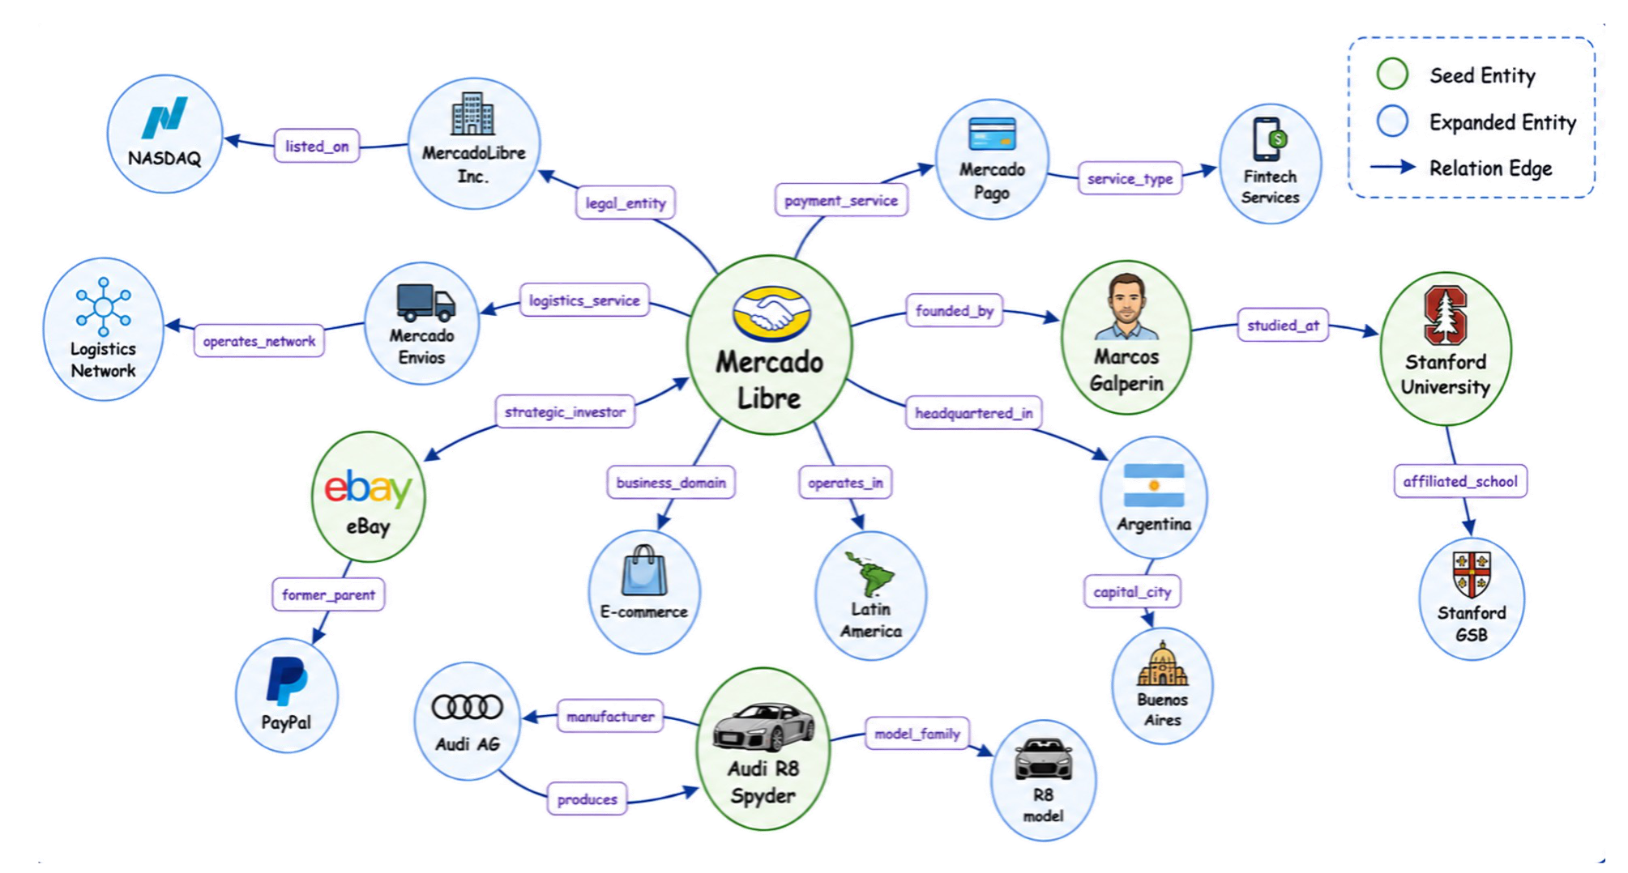































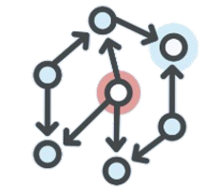

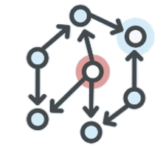
































Visual
Visual
Discovery
Anchor
Discovery
Dense
Anchor
(b)
Dense
Curation
(b)
Visual
Curation
(a)
Visual
(a)
Source
Source
Web
Video
Upload
Date
Video
Clip
&
Caption
Key
-
Frame
Selection
&
Caption
Cross
-
Clip
Frame
Source
Pool
Filter
(>
2023)
In
one
clip
Deduplication
x3
1.3
x3
→
2.5
1.3
2.5
M
M
M
M
one
keep
one
+
keep
+
Caption
Image
Caption
Image
Score
Embedding
Score
Yellow
Embedding
I
ndoor
online
Yellow
x3
Landing
x3
Speaker
Landing
A
irplane
cars
on
Speaker
Plane
T
alking
shopping
Plane
scene
→
intro
scene
T
akeoff
roadway
intro
with
with
logo
Meta
Data
Category
Balance
S
cene
page
logo
one
keep
one
Coarse
Filter
&
Exclusion
keep
128K
Event
Aggregation
&
Caption
Event
Key
-
Frame
Selection
&
Video
Dense
378
K
128K
Key
Object
Grounding
Caption
Tree
(Caption)
Video
(Caption)
...
Video
Video
Snippet
Video
Duration
↓
↓
↓
↓
...
↓
+
+
Caption)
(Segment
Caption)
Event
(Segment
LLM
Filter
Balance
Event
↓
(
(
+
+
Caption)
idx
Caption)
Key
idx
Key
Frames
72K
↓
↓
↓
↓
Frames
↓
72K
70K
70K
Engage
Business
Engage
Business
Cars
Opening
Cars
Opening
R8
Plane
R8
Plane
eBay
eBay
+
Audi
+
Audi
Marcos
Marcos
(Box
(Box
Caption)
Objects
Caption)
Objects
Construction
Entity
Construction
Entity
Graph
Web
Graph
Web
Search
(c)
Search
(c)
Need
Web
Entity
Graph
Need
Search
Image
Search
Objects
Image
Image
Search
Text
Search
Livre
Mercado
Livre
Mercado
plane
cargo
plane
cargo
-
Page
Visit
Page
Visit
Entity
-
Same
Entity
Same
Candidate
Search
Candidate
Multi
Search
Galperin
Multi
Marcos
Galperin
Marcos
eBay
Summery
&
Verifier
Summery
&
Verifier
eBay
logo
logo
OCR
OCR
then
then
text
text
search
text
search
Stanford
text
Stanford
Text
Search
R8
R8
Spyder
Audi
Spyder
Audi
Page
Visit
UI
Candidate
Entity
Pool
YouTube
UI
YouTube
Summery
&
Verifier
Audi
R8
Marcos
eBay
Expand
Entity
Pipeline
458
Ferrari
458
Ferrari
platform
-
platform
-
watermark
object:
watermark
object:
UI
UI
/
generic
/
need
generic
No
need
No
Stanford
Mercado
Libre
multi
Plan
Text
Search
Page
Visit
Summery
Expand
Related
-
turn
-
/
UI
/
site
UI
video
site
video
&
Verifier
Entity
&
Attribute
watermark
watermark
Trajectory
(e)
Trajectory
(e)
Synthesis
Expert
Synthesis
Construction
Expert
(d)
Construction
(d)
Based
VGEG
Based
VGEG
-
-
Task
Task
LLM
-
Guided
QA
Generation
QA
Verifier
Multi
-
Turn
Trajectory
Synthesis
Reject
Sampling
Expert
Answer
Correctness
Judge
Expert
Model:
Web
Entity
Graph
VGEG
Evidence
-
Path
Verifier
Model:
Seed
2.0
Pro
Final
Answer
must
Interact
with
real
Environment
A
Dense
Video
Caption
Walk
Graph
via
tool
set
Match
ground
truth
A
QA
Template
QA
Pair
→
VGEG
+
Q
-
>
A
Image
Search
Text
Search
Page
Visit
Python
Process
-
level
Judge
call
Visual
Entity
Fuzzing
Rewrite
Quality
Filter
Image
Crop
OCR
Sharpen
Clip
Crop
Select
Frame
At
least
one
tool
→
Logical
consistency
What
well
-
known
venture
did
Masking
with
tool
observations
Livre
Masking
(feed
the
images/video)
Mercado
Livre
the
founder
of
Mercado
What
well
-
known
venture
did
the
No
ineffective
repetition
build
build
?
yellow
yellow
cargo
founder
the
cargo
of
the
-
-
Uniqueness
build
Uniqueness
(answer
is
unique)
plane
build
plane
brand
brand
?
Visual
Think
Tool
Observation
Think
Tool
Answer
High
-
Quality
Expert
Trajectory
Visual
Relevance
Relevance
→
(images/video
is
useful)
36k
36k
image
Trajectories;
37k
Q
+
Visual
Reference
-
>
Q_f
Non
37k
multi
-
image
Trajectories
;
Non
-
-
triviality
triviality
Raw
Expert
Rollouts
35k
(multi
-
hop
reasoning)
35k
video
Trajectories
;
10.1
Avg
10.1
tool
turns
Notes:
ReFigure reconstruction of VGEG-centered multimodal data engine.
Source: https://arxiv.org/abs/2610.12419v1. Original Figure 1, PDF page 5.
Reconstructed editable diagram, not an author-provided PowerPoint. Text and diagram geometry remain native objects. Local source imagery has non-editable internal pixels. Mathematical glyph outlines are editable paths, not typeable equation objects. Freeform arrows are not endpoint-bound connectors and diagram plots are not data-bound charts.

Slide 2
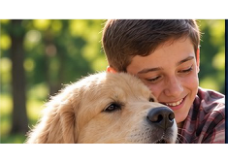


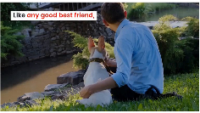
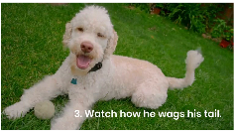
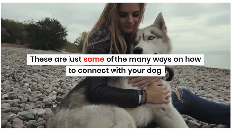

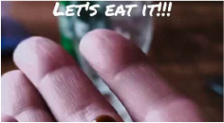
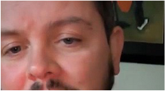
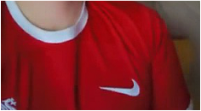
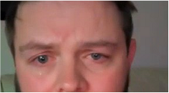



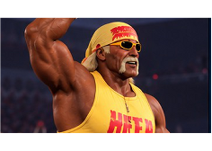
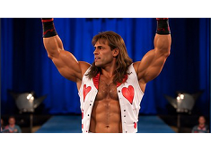
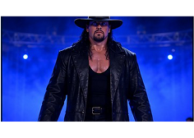
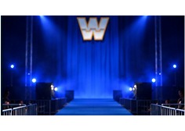


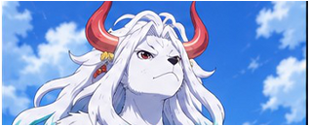
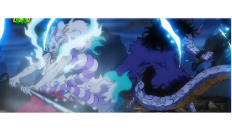
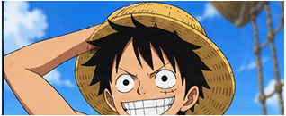




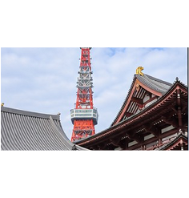
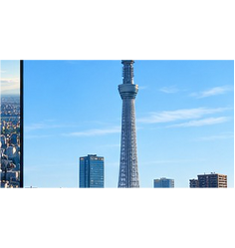

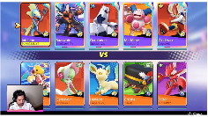
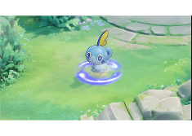
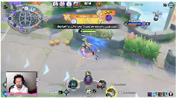
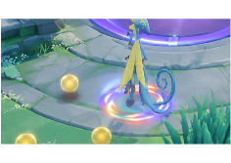



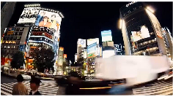
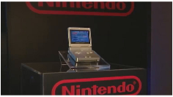
Single
-
anchor
Multi
-
hop
1
Lookup
1
Retrieval
VGEG:
1
Golden Retriever
native country
Scotland
VGEG:
1
Nike
designer
Carolyn
alma mater
Portland State
location
Downtown
Swoosh
Davidson
University
Portland
Q
What is the native country of the dog breed
hugged by the boy in a plaid shirt?
A
Scotland
Q
Where is the alma mater of the white
logo’s designer located?
A
Downtown
Portland
Multi
-
hop
Know.
-
Count
15.6%
19.4%
Knowledge
-
1
2
3
Lookup
1
2
conditioned
8.7%
Multi
-
Anchor
Counting
OneSearch
Join
1
Hulk Hogan
rumble wins
2
Bench
MA
-
Join
Yamato
father
Kaido
VGEG:
Shawn Michaels
rumble wins
2
COUNT
∑
1
= 3
3
18.1%
VGEG:
1
JOIN
facts
Kaido;
Monkey
2
MA
-
Comp.
2
Luffy
father
Monkey D.
in order
D. Dragon
3
The Undertaker
rumble wins
1
20.
7
%
Dragon
Q
How many of the three depicted wrestlers
have won at least one Royal Rumble match?
A
3
MA
-
Arith
.
Q
Who are the biological fathers of the horned
fighter and the dark
-
haired protagonist?
A
Kaido;
Monkey
17.4%
D. Dragon
1
2
Multi
-
Anchor
Multi
-
Anchor
Arithmetic
301 Samples
307 Samples
Comparison
1
2
1
Sobble
height
0.3 m
SUBTRACT
Multi
-
Image
Video
1
Tokyo Tower
height
333 m
MAX
VGEG:
height
1.9
−
0.3
1.6 m
VGEG:
height
(333, 634)
634 m
2
Inteleon
1.9 m
2
Tokyo Skytree
634 m
Q
What is the height difference between this
Pokémon’s final and base evolution stages?
A
1.6 m
Q
How tall is the taller observation tower
shown in the video?
A
634 m
Notes:
ReFigure reconstruction of Research operations and benchmark overview.
Source: https://arxiv.org/abs/2610.12419v1. Original Figure 2, PDF page 6.
Reconstructed editable diagram, not an author-provided PowerPoint. Text and diagram geometry remain native objects. Local source imagery has non-editable internal pixels. Mathematical glyph outlines are editable paths, not typeable equation objects. Freeform arrows are not endpoint-bound connectors and diagram plots are not data-bound charts.

Slide 3





























Multimodal
Rollout
Samples
Evidence
-
aware
Visual
-
Grounded
Rubric
reward
Reference
Reference
VGEG
VGEG
Claim
Claim
Judge
&
Judge
&
Evidence
Image
Video
Question
Visual
Evidence
Anchor
Entity
Entity
Supported
Claim
supported
Fact
URL
/
title
/
summary
match
t=14.4s+bbox
No
hallucination
pass
Agent
Tool
Set
Visual
compose
Anchor
Entity
Supported
Visual
Visual
Grounded
-
Grounded
-
Judge
Fact
Supported
Judge
Answer
Image
or
Video
used
Image
Search
Text
Search
Page
Visit
Python
Image
Crop
t=30.4s+bbox
Frame
t=14.4
grounded
Ledger
BBox
[x0,y0,x1,y1]
grounded
Evidence
Ledger
Evidence
No
Visual
bypass
OCR
Sharpen
Super
Perspective
Clip
Crop
Select
Frame
Resolution
Correct
Source
Title
Summary
Frame
idx
/Time
BBox
/OCR
Video
Clip
Sailboat
Race
Clip
shows
the
sailboat
12.4s
-
18.4s
-
Agentic
Tool
Use
ReAct
Rollout
Highlights
near
the
buoy
during
the
race
.
EVGR
Reward
Policy
Reward
Image
Sailboat
T
h
e
s
a
i
l
b
o
a
t
i
s
14.4s
[x0,y0,x1,y1]
Near
Buoy
rounding
a
buoy
during
the
race
.
Tool
Observation
Think
Tool
Observation
Think
Answer
Web
Page
Sailboat
Sailboats
round
the
-
-
Think
Tactics
Guide
buoy
on
a
downwind
leg
of
the
course
.
Notes:
ReFigure reconstruction of Evidence-aware Visual-Grounded Rubric reward.
Source: https://arxiv.org/abs/2610.12419v1. Original Figure 3, PDF page 7.
Reconstructed editable diagram, not an author-provided PowerPoint. Text and diagram geometry remain native objects. Local source imagery has non-editable internal pixels. Mathematical glyph outlines are editable paths, not typeable equation objects. Freeform arrows are not endpoint-bound connectors and diagram plots are not data-bound charts.

