Slide 1
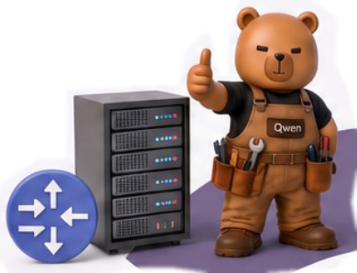
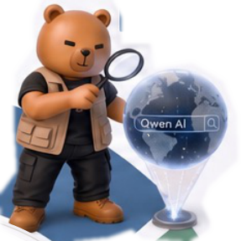

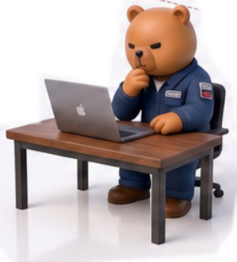
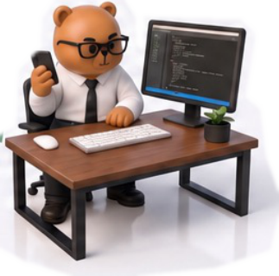
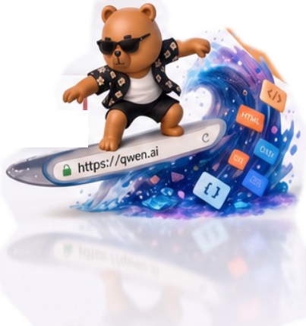

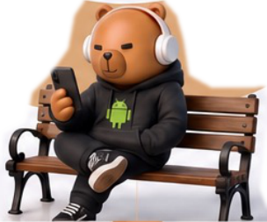
MCP Servers
Search Engine
Tool Calls · Function Routing
Queries · Results · Knowledge
Operating System
IDE
Code Editing · Git · CI/CD
Desktop · Files · Processes
Qwen-AgentWorld
A
L
L
-
I
N
-
O
N
E
L
A
N
G
U
A
G
E
W
O
R
L
D
M
O
D
E
L
Web Browser
Terminal / CLI
DOM · Forms · Navigation
Bash · Shell · File I/O
Android System
Apps · UI Navigation · Settings
Notes:
Figarium editable reconstruction — not author-provided PowerPoint.
Seven Environment Domains and Their Interfaces
Source: https://arxiv.org/abs/2606.24597v1
Approved image: fig2_seven_environment_domains.png; SHA-256: 64e7e33f283fde4474931c040511f5679d3e66401a022fc2e0e8036407b30a99
Text and vector paths are native editable PowerPoint objects. Arrow paths are not endpoint-bound connectors; plot paths are not data-bound charts. Photos/screenshots remain independent raster objects (8).
Font substitution: source PDF families mapped to Times New Roman, Arial (installed Windows fonts); equations may use Cambria Math. Source crop boundaries are preserved.
Final-file renderer: Artifact Tool PPTX roundtrip; this is not a PowerPoint application compatibility test.

