Slide 1






(1)
Building
the
Foundation
Model
for
Agentic
Environment
Simulation
AgentWorldBench
Models
CPT
→
SFT
→
RL
10M+
Environment
Trajectories
native
world
model
training
SWE
Terminal
Search
MCP
Web
OS
Android
[
]
[ii]
(2)
Role
of
World
Modeling
in
Agent
Training:
i
Decoupling
or
Unifying
Agents
and
World
Models
[
]
[ii]
i
Decoupling
LWM
as
Environment
Simulator:
Sim
Agentic
RL
Unifying
Both
into
One
Agent
:
Building
Agents
on
LWMs
Agent
bash:
ls
-
la
/home/
State
Action
Next
State
Unified
drwxr
xr
x
3
user
...
World
Agent
-
-
Standard
Agent
World
Model
-
rw
r
r
1
user
...
Model
-
--
--
''Simulation'':
Thinking
Pattern
Parallel
to
''Reflection''
Claw
Eval
Qwen
MCP
Mark
WideSearch
Terminal
Bench
Claw
Eval
SWE
Bench
BFCL
v4
-
-
-
-
80
+4.3
ClawBench
397B
60
2.0
Pro
+9.0
+7.1
+3.9
+11.8
60
60
80
40
+5.2
4.6
Opus
4.6
+12.3
Opus
+6.3
40
40
60
20
Infinite
Real
World
Envs
Controlled
Adversarial
Envs
LWM
RL
(
without
tool
calls
)
-
Generalize
Well
to
Generalize
to
Claw
Agent
Beyond
Real
Env
Surprisingly
Agentic
Tasks
Notes:
Figarium editable reconstruction — not author-provided PowerPoint.
Language World Model Overview and Agent Improvements
Source: https://arxiv.org/abs/2606.24597v1
Approved image: fig1_agentworld_overview.png; SHA-256: 94d39332ee214992afe61e0d7d85136256e36f55cd86e0a4abde7c026d897516
Readable diagram labels and vector geometry are native editable PowerPoint objects. Some equations, small ticks, and unavailable font symbols are exact or traced native vector outlines rather than typeable text/live equations. Arrow paths are not endpoint-bound connectors; plot paths are not data-bound charts. Photos/screenshots/complex illustrations and local effects remain independent raster objects (6), whose internal pixels are not editable.
Font substitution: source PDF families mapped to Arial (installed Windows fonts). Some shadows, gradients, and antialiasing are approximate; this is not pixel-identical author source. Source crop boundaries are preserved.
Final-file renderer: Artifact Tool PPTX roundtrip; this is not a PowerPoint application compatibility test.

Slide 2
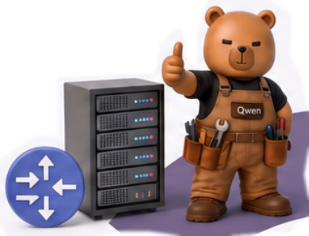
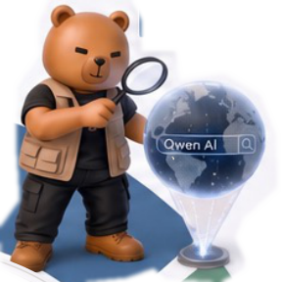

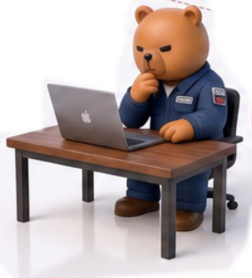
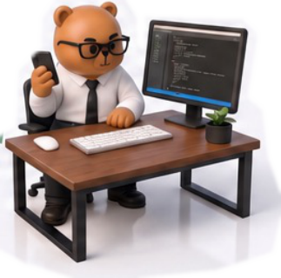
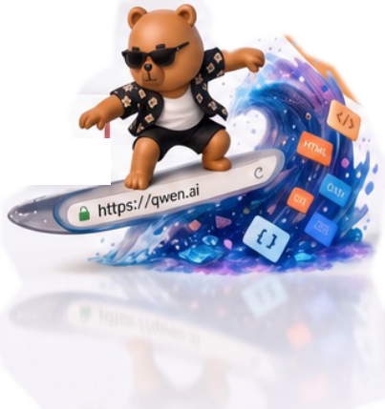

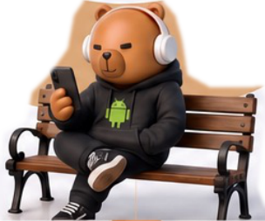
MCP Servers
Search Engine
Tool Calls · Function Routing
Queries · Results · Knowledge
Operating System
IDE
Code Editing · Git · CI/CD
Desktop · Files · Processes
Qwen-AgentWorld
A
L
L
-
I
N
-
O
N
E
L
A
N
G
U
A
G
E
W
O
R
L
D
M
O
D
E
L
Web Browser
Terminal / CLI
DOM · Forms · Navigation
Bash · Shell · File I/O
Android System
Apps · UI Navigation · Settings
Notes:
Figarium editable reconstruction — not author-provided PowerPoint.
Seven Environment Domains and Their Interfaces
Source: https://arxiv.org/abs/2606.24597v1
Approved image: fig2_seven_environment_domains.png; SHA-256: 64e7e33f283fde4474931c040511f5679d3e66401a022fc2e0e8036407b30a99
Readable diagram labels and vector geometry are native editable PowerPoint objects. Some equations, small ticks, and unavailable font symbols are exact or traced native vector outlines rather than typeable text/live equations. Arrow paths are not endpoint-bound connectors; plot paths are not data-bound charts. Photos/screenshots/complex illustrations and local effects remain independent raster objects (8), whose internal pixels are not editable.
Font substitution: source PDF families mapped to Times New Roman, Arial (installed Windows fonts). Some shadows, gradients, and antialiasing are approximate; this is not pixel-identical author source. Source crop boundaries are preserved.
Final-file renderer: Artifact Tool PPTX roundtrip; this is not a PowerPoint application compatibility test.

Slide 3
CPT
injects
,
SFT
activates
,
RL
sharpens
1
STAGE 1
2
STAGE 2
3
STAGE 3
Continual Pre-Training
(CPT)
Supervised Fine-Tuning
(SFT)
Reinforcement Learning
(RL)
D
DATA
D
DATA
D
DATA
Environment interaction trajectories + world
Trajectories with explicit reasoning chains
On-policy rollouts via GSPO
knowledge corpora
INJECTS
OBJECTIVE
ACTIVATES
OBJECTIVE
O
O
O
OBJECTIVE
Activate next-state prediction as explicit
Sharpen simulation fidelity with hybrid
Next-token prediction (non-thinking)
thinking
rewards
T
TECHNIQUE
T
TECHNIQUE
T
TECHNIQUE
Turn-level information-theoretic loss masking
Rejection sampling with quality threshold
Rubric-based LLM judge + rule-based
filtering
verifiers
Notes:
Figarium editable reconstruction — not author-provided PowerPoint.
Three-Stage World Model Training Pipeline
Source: https://arxiv.org/abs/2606.24597v1
Approved image: fig5_three_stage_training_pipeline.png; SHA-256: be3e210e0f3b7251941cf7d017c91e07d51187aa2ae8eb3443c99a8e81273d36
Readable diagram labels and vector geometry are native editable PowerPoint objects. Some equations, small ticks, and unavailable font symbols are exact or traced native vector outlines rather than typeable text/live equations. Arrow paths are not endpoint-bound connectors; plot paths are not data-bound charts. Photos/screenshots/complex illustrations and local effects remain independent raster objects (0), whose internal pixels are not editable.
Font substitution: source PDF families mapped to Arial (installed Windows fonts). Some shadows, gradients, and antialiasing are approximate; this is not pixel-identical author source. Source crop boundaries are preserved.
Final-file renderer: Artifact Tool PPTX roundtrip; this is not a PowerPoint application compatibility test.

