Slide 1













































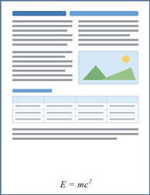





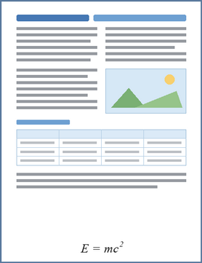











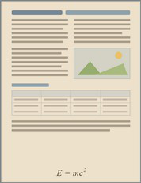
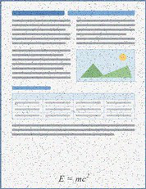
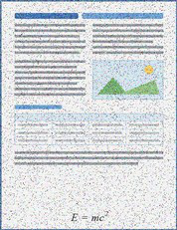
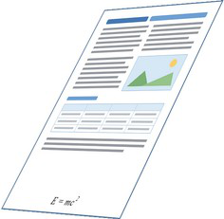
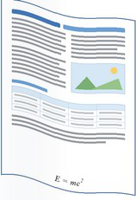
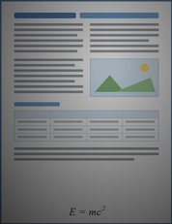
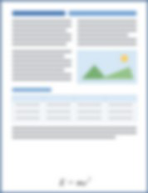
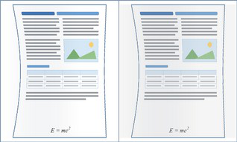


1
Data
Sources
&
Coverage
2
Expert
Annotation
&
Difficulty
Assessment
Content
&
Domains
Layout
&
Element
Composition
Input
Documents
Academic
Forms
&
Single-column
Dense
pages
papers
receipts
Multi-column
Formula-rich
Textbooks
News
&
media
pages
MinerU2.5-Pro
PaddleOCR-VL-1.6
dots.mocr
Free-form
layouts
Table-rich
pages
Reports
Handwritten
Sparse
pages
Mixed
text,
image
notes
&
chart
layouts
Low
Agreement
&
Reliability
Assessment
Agreement
Language
&
Writing
Style
Acquisition
Conditions
Human
+
Stronger-Model
Review
Simplified
Chinese
Multilingual
Born-digital
PDFs
Screenshots
pages
Stage
I
Training
Pool
Reliable
Targets
Traditional
Chinese
Printed
text
Scanned
pages
Screen
recapture
En
English
Handwriting
Mobile
photographs
Difficulty
Stratification
Validated
Collected
Collected
Pages
Records
Easy
Medium
Hard
Exact
Synthetic
Validated
Collected
Records
3
Broad-Coverage
Synthesis
Records
Factorized
Page
Program
Semantic
context
Semantic
HTML/CSS
Target-Preserving
4
Appearance
Degradation
&
Augmentation
Augmented
Records
Element
composition
Propagation
&
Reproduction
Clean
Records
from
Physical
Acquisition
Collected
&
Synthetic
Streams
Perspective
Uneven
Paper
tone
&
Noise
&
distortion
illumination
Page
density
Rendered
Page
Image
Exact
Structured
Targets
texture
compression
Page
Screen
Markdown
Printing
/
curvature
recapture
Aa
Typography
Bounding
Boxes
scanning
Scan
bands
Blur
Moiré
Layout
organization
Element
Categories
HTML
Tables
Source-Conditioned
Views
LaTeX
Formulas
...
Paired
Training
Records
Target-Preserving
Augmented
Records
Notes:
Figarium editable reconstruction — not author-provided PowerPoint.
Stage I: Coverage-Oriented Data Construction
Source: https://arxiv.org/abs/2609.20423v1
Approved image: fig2_stage1_coverage_data_construction.png; SHA-256: 4029672a84275587cf8ac65be99e04043473146998a7767f75337985cf03e1fb
Text and vector paths are native editable PowerPoint objects. Arrow paths are not endpoint-bound connectors; plot paths are not data-bound charts. Photos/screenshots remain independent raster objects (73).
Font substitution: source PDF families mapped to Arial (installed Windows fonts); equations may use Cambria Math. Source crop boundaries are preserved.
Final-file renderer: Artifact Tool PPTX roundtrip; this is not a PowerPoint application compatibility test.

