Slide 1













































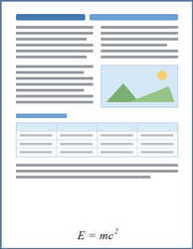





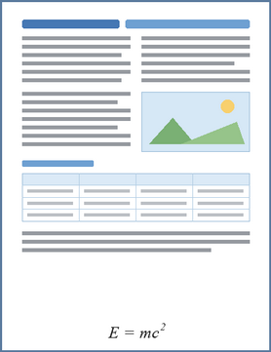











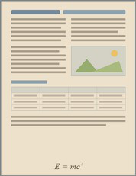
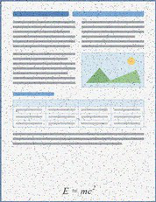
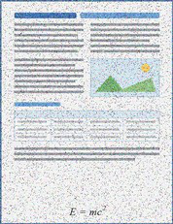
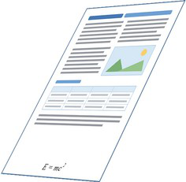
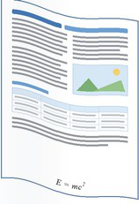
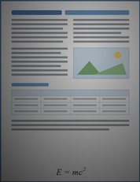
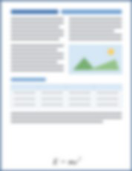
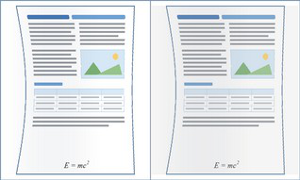


1
Data
Sources
&
Coverage
2
Expert
Annotation
&
Difficulty
Assessment
Content
&
Domains
Layout
&
Element
Composition
Input
Documents
Academic
Forms
&
Single-column
Dense
pages
papers
receipts
Multi-column
Formula-rich
Textbooks
News
&
media
pages
MinerU2.5-Pro
PaddleOCR-VL-1.6
dots.mocr
Free-form
layouts
Table-rich
pages
Reports
Handwritten
Sparse
pages
Mixed
text,
image
notes
&
chart
layouts
Low
Agreement
&
Reliability
Assessment
Agreement
Language
&
Writing
Style
Acquisition
Conditions
Human
+
Stronger-Model
Review
Simplified
Chinese
Multilingual
Born-digital
PDFs
Screenshots
pages
Stage
I
Training
Pool
Reliable
Targets
Traditional
Chinese
Printed
text
Scanned
pages
Screen
recapture
En
English
Handwriting
Mobile
photographs
Difficulty
Stratification
Validated
Collected
Collected
Pages
Records
Easy
Medium
Hard
Exact
Synthetic
Validated
Collected
Records
3
Broad-Coverage
Synthesis
Records
Factorized
Page
Program
Semantic
context
Semantic
HTML/CSS
Target-Preserving
4
Appearance
Degradation
&
Augmentation
Augmented
Records
Element
composition
Propagation
&
Reproduction
Clean
Records
from
Physical
Acquisition
Collected
&
Synthetic
Streams
Perspective
Uneven
Paper
tone
&
Noise
&
distortion
illumination
Page
density
Rendered
Page
Image
Exact
Structured
Targets
texture
compression
Page
Screen
Markdown
Printing
/
curvature
recapture
Aa
Typography
Bounding
Boxes
scanning
Scan
bands
Blur
Moiré
Layout
organization
Element
Categories
HTML
Tables
Source-Conditioned
Views
LaTeX
Formulas
...
Paired
Training
Records
Target-Preserving
Augmented
Records
Notes:
Figarium editable reconstruction — not author-provided PowerPoint.
Stage I: Coverage-Oriented Data Construction
Source: https://arxiv.org/abs/2609.20423v1
Approved image: fig2_stage1_coverage_data_construction.png; SHA-256: 4029672a84275587cf8ac65be99e04043473146998a7767f75337985cf03e1fb
Readable diagram labels and vector geometry are native editable PowerPoint objects. Some equations, small ticks, and unavailable font symbols are exact or traced native vector outlines rather than typeable text/live equations. Arrow paths are not endpoint-bound connectors; plot paths are not data-bound charts. Photos/screenshots/complex illustrations and local effects remain independent raster objects (73), whose internal pixels are not editable.
Font substitution: source PDF families mapped to Arial (installed Windows fonts). Some shadows, gradients, and antialiasing are approximate; this is not pixel-identical author source. Source crop boundaries are preserved.
Final-file renderer: Artifact Tool PPTX roundtrip; this is not a PowerPoint application compatibility test.

Slide 2
1.
Hard-Example
Mining
2.
Unsupervised
Clustering
&
Long-Tail
Diagnosis
Stage
I
Model
Reliable
Fixed
Target-Token
Budget
Training
SigLIP2
Unsupervised
Visual–Structural
Clusters
Parser
Predictions
Reference
Documents
Visual
Targets
Features
Stage
II
Training
Pool
Compare
&
Measure
•
•
•
Structural
Features
High-Support
Clusters
Low-Support
Clusters
A)
Page-Level
NED
Post-Clustering
Diagnostics
B)
Component
Error
Metrics
Record
Support
/
Local
Dispersion
Cluster
Capability
Residual
Structured-Element
Text
Error
Table
Error
Formula
Error
Reading-Order
Verified
Hard
Prevalence
Residual
f(x)
Error
Examples
f(x)
NED
1
−
TEDS
1
−
CDM
Order
Edit
Intervention
Priority
&
Data-Availability
Decision
Hard-Candidate
Validation
&
Failure
Attribution
Targeted
Refill
3.
Targeted
Data
Synthesis
Annotation
Decoding
Low
Genuine
Error
Degeneration
Observability
Capability
Residual-Aware
Coverage-Gap
Failure
Replay
Allocation
Specifications
Semantic
Controllable
Page
Program
Repair
Retain
with
Robustness
Diagnostics
/
HTML/CSS
Element
Proportion
Nesting
Adjacency
Language
/
Layout
Failure
Label
Reacquire
/
Exclude
Residual-Aware
</>
Density
Context
Complexity
Replay
Human
+
Stronger-Model
Review
Synchronized
Outputs
+
Rendered
Page
Image
Exact
Structured
Supervision
f(x)
1
2
Structured
Element
Bounding
3
Verified,
Observable,
Learnable
Failure
Markdown
HTML
LaTeX
Reading-Order
Categories
Boxes
Tables
Formulas
Indices
Verified
Hard
Examples
Validated
Targeted
Refill
Validation
&
Fixed-Cluster
Assignment
Reject
Notes:
Figarium editable reconstruction — not author-provided PowerPoint.
Stage II: Capability-Aware Data Refinement
Source: https://arxiv.org/abs/2609.20423v1
Approved image: fig5_stage2_capability_refinement.png; SHA-256: a9539bdf066797a1a4674490bfe4e4a4f59918ca9021624d8d264be8b092c586
Readable diagram labels and vector geometry are native editable PowerPoint objects. Some equations, small ticks, and unavailable font symbols are exact or traced native vector outlines rather than typeable text/live equations. Arrow paths are not endpoint-bound connectors; plot paths are not data-bound charts. Photos/screenshots/complex illustrations and local effects remain independent raster objects (0), whose internal pixels are not editable.
Font substitution: source PDF families mapped to Arial, Times New Roman (installed Windows fonts). Some shadows, gradients, and antialiasing are approximate; this is not pixel-identical author source. Source crop boundaries are preserved.
Final-file renderer: Artifact Tool PPTX roundtrip; this is not a PowerPoint application compatibility test.

