Slide 1

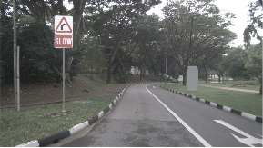
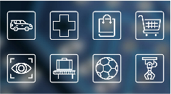













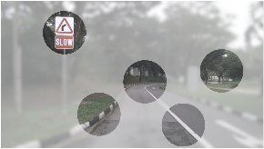
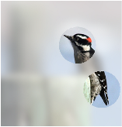
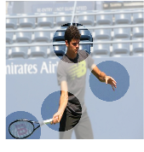
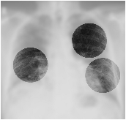
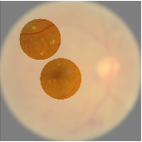

















a
Neural
Networks
Current
Computer
Extracting
Features
Specific
Applications
Vision
Paradigm
Visual
Environment
from
All
Regions
High-resolution
Visual
Signals
with
High
Frame
Rates:
Sufficient
Continuously
Low-latency
Information
for
Complex
Problems
Scaling
up
Interaction
Model
Size
with
Physical
…
…
…
Under
the
LeNet-5
~60K
parameters
>
10
^
5
times
Environments
Scaling
Laws
(1998)
or
Users
ViT-22B
~22,000,000K
parameters
Human
Demands
(2023)
900
×
1600
high-frame-rate
videos
#2
Large-scale
Neural
Networks
for
driver
assistance
tasks
Resource
×
for
28
28
images
digit
>
1800
classification
(MNIST,
1998)
#1
times
High-dimensional
#3
Efficiency
Computation
Power
Memory
Spatial-temporal
Input
Resolution
Inputs
Resource-constrained
Hardware
#1
+
#2
=
Strong
,
generalizable
performance
for
Real-world
“Impossible
Triangle”
challenging
vision
tasks,
but
inefficient
.
Applications
of
the
Current
Computer
Vision
Paradigm
#3
=
Safe
,
flexible
,
user-
and
environmentally
Future
friendly
but
with
limited
performance
,
.
Advancements
b
1
5
1
3
1
4
1
4
2
2
2
3
2
2
3
1
Examples
of
Human
“Slow
down
,
go
straight
,
and
turn
right.”
“Downy
woodpecker.”
“A
man
plays
tennis.”
“Pulmonary
fibrosis.”
“Diabetic
retinopathy.”
Visual
Perception
Visual
Sequentially
Fixating
on
Regions
of
Interest
Conclusion
Visual
Environments
through
Eye
Movement
or
Decision
Fixations
Notes:
Figarium editable reconstruction — not author-provided PowerPoint.
Adaptive Vision Motivation and Impossible Triangle
Source: https://arxiv.org/abs/2509.15333
Approved image: image1.png; SHA-256: 6e2a52ea9e538f0db8a4ee168d543c93425c321b06d9db606c7ffdf68ed52e9b
Text and vector paths are native editable PowerPoint objects. Arrow paths are not endpoint-bound connectors; plot paths are not data-bound charts. Photos/screenshots remain independent raster objects (42).
Font substitution: source PDF families mapped to Arial (installed Windows fonts); equations may use Cambria Math. Source crop boundaries are preserved.
Final-file renderer: Artifact Tool PPTX roundtrip; this is not a PowerPoint application compatibility test.

