Slide 1

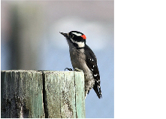


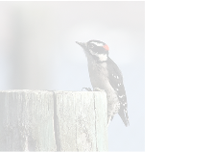
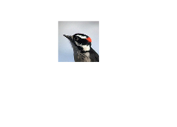


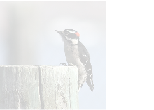
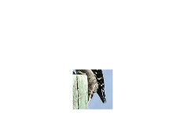

a
Prompt
Input
,
e.g.
,
text
Representation
Internal
Vision
Decision-
Learning
fi
making
(optional,
specifying
the
task)
Representation
Neural
Networks
(dynamic,
evolving)
Neural
Networks
Visual
Environment
(image
as
an
example)
Terminating
Yes
No
Perception
Initialize
Vision
Agent
Observation
is
Localizing
Next
Net
Sufficient?
Visual
Fixation
Glance
Input
(Gaussian
distribution)
Parameterize
(down-sampled
to
the
fixation
size)
Sample
Update
Terminating
Yes
1
No
Crop
Perception
Vision
Agent
Observation
is
Localizing
Next
Net
Sufficient?
Visual
Fixation
(Gaussian
distribution)
Parameterize
Parameterize
Visual
Fixation
Sample
Update
Terminating
Yes
No
Crop
Perception
Vision
Agent
Observation
is
Localizing
Next
Net
Sufficient?
Visual
Fixation
2
Visual
Fixation
…
…
…
…
…
Notes:
Figarium editable reconstruction — not author-provided PowerPoint.
AdaptiveNN Sequential Fixation Pipeline
Source: https://arxiv.org/abs/2509.15333
Approved image: image2.png; SHA-256: 73712e02899820ee58064abd57753b9f3aaef13365f35adf47fd1413809ffab6
Text and vector paths are native editable PowerPoint objects. Arrow paths are not endpoint-bound connectors; plot paths are not data-bound charts. Photos/screenshots remain independent raster objects (11).
Font substitution: source PDF families mapped to Times New Roman, Arial (installed Windows fonts); equations may use Cambria Math. Source crop boundaries are preserved.
Final-file renderer: Artifact Tool PPTX roundtrip; this is not a PowerPoint application compatibility test.

