Slide 1

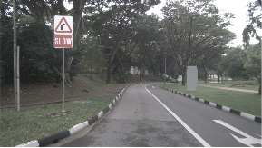














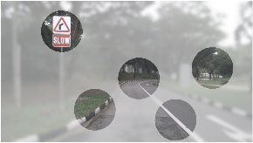
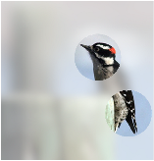
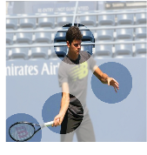
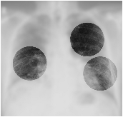
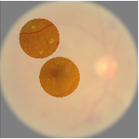

















a
Neural
Networks
Current
Computer
Extracting
Features
Specific
Applications
Vision
Paradigm
Visual
Environment
from
All
Regions
High-resolution
Visual
Signals
with
High
Frame
Rates:
Sufficient
Continuously
Low-latency
Information
for
Complex
Problems
Scaling
up
Interaction
Model
Size
with
Physical
…
…
…
Under
the
LeNet-5
~60K
parameters
>
10
^
5
times
Environments
Scaling
Laws
(1998)
or
ViT-22B
~22,000,000K
parameters
Human
Users
Demands
(2023)
900
×
1600
high-frame-rate
videos
#2
Large-scale
Neural
Networks
for
driver
assistance
tasks
Resource
×
28
28
images
for
digit
>
1800
classification
(MNIST,
1998)
#1
times
High-dimensional
#3
Efficiency
Computation
Power
Memory
Spatial-temporal
Input
Resolution
Inputs
Resource-constrained
Hardware
#1
+
#2
=
Strong
,
generalizable
performance
for
Real-world
“Impossible
Triangle”
challenging
vision
tasks,
but
inefficient
.
Applications
of
the
Current
Computer
Vision
Paradigm
#3
=
Safe
,
flexible
,
user-
and
environmentally
Future
,
but
with
performance
.
friendly
limited
Advancements
b
1
5
1
3
1
4
1
4
2
2
2
3
2
2
3
1
Examples
of
Human
“Slow
down
,
go
straight
,
and
turn
right.”
“Downy
woodpecker.”
“A
man
plays
tennis.”
“Pulmonary
fibrosis.”
“Diabetic
retinopathy.”
Visual
Perception
Visual
Sequentially
Fixating
on
Regions
of
Interest
Conclusion
Visual
Environments
through
Eye
Movement
or
Decision
Fixations
Notes:
Figarium editable reconstruction — not author-provided PowerPoint.
Adaptive Vision Motivation and Impossible Triangle
Source: https://arxiv.org/abs/2509.15333
Approved image: image1.png; SHA-256: 6e2a52ea9e538f0db8a4ee168d543c93425c321b06d9db606c7ffdf68ed52e9b
Readable diagram labels and vector geometry are native editable PowerPoint objects. Some equations, small ticks, and unavailable font symbols are exact or traced native vector outlines rather than typeable text/live equations. Arrow paths are not endpoint-bound connectors; plot paths are not data-bound charts. Photos/screenshots/complex illustrations and local effects remain independent raster objects (42), whose internal pixels are not editable.
Font substitution: source PDF families mapped to Arial (installed Windows fonts). Some shadows, gradients, and antialiasing are approximate; this is not pixel-identical author source. Source crop boundaries are preserved.
Final-file renderer: Artifact Tool PPTX roundtrip; this is not a PowerPoint application compatibility test.

Slide 2

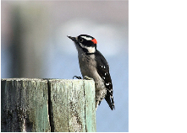


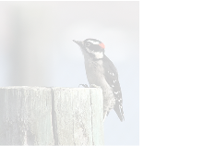
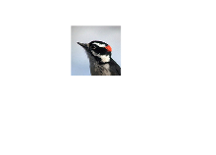


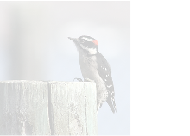
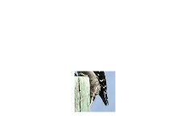

a
Prompt
Input
,
e.g.
,
text
Representation
Internal
Vision
Decision-
Learning
fi
making
(optional,
specifying
the
task)
Representation
Neural
Networks
(dynamic,
evolving)
Neural
Networks
Visual
Environment
(image
as
an
example)
Terminating
Yes
No
Perception
Initialize
Vision
Agent
Observation
is
Localizing
Next
Net
Sufficient?
Visual
Fixation
Glance
Input
(Gaussian
distribution)
Parameterize
(down-sampled
to
the
fixation
size)
Sample
Update
Terminating
Yes
1
No
Crop
Perception
Vision
Agent
Observation
is
Localizing
Next
Net
Sufficient?
Visual
Fixation
(Gaussian
distribution)
Parameterize
Parameterize
Visual
Fixation
Sample
Update
Terminating
Yes
No
Crop
Perception
Vision
Agent
Observation
is
Localizing
Next
Net
Sufficient?
Visual
Fixation
2
Visual
Fixation
…
…
…
…
…
Notes:
Figarium editable reconstruction — not author-provided PowerPoint.
AdaptiveNN Sequential Fixation Pipeline
Source: https://arxiv.org/abs/2509.15333
Approved image: image2.png; SHA-256: 73712e02899820ee58064abd57753b9f3aaef13365f35adf47fd1413809ffab6
Readable diagram labels and vector geometry are native editable PowerPoint objects. Some equations, small ticks, and unavailable font symbols are exact or traced native vector outlines rather than typeable text/live equations. Arrow paths are not endpoint-bound connectors; plot paths are not data-bound charts. Photos/screenshots/complex illustrations and local effects remain independent raster objects (11), whose internal pixels are not editable.
Font substitution: source PDF families mapped to Times New Roman, Arial (installed Windows fonts). Some shadows, gradients, and antialiasing are approximate; this is not pixel-identical author source. Source crop boundaries are preserved.
Final-file renderer: Artifact Tool PPTX roundtrip; this is not a PowerPoint application compatibility test.

Slide 3















b
Various
Vision
Tasks
Internal
Vision
…
Applicable
to
(without
relying
on
specialized
task
structures)
Representation
1.
Address
a
pre-defined
static
task
“Cat”
Neural
Networks
Task
1
Visual
Recognition
Object
Localization
2.
Adapt
to
variable
task
demands
Perception
Guiding
MLLM
Vision
Agent
the
Behaviors
Prompt
Task
1
Net
through
Training
“move
the
“place
the
red
Medical
Image
Input
Task
2
switch
to
turn
on
“push
the
button”
block
in
the
Analysis
(
e.g.
,
text)
the
light
bulb”
slider”
…
Vision-language
Driven
Robot
Execution
Specify
…
…
…
c
Theorem
1:
Gradient
Enabling
End-to-end
Optimization
Decision-
Representation
Back-propagation
Minimize
making
Fixation
1
Learning
(the
expected
loss)
(non-differentiable)
(differentiable)
:
training
data,
label,
and
loss
of
a
vision
task
:
length
of
the
visual
perception
process
…
…
:
visual
fixation
locations
Fixation
1+2
:
outputs
of
the
model
parameterized
by
…
Vision
Representation
Task
Loss
Equivalent
to
…
at
Each
Step
at
Each
Step
Self-rewarding
Signals
Fixation
1+2+
…
+T
for
Reinforcement
Learning
Integration
of
(without
relying
on
additional
annotations)
Representation
Learning
+
Self-rewarding
Reinforcement
Learning
d
An
Improved
Implementation
Specific
Formulation
of
the
Decision-making
Neural
Networks
Challenge:
Behavior
Learning
Policy
Network
(
localizing
proper
visual
fixations
)
for
Adaptive
Visual
Perception
Address
Where
to
look?
Vision
Agent
Value
Network
(
predicting
the
expected
gains
of
further
observing
)
When
to
conclude
Address
observation?
Offer
a
Baseline
Function
for
Stabilizing
Training
Notes:
Figarium editable reconstruction — not author-provided PowerPoint.
AdaptiveNN Task Generality and Training Objective
Source: https://arxiv.org/abs/2509.15333
Approved image: image3.png; SHA-256: abdd7a97831036a99530613ea285542d6b21892323e9a115c2b18117fca5eae5
Readable diagram labels and vector geometry are native editable PowerPoint objects. Some equations, small ticks, and unavailable font symbols are exact or traced native vector outlines rather than typeable text/live equations. Arrow paths are not endpoint-bound connectors; plot paths are not data-bound charts. Photos/screenshots/complex illustrations and local effects remain independent raster objects (15), whose internal pixels are not editable.
Font substitution: source PDF families mapped to Arial (installed Windows fonts). Some shadows, gradients, and antialiasing are approximate; this is not pixel-identical author source. Source crop boundaries are preserved.
Final-file renderer: Artifact Tool PPTX roundtrip; this is not a PowerPoint application compatibility test.

