Slide 1
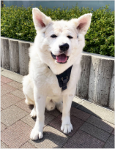

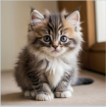

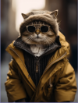
Real Image
Synthetic Image
JPEG
PNG
Dog
Cat
256 x 512
512 x 512
Format Bias
Semantic Bias
Size Bias
JPEG
Dog
256 x 512
All synthetic images are mistakenly classified as REAL
Notes:
Figarium editable reconstruction — not author-provided PowerPoint.
Dataset Biases in AI-generated Image Detection
Source: https://arxiv.org/abs/2505.14359
Approved image: image1.png; SHA-256: 676f5d63077d24624b63251b740dcdbe8b993104c23c05c38c9ad20275871388
Text and vector paths are native editable PowerPoint objects. Arrow paths are not endpoint-bound connectors; plot paths are not data-bound charts. Photos/screenshots remain independent raster objects (5).
Font substitution: source PDF families mapped to Arial (installed Windows fonts); equations may use Cambria Math. Source crop boundaries are preserved.
Final-file renderer: Artifact Tool PPTX roundtrip; this is not a PowerPoint application compatibility test.

