Slide 1



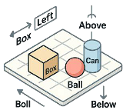



















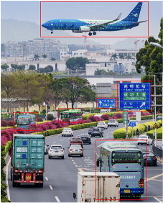








8.
Scene
Knowledge
7.
Spatial
Relationship
Comprehension
Inference
Spatial
From
the
perspective
of
the
,
When
driving
on
the
far
left
Information
lane
,
heading
to
Gaoqi
Airport
a
is
located
in
the
left
need
to
change
to
the
far
front
of
it.
right
lane
.
Bus
s
o
Airplane
Knowledge
e
a
n
i
n
6.
Region
-
R
g
Road
Sign
Injection
wise
OCR
1.
Object
Detection
Gaoqi
Airport
[811.3,696.5,933.2,716.8]
2.
Object
Progression
5.
Visual
Grounding
Counting
g
P
n
Obj.
Num.
e
i
The
blue
and
white
airplane
at
d
Road
Sign
2
r
n
the
top
of
the
picture:
c
a
[
256.6,152.8,959.8,366.8
]
Airplane
1
e
t
…
p
r
s
t
e
i
o
n
n
d
3.
Object
Existence
U
Two
traveling
in
front
and
behind.
Determination
4.
Relation
Extraction
There
are
trucks
,
buses
and
...
The
are
traveling
in
opposite
directions
.
Notes:
Figarium editable reconstruction — not author-provided PowerPoint.
LENS Multi-level Task Taxonomy
Source: https://arxiv.org/abs/2505.15616
Approved image: image1.png; SHA-256: 89a2989ca49faa50cf4bd7fb32eac537d693b3f07de4ee435ef691821c7a2e31
Text and vector paths are native editable PowerPoint objects. Arrow paths are not endpoint-bound connectors; plot paths are not data-bound charts. Photos/screenshots remain independent raster objects (34).
Font substitution: source PDF families mapped to Comic Sans MS (installed Windows fonts); equations may use Cambria Math. Source crop boundaries are preserved.
Final-file renderer: Artifact Tool PPTX roundtrip; this is not a PowerPoint application compatibility test.

