Slide 1



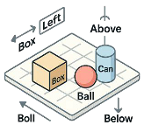



















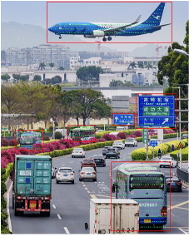








8.
Scene
Knowledge
7.
Spatial
Relationship
Comprehension
Inference
Spatial
From
the
perspective
of
the
,
When
driving
on
the
far
left
Information
lane
,
heading
to
Gaoqi
Airport
a
is
located
in
the
left
need
to
change
to
the
far
front
of
it.
right
lane
.
Bus
a
s
o
Airplane
Knowledge
e
n
i
n
6.
Region
-
R
g
Road
Sign
Injection
wise
OCR
1.
Object
Detection
Gaoqi
Airport
[811.3,696.5,933.2,716.8]
Progression
2.
Object
Counting
5.
Visual
Grounding
g
P
n
Obj.
Num.
e
i
The
blue
and
white
airplane
at
d
Road
Sign
2
r
n
the
top
of
the
picture:
c
a
[
256.6,152.8,959.8,366.8
]
Airplane
1
e
t
…
p
r
s
t
e
i
o
n
n
d
3.
Object
Existence
U
Two
traveling
in
front
and
behind.
Determination
4.
Relation
Extraction
There
are
trucks
,
buses
and
...
The
are
traveling
in
opposite
directions
.
Notes:
Figarium editable reconstruction — not author-provided PowerPoint.
LENS Multi-level Task Taxonomy
Source: https://arxiv.org/abs/2505.15616
Approved image: image1.png; SHA-256: 89a2989ca49faa50cf4bd7fb32eac537d693b3f07de4ee435ef691821c7a2e31
Readable diagram labels and vector geometry are native editable PowerPoint objects. Some equations, small ticks, and unavailable font symbols are exact or traced native vector outlines rather than typeable text/live equations. Arrow paths are not endpoint-bound connectors; plot paths are not data-bound charts. Photos/screenshots/complex illustrations and local effects remain independent raster objects (34), whose internal pixels are not editable.
Font substitution: source PDF families mapped to Comic Sans MS (installed Windows fonts). Some shadows, gradients, and antialiasing are approximate; this is not pixel-identical author source. Source crop boundaries are preserved.
Final-file renderer: Artifact Tool PPTX roundtrip; this is not a PowerPoint application compatibility test.

Slide 2
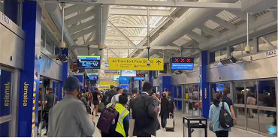











Question:
What
is
Stage
2:
Build
an
expert
team
based
on
the
questions
Stage
3:
Expert
screening
model
retains
the
address
where
and
initial
answers
.
the
most
reliable
experts.
the
picture
was
Given
the
significant
overlap
taken?
Please
answer
between
Scene
understanding
and
North
America,
Geospatial
analysis
expert,
as
well
as
the
South
America
or
greater
suitability
of
geographic
analysis
unable
to
determine.
Region
perception
Scene
understanding
experts
for
geolocation
tasks
-
related
tasks,
expert
expert
experts
in
scene
understanding
have
been
Stage
1:
Original
model
outputs
the
initial
answer.
excluded
from
consideration.
Initial
Answer
Unkown
.
It
is
not
possible
to
determine
the
Expert
Expert
Remove
the
Scene
following
reasons
:
construction
screening
understanding
expert.
1.
The
image
shows
the
interior
of
a
train
Cultural
analysis
Geospatial
analysis
model
station,
and
there
are
not
enough
geographic
model
expert
expert
markers
or
other
clear
geographic
clues
to
determine
its
exact
location
.
2.
Although
“Jamaica”
(Jamaica)
is
an
island
Stage
4:
Integrate
to
obtain
the
final
answer
.
Original
country
located
in
North
America,
the
model
symbol
may
be
only
part
of
the
station's
Final
North
America
.
This
conclusion
is
robustly
supported
by
the
collective
expertise
of
the
name
and
does
not
represent
the
geographic
Answer
Geospatial
analysis
expert,
region
perception
expert,
and
cultural
analyst,
who
all
location
of
the
entire
area
.
independently
identified
key
indicators
consistent
with
North
American,
particularly
New
York
City,
urban
planning
and
transportation
infrastructure
.
Notes:
Figarium editable reconstruction — not author-provided PowerPoint.
Self-driven Multi-expert Collaborative Reasoning
Source: https://arxiv.org/abs/2505.15616
Approved image: image2.png; SHA-256: e8af5812119e3979016587628efe087c9aaed77408324037bd3b1e366d48b01b
Readable diagram labels and vector geometry are native editable PowerPoint objects. Some equations, small ticks, and unavailable font symbols are exact or traced native vector outlines rather than typeable text/live equations. Arrow paths are not endpoint-bound connectors; plot paths are not data-bound charts. Photos/screenshots/complex illustrations and local effects remain independent raster objects (12), whose internal pixels are not editable.
Font substitution: source PDF families mapped to Comic Sans MS (installed Windows fonts). Some shadows, gradients, and antialiasing are approximate; this is not pixel-identical author source. Source crop boundaries are preserved.
Final-file renderer: Artifact Tool PPTX roundtrip; this is not a PowerPoint application compatibility test.

