Slide 1
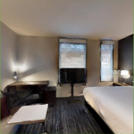
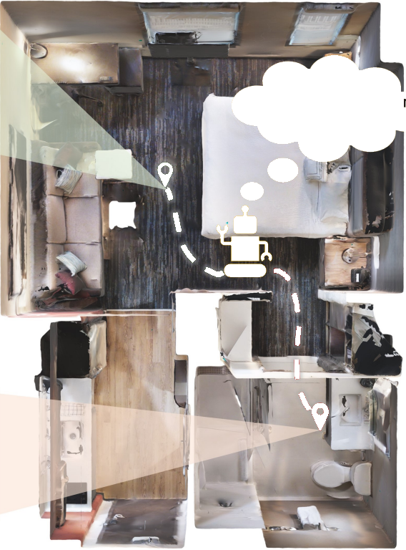
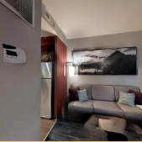
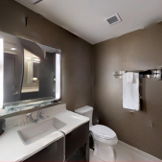
Goal Image
Am I in the same roo
with the goal image
Current
observation
Goal Image
Notes:
Figarium editable reconstruction — not author-provided PowerPoint.
Room-aware Image-goal Navigation Intuition
Source: https://arxiv.org/abs/2502.10785
Approved image: image1.png; SHA-256: 993215d302155f45c9a388ac7c620b91e2acb71204c68fc89e313b332f1a5ca1
Text and vector paths are native editable PowerPoint objects. Arrow paths are not endpoint-bound connectors; plot paths are not data-bound charts. Photos/screenshots remain independent raster objects (4).
Font substitution: source PDF families mapped to Arial (installed Windows fonts); equations may use Cambria Math. Source crop boundaries are preserved.
Final-file renderer: Artifact Tool PPTX roundtrip; this is not a PowerPoint application compatibility test.

