Slide 1
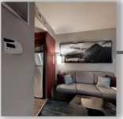
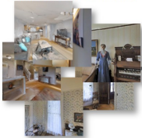
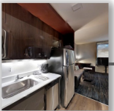

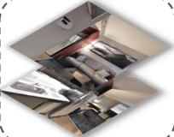

Assign pseudo labels
Environment
√
×
Refine D
RGB Observation (
I
)
Room-expert
t
×
√
Unlabeled data
Style
Encoder
Constraints set
1 2 3 ... N
1
Extract
features
2
3
Relation
Network
Actions (aₜ)
...
Share weights
N
Features
Distance matrix
Clusters
Batching
Style
Encoder
L
cluster
Actor
Critic
Style
Encoder
Navigation
policy π
Goal Image (
I
)
g
Relation
Network
v
vis
Shuffle
E
s
Style
Encoder
Reward (rₜ)
E
ResNet-9
Flatten
r
Relation Labels
L
Channel Concatenate
Visual Feature Extractor
E
pred
v
(a) Offline Pre-training of Room Expert
(b) Image-goal Navigation Architecture with Room Expert
Notes:
Figarium editable reconstruction — not author-provided PowerPoint.
Room Expert Pretraining and Navigation Architecture
Source: https://arxiv.org/abs/2502.10785
Approved image: image2.png; SHA-256: 9fd26a5a8cb21b28f14ed687f702b2765fe7b00f8aebf10cb4c7e374481b80f0
Text and vector paths are native editable PowerPoint objects. Arrow paths are not endpoint-bound connectors; plot paths are not data-bound charts. Photos/screenshots remain independent raster objects (6).
Font substitution: source PDF families mapped to Arial, Times New Roman (installed Windows fonts); equations may use Cambria Math. Source crop boundaries are preserved.
Final-file renderer: Artifact Tool PPTX roundtrip; this is not a PowerPoint application compatibility test.

