Slide 1
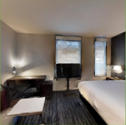
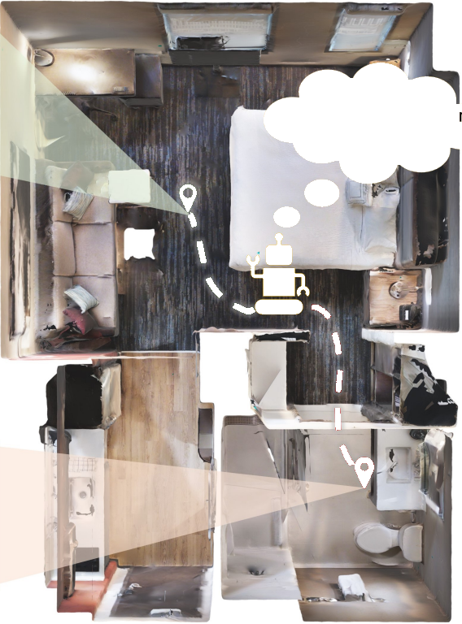
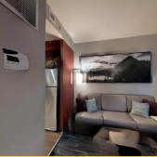
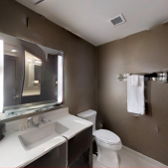
Goal Image
Am I in the same roo
with the goal image
Current
observation
Goal Image
Notes:
Figarium editable reconstruction — not author-provided PowerPoint.
Room-aware Image-goal Navigation Intuition
Source: https://arxiv.org/abs/2502.10785
Approved image: image1.png; SHA-256: 993215d302155f45c9a388ac7c620b91e2acb71204c68fc89e313b332f1a5ca1
Readable diagram labels and vector geometry are native editable PowerPoint objects. Some equations, small ticks, and unavailable font symbols are exact or traced native vector outlines rather than typeable text/live equations. Arrow paths are not endpoint-bound connectors; plot paths are not data-bound charts. Photos/screenshots/complex illustrations and local effects remain independent raster objects (4), whose internal pixels are not editable.
Font substitution: source PDF families mapped to Arial (installed Windows fonts). Some shadows, gradients, and antialiasing are approximate; this is not pixel-identical author source. Source crop boundaries are preserved.
Final-file renderer: Artifact Tool PPTX roundtrip; this is not a PowerPoint application compatibility test.

Slide 2
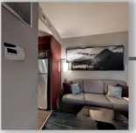
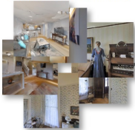
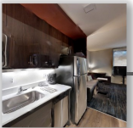

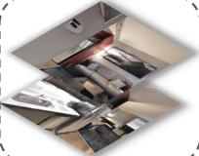

Assign pseudo labels
Environment
√
×
Refine D
RGB Observation (
I
)
Room-expert
×
t
Unlabeled data
√
Constraints set
1 2 3 ... N
Style
Encoder
1
Extract
features
2
3
Relation
Network
Actions (aₜ)
...
Share weights
Features
N
Distance matrix
Clusters
Batching
L
Style
Encoder
Actor
Critic
cluster
Style
Encoder
Navigation
policy π
Goal Image (
I
)
g
Relation
Network
v
vis
Shuffle
E
s
Style
Encoder
Reward (rₜ)
E
r
ResNet-9
Flatten
Relation Labels
L
pred
Channel Concatenate
Visual Feature Extractor
E
v
(a) Offline Pre-training of Room Expert
(b) Image-goal Navigation Architecture with Room Expert
Notes:
Figarium editable reconstruction — not author-provided PowerPoint.
Room Expert Pretraining and Navigation Architecture
Source: https://arxiv.org/abs/2502.10785
Approved image: image2.png; SHA-256: 9fd26a5a8cb21b28f14ed687f702b2765fe7b00f8aebf10cb4c7e374481b80f0
Readable diagram labels and vector geometry are native editable PowerPoint objects. Some equations, small ticks, and unavailable font symbols are exact or traced native vector outlines rather than typeable text/live equations. Arrow paths are not endpoint-bound connectors; plot paths are not data-bound charts. Photos/screenshots/complex illustrations and local effects remain independent raster objects (6), whose internal pixels are not editable.
Font substitution: source PDF families mapped to Arial, Times New Roman (installed Windows fonts). Some shadows, gradients, and antialiasing are approximate; this is not pixel-identical author source. Source crop boundaries are preserved.
Final-file renderer: Artifact Tool PPTX roundtrip; this is not a PowerPoint application compatibility test.

