Slide 1
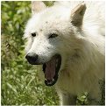
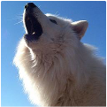
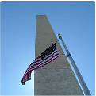
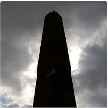
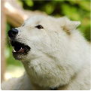
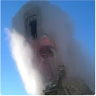
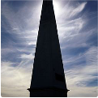


Figure
11:
Comparison
of
“good”
vs.
“bad”
samples
on
ImageNet,
illustrated
with
an
analogy
to
a
2D
toy
example.
Toy
training
data:
(
,
,
,
);
generated
samples:
,
.
Notes:
Figarium editable reconstruction — not author-provided PowerPoint.
Good and Bad Samples in Diffusion Space
Source: https://arxiv.org/abs/2510.01378
Approved image: image2.png; SHA-256: 6bea55c8acd7dfeb858cc4eff2624ec427c787bfe3e6d32692cfebe8a423d7e0
Text and vector paths are native editable PowerPoint objects. Arrow paths are not endpoint-bound connectors; plot paths are not data-bound charts. Photos/screenshots remain independent raster objects (10).
Font substitution: source PDF families mapped to Times New Roman (installed Windows fonts); equations may use Cambria Math. Source crop boundaries are preserved.
Final-file renderer: Artifact Tool PPTX roundtrip; this is not a PowerPoint application compatibility test.

