Slide 1













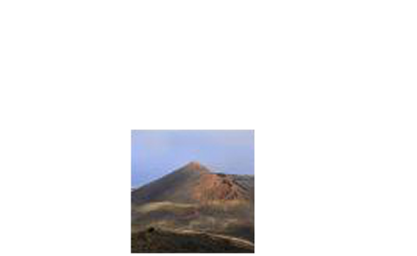


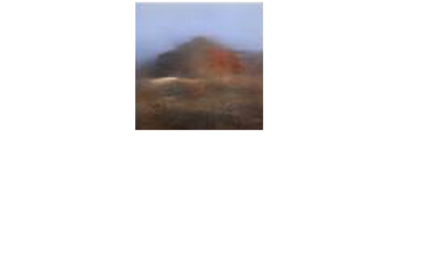

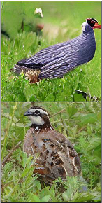
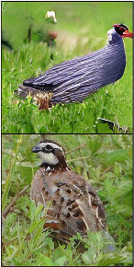
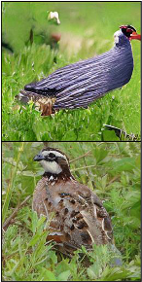
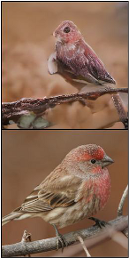
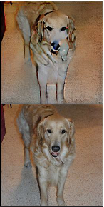
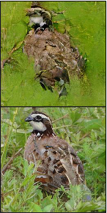
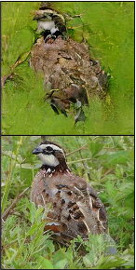
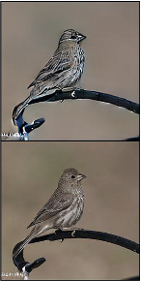
(a)
Generalization.
Small
supervi-
(b)
Memorization.
Larger
super-
sion
region
(
)
en-
vision
region
(
)
region
score
region
score
sures
freedom
to
extrapolate
.
limits
freedom
to
extrapolate
.
Notes:
Figarium editable reconstruction — not author-provided PowerPoint.
Supervision Region Size and Generalization-Memorization Trade-off
Source: https://arxiv.org/abs/2510.01378
Approved image: image3.png; SHA-256: 114bdea390a4e2fbf5eb8add5dff08cc5f37a913066d03a2c8f79c984ead5515
Text and vector paths are native editable PowerPoint objects. Arrow paths are not endpoint-bound connectors; plot paths are not data-bound charts. Photos/screenshots remain independent raster objects (26).
Font substitution: source PDF families mapped to Times New Roman (installed Windows fonts); equations may use Cambria Math. Source crop boundaries are preserved.
Final-file renderer: Artifact Tool PPTX roundtrip; this is not a PowerPoint application compatibility test.

