Slide 1
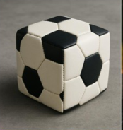
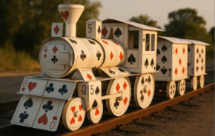
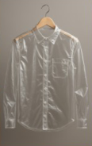
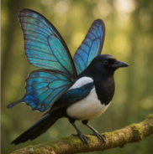
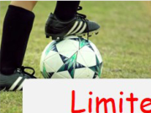
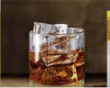





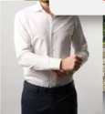

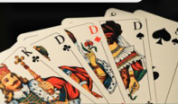




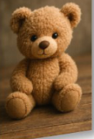


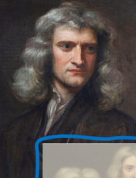


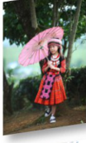



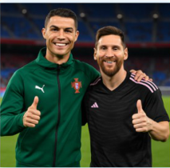



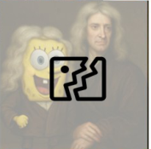


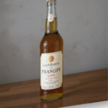






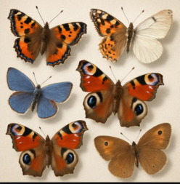

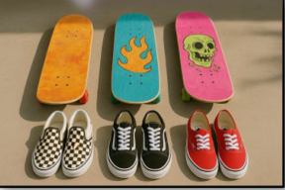








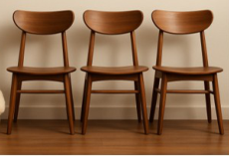

Real-world images
a. Surreal fantasy data
Transpar-
ent shirt?
A square
Limited expression
football?
Poker card
train?
General knowledge
Surreal knowledge
Beyond Real-world Data Distribution
Real-world images
b. Multi-reference image generation
Two-reference
Three-reference
Four-reference
c. Pure instruction alignment
d. Controllable long-tail composition
Number
Real-world
images
One apple
Objects
Three apples
Real-world images
Color
Cluttered
Background
Size
Eight apples
Pure
Structure
A photo of six
A photo of three
Attribute
butterflies neatly
skateboards and
Complexity
arranged
three pairs of shoes
Long-tail Scarcity
Notes:
ReFigure editable reconstruction, not author-provided PowerPoint.
Synthetic Data Advantages
Source: https://arxiv.org/abs/2508.09987v1
Approved image: fig2_synthetic_data_advantages.png; SHA-256: ad4d7f02698179c56cf04cb1240de784cabf8c7c1c4584edd3f237b528be46c2
Readable diagram labels and vector geometry are native editable PowerPoint objects. Arrow paths are not endpoint-bound connectors and plot paths are not data-bound charts. Photos and complex local illustrations remain independent raster objects (55), whose internal pixels are not editable.
Font substitution: flattened source artwork rebuilt with Comic Sans MS (installed Windows fonts). Gradients, shadows, 3-D bar shading and freehand strokes are approximate. This is a reconstruction, not pixel-identical author source. Source crop boundaries are preserved.
Final-file renderer: Artifact Tool PPTX roundtrip, not a PowerPoint application compatibility test.

