Slide 1

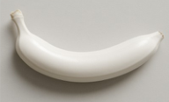






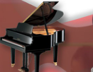



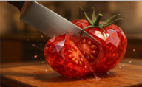

























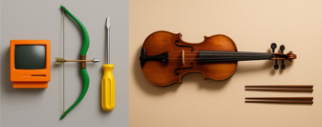



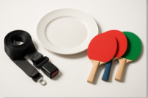
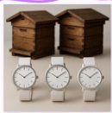

n
Common
Objects
a. Surreal fantasy data
i
o
Generate
a
t
Spatiotemporal
Human-
Human
i
n
g
GPT-4o
Attribute
Deflection
a
color
I
m
Multi-Object
Object-
Object
size
Compositional
Content
8401
11084
Regular
attributes
structure
Spatiotemporal
Anomaly
M
8881
24001
u
l
Attribute Construction
Conceptual Deflection
Attribute Shift
Any Two
Entities
t
i
-
R
b. Multi-reference image generation
8282
19174
e
f
e
human
scene
ECHO-4o
r
+
e
human
n
scene
human
object
Explicit
Instruction
11977
13568
c
+
e
Image Collection
Hybridization
Human-
Object-Scene
human
+
scene
+
I
object
Optimize
m
object
...
GPT-4o
14137
4904
a
Classification
Multi-reference generation
Diversity
g
e
21016
32805
c. Instruction alignment
A photo of two
Easy(1-3)
Others
GPT-4o
brown beehives on
Refine
I
Numb.
Color
Size
Object
...
the top and four
four
⇔
three
n
white wristwatches
s
t
Medium(3-5)
Hard(≥6)
Complex Textual Instructions
on the bottom.
Aligned!
r
Misaligned
u
c
A photo of ______ ___ ___
t
i
_______ ...
No invalid images,
o
n
F
i
n
g
only invalid prompts!
o
l
l
o
w
Notes:
ReFigure editable reconstruction, not author-provided PowerPoint.
Dataset Construction Pipeline
Source: https://arxiv.org/abs/2508.09987v1
Approved image: fig3_dataset_construction_pipeline.png; SHA-256: 62733a814f15a077ddaeb763b1174ad1836c08e7b5355184d8e674dd98ca0870
Readable diagram labels and vector geometry are native editable PowerPoint objects. Arrow paths are not endpoint-bound connectors and plot paths are not data-bound charts. Photos and complex local illustrations remain independent raster objects (45), whose internal pixels are not editable.
Font substitution: flattened source artwork rebuilt with Comic Sans MS, Times New Roman (installed Windows fonts). Gradients, shadows, 3-D bar shading and freehand strokes are approximate. This is a reconstruction, not pixel-identical author source. Source crop boundaries are preserved.
Final-file renderer: Artifact Tool PPTX roundtrip, not a PowerPoint application compatibility test.

