Slide 1
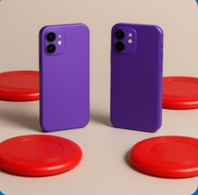
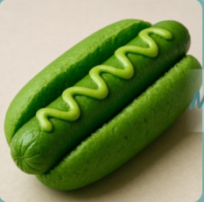

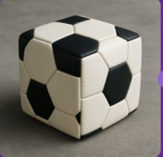



Existing GenEval
GenEval ++
Checklist
Not
"A photo of two
MaskFormer
Hotdog
purple cell phones
✓
Object classes
and three red
GPT-4.1
×
Counts of each object
frisbees"
Evaluator
"a photo of a
Inaccurate
✓
Colors of each object
green hotdog"
Text Instruction
✓
Spatial position within the image
Indicator saturation
Complex Textual Instructions
✓
Size and relative scale of objects
"a photo of a cow"
TOO EASY !!
Avoid indicator saturation
Incorrect (4/5)
"a photo of a fork and a book"
Imagine-Bench
Judgement Dimension
"A photo of
•
Fantasy Fulfillment
a square
GPT-4.1
•
Identity Preservation
Checklist
Evaluator
soccer ball"
•
Aesthetic Quality
GPT-4o
•
A square football instead of round one
Text Instruction
•
Black and white texture
Score + Reason
•
...
Notes:
ReFigure editable reconstruction, not author-provided PowerPoint.
GenEval++ and Imagine-Bench Evaluation
Source: https://arxiv.org/abs/2508.09987v1
Approved image: fig4_geneval_and_imagine_bench_evaluation.png; SHA-256: 455d5d9353b8fd0b7b7cb8edc81b90152a40bd9d232dde49884771eb4a3b76a4
Readable diagram labels and vector geometry are native editable PowerPoint objects. Arrow paths are not endpoint-bound connectors and plot paths are not data-bound charts. Photos and complex local illustrations remain independent raster objects (7), whose internal pixels are not editable.
Font substitution: flattened source artwork rebuilt with Comic Sans MS, Arial (installed Windows fonts). Gradients, shadows, 3-D bar shading and freehand strokes are approximate. This is a reconstruction, not pixel-identical author source. Source crop boundaries are preserved.
Final-file renderer: Artifact Tool PPTX roundtrip, not a PowerPoint application compatibility test.

