Slide 1
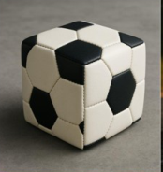
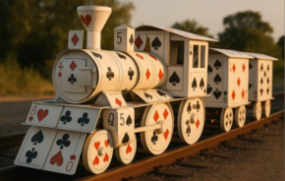
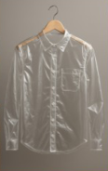
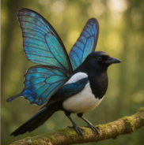
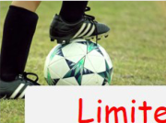
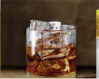


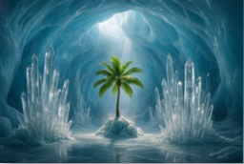
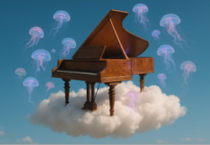
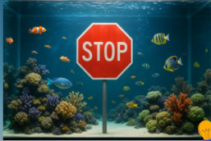
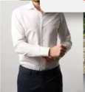

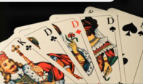




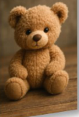
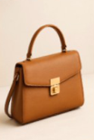

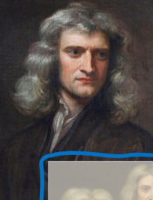
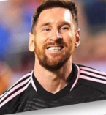

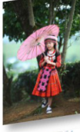



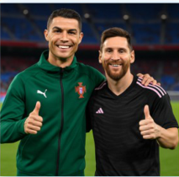

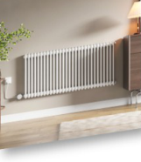
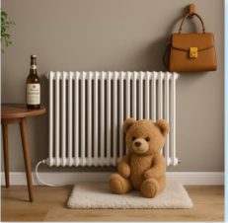
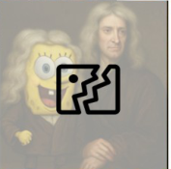
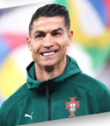
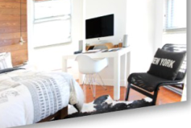
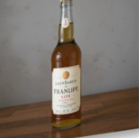






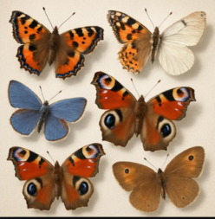

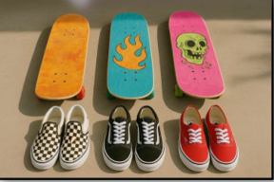







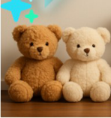
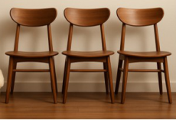
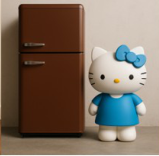
Real-world images
a. Surreal fantasy data
Transpar-
ent shirt?
A square
Limited expression
football?
Poker card
train?
General knowledge
Surreal knowledge
Beyond Real-world Data Distribution
Real-world images
b. Multi-reference image generation
Two-reference
Three-reference
Four-reference
c. Pure instruction alignment
d. Controllable long-tail composition
Number
Real-world
images
One apple
Objects
Three apples
Real-world images
Color
Cluttered
Background
Size
Eight apples
Pure
Structure
A photo of six
A photo of three
Attribute
butterflies neatly
skateboards and
Complexity
arranged
three pairs of shoes
Long-tail Scarcity
Notes:
ReFigure editable reconstruction, not author-provided PowerPoint.
Synthetic Data Advantages
Source: https://arxiv.org/abs/2508.09987v1
Approved image: fig2_synthetic_data_advantages.png; SHA-256: ad4d7f02698179c56cf04cb1240de784cabf8c7c1c4584edd3f237b528be46c2
Readable diagram labels and vector geometry are native editable PowerPoint objects. Arrow paths are not endpoint-bound connectors and plot paths are not data-bound charts. Photos and complex local illustrations remain independent raster objects (55), whose internal pixels are not editable.
Font substitution: flattened source artwork rebuilt with Comic Sans MS (installed Windows fonts). Gradients, shadows, 3-D bar shading and freehand strokes are approximate. This is a reconstruction, not pixel-identical author source. Source crop boundaries are preserved.
Final-file renderer: Artifact Tool PPTX roundtrip, not a PowerPoint application compatibility test.

Slide 2

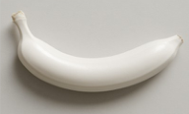






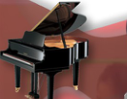



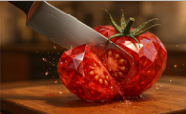













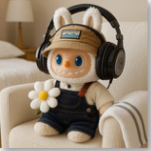











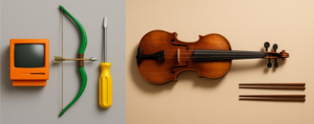



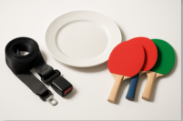
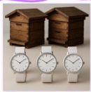

o
n
Common
Objects
a. Surreal fantasy data
a
t
i
Spatiotemporal
Human-
Human
Generate
i
n
GPT-4o
Attribute
Deflection
a
g
color
I
m
Multi-Object
Object-
Object
size
Compositional
Content
8401
11084
Regular
attributes
structure
Spatiotemporal
Anomaly
M
8881
24001
u
l
Attribute Construction
Conceptual Deflection
Attribute Shift
Any Two
Entities
t
i
-
R
b. Multi-reference image generation
8282
19174
e
f
e
human
scene
ECHO-4o
r
human
+
e
Explicit
Instruction
n
scene
human
object
11977
13568
c
Image Collection
+
Hybridization
Human-
Object-Scene
e
human
+
scene
+
I
object
Optimize
m
object
...
GPT-4o
14137
4904
a
Classification
Multi-reference generation
Diversity
g
21016
32805
e
Easy(1-3)
Others
c. Instruction alignment
A photo of two
brown beehives on
GPT-4o
Refine
I
Numb.
Color
Size
Object
...
the top and four
four
⇔
three
n
s
white wristwatches
t
Medium(3-5)
Hard(≥6)
Complex Textual Instructions
on the bottom.
Aligned!
r
u
Misaligned
c
t
A photo of ______ ___ ___
No invalid images,
i
o
n
F
i
n
g
_______ ...
only invalid prompts!
o
l
l
o
w
Notes:
ReFigure editable reconstruction, not author-provided PowerPoint.
Dataset Construction Pipeline
Source: https://arxiv.org/abs/2508.09987v1
Approved image: fig3_dataset_construction_pipeline.png; SHA-256: 62733a814f15a077ddaeb763b1174ad1836c08e7b5355184d8e674dd98ca0870
Readable diagram labels and vector geometry are native editable PowerPoint objects. Arrow paths are not endpoint-bound connectors and plot paths are not data-bound charts. Photos and complex local illustrations remain independent raster objects (45), whose internal pixels are not editable.
Font substitution: flattened source artwork rebuilt with Comic Sans MS, Times New Roman (installed Windows fonts). Gradients, shadows, 3-D bar shading and freehand strokes are approximate. This is a reconstruction, not pixel-identical author source. Source crop boundaries are preserved.
Final-file renderer: Artifact Tool PPTX roundtrip, not a PowerPoint application compatibility test.

Slide 3
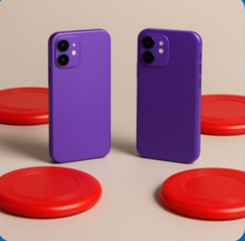
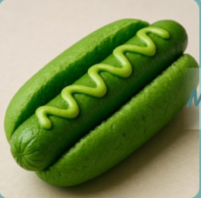

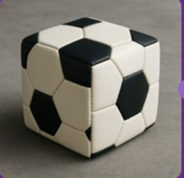



Existing GenEval
GenEval ++
Not
Checklist
"A photo of two
MaskFormer
Hotdog
purple cell phones
Object classes
✓
and three red
GPT-4.1
frisbees"
×
Counts of each object
"a photo of a
Inaccurate
Evaluator
✓
Colors of each object
green hotdog"
Text Instruction
✓
Spatial position within the image
Indicator saturation
Complex Textual Instructions
✓
Size and relative scale of objects
"a photo of a cow"
TOO EASY !!
Avoid indicator saturation
Incorrect (4/5)
"a photo of a fork and a book"
Imagine-Bench
Judgement Dimension
"A photo of
•
Fantasy Fulfillment
a square
GPT-4.1
•
Identity Preservation
Checklist
Evaluator
soccer ball"
•
Aesthetic Quality
GPT-4o
•
A square football instead of round one
Text Instruction
•
Black and white texture
Score + Reason
•
...
Notes:
ReFigure editable reconstruction, not author-provided PowerPoint.
GenEval++ and Imagine-Bench Evaluation
Source: https://arxiv.org/abs/2508.09987v1
Approved image: fig4_geneval_and_imagine_bench_evaluation.png; SHA-256: 455d5d9353b8fd0b7b7cb8edc81b90152a40bd9d232dde49884771eb4a3b76a4
Readable diagram labels and vector geometry are native editable PowerPoint objects. Arrow paths are not endpoint-bound connectors and plot paths are not data-bound charts. Photos and complex local illustrations remain independent raster objects (7), whose internal pixels are not editable.
Font substitution: flattened source artwork rebuilt with Comic Sans MS, Arial (installed Windows fonts). Gradients, shadows, 3-D bar shading and freehand strokes are approximate. This is a reconstruction, not pixel-identical author source. Source crop boundaries are preserved.
Final-file renderer: Artifact Tool PPTX roundtrip, not a PowerPoint application compatibility test.

