Slide 1



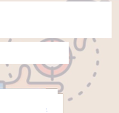
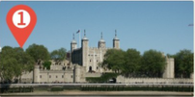
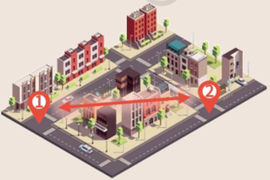
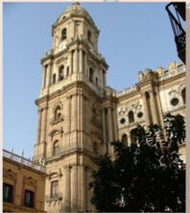









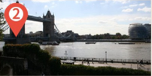




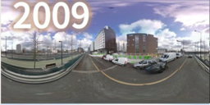
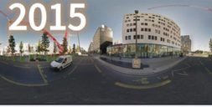
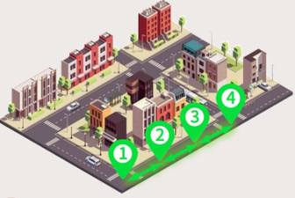
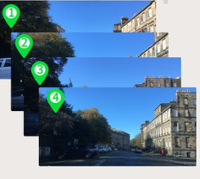
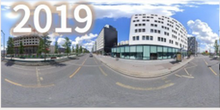
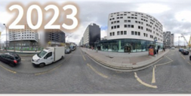


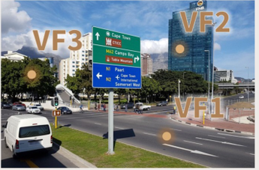



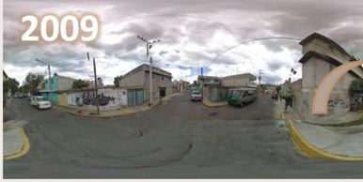
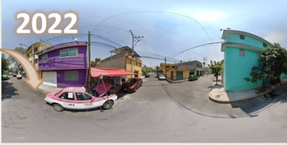

Existing Urban Scene Benchmark
Spatial Discontinuity
Short Time Span
Focus on Spatial Understanding
The images from the same area
The time span between images from
Q:
Where is this picture possibly taken?
are far apart.
the same area is short.
A Málaga
B Vancouver
C Córdoba
2023
D Granada
2022
UrbanFeel (Ours)
Spatial Continuity
Long Time Span
The images from the same area show
The time span between images from the same area is long.
sequential changes over time.
800
Image Number
400
0
Year
2007
2024
Perceptual Domain
Q: Please judge whether the city appears Beauty or not from a hu-
Q: The two scenes show the same place, one from 2009 and one
man perspective and find some VisualFactors(VF) that contribute to it.
from 2022. Please determine whether the scene has become
A: The city is beautiful, because:
more
wealthy, less
wealthy, or stayed the same.
<VF1>: The road is clean and tidy…
<VF2>: The buildings are diverse and
visually appealing…
<VF3>: High degree of greenery…
Notes:
ReFigure editable reconstruction — not author-provided PowerPoint.
Figure 1: fig1 urban benchmark comparison
Source: https://arxiv.org/abs/2509.22228v1
Approved image: fig1_urban_benchmark_comparison.png; SHA-256: 4bae6094128a075df1b749d9bd69281dae341111e242a8089b803b3017ace329
The reference PDF artwork is raster-only. Primary readable captions, stage/module labels, panels, category badges, statistical-sector geometry, bars and arrow paths are reconstructed native editable PowerPoint objects. Arrow paths are freeforms, not endpoint-bound connectors; sectors/bars are not data-bound charts. Original street-view photographs and panorama stacks, 3D city illustrations, maps, source logos, small pictograms and photograph-embedded annotations remain named independent raster objects (36); their internal pixels are not editable. No whole-figure screenshot or full-slide backdrop is used.
Source font identities are unavailable from flattened artwork. Installed Arial approximate the source typefaces. Fine typography, statistical-sector geometry, small pictograms, decorative effects and antialiasing differ; this is not pixel-identical author source. Source crop boundaries and original evidence are preserved.
Final-file renderer: Artifact Tool PPTX roundtrip; this is not a PowerPoint application compatibility test.

