Slide 1
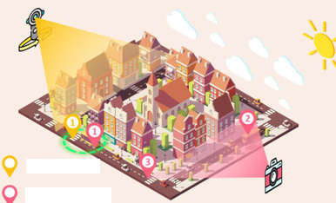
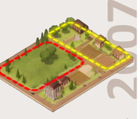
















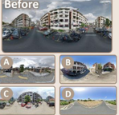
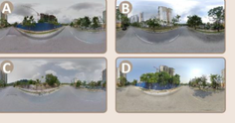


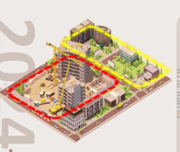


Subjective Environmental Perception
2008
2017
2024
Global Perception(GP)
Temporal Change Understanding
Reasoning: in the
Static Scene Perception
Beauty
✓
red region:
SCR
DEE
Wealthy
×
1. A high degree of
greenery and
2200
2000
Temporal Co-location Recognition(TCR)
Safety
✓
vegetation coverage…
PCR
CR
Q: Determine whether two images are from
2. The view is
1100
2000
the same location.
Lively
×
unobstructed…
2200
2200
A: = Same Location
3. The ground is clean…
Local Perception(LP)
1100
2200
Panorama
Single-View
Scene-Level Change Recognition(SCR)
Comparative Perceptual Analysis (CP)
Q: Which category best describes the
FSI
SPM
Single-to-Pano Matching(SPM)
change between the two time periods?
Q: The two scenes show the same place, one from 2008 and one
2200
1100
Single-view
298
596
Q: Determine whether
Road Change
Pixel-Level Change Recognition(PCR)
from 2024. Please determine whether the scene has become more
and are from the
Vegetation Change
Q: Which urban element has changed
{Beauty, Wealthy, Safety, Lively}, less, or no significant change.
Panorama
same location.
Building Façade Change
the most in terms of city development?
500
1918
A: = Same Location
Mobility-Related Change
Road
Vehicle
Sky
2004
Beauty
Wealthy
Safety
Lively
TCR
510
523
GP
Building Presence Change
Vegetation
Building
∨
∧
=
∧
Co-location Recognition(CR)
219
1922
Q: Determine whether
Future Scene Identification(FSI)
2024
Beauty
Wealthy
Safety
Lively
1961
and are from the same
876
323
street.
Global Perception(GP)
TSR
1140
LP
A: ≠ Different Street
Reasoning: in the
CP
yellow region:
×
Beauty
Answer Type
Image per Q
Dominant Element Extraction(DEE)
1. The road infrastruc-
Q: Which element occupies the
ture is well-developed.
✓
Wealthy
MC
7961
View Type
1 image
5840
most visible area in the image?
Temporal-Sequence Reasoning(TSR)
2. Modern buildings
Road
Vehicle
Sky
Q: Which image most likely
Q: Please rank the four street-view
are prevalent…
✓
Safety
Judgement
4916
mono-str
2600
2 images
7159
shows the same location after
images in chronological order from
3. The degree of urba-
Vegetation
Building
city development.
least to most developed.
Local Perception(LP)
nization is high…
✓
Lively
Open
1922
pano-str
11420
4 images
1100
A: Image C
A: C → A → D → B
Sorting
219
multi-str
298
5 images
1100
Static Scene Perception
Temporal Change Understanding
Subjective Environmental Perception
(a) UrbanFeel Data Statistics
(b) Overview of the 11 Types of Tasks in UrbanFeel
Notes:
ReFigure editable reconstruction — not author-provided PowerPoint.
Figure 2: fig2 urbanfeel task taxonomy and statistics
Source: https://arxiv.org/abs/2509.22228v1
Approved image: fig2_urbanfeel_task_taxonomy_and_statistics.png; SHA-256: 24c1016a570ee055d31f77df880b21c963aa9cd0882da13e4c947a854bdd1922
The reference PDF artwork is raster-only. Primary readable captions, stage/module labels, panels, category badges, statistical-sector geometry, bars and arrow paths are reconstructed native editable PowerPoint objects. Arrow paths are freeforms, not endpoint-bound connectors; sectors/bars are not data-bound charts. Original street-view photographs and panorama stacks, 3D city illustrations, maps, source logos, small pictograms and photograph-embedded annotations remain named independent raster objects (58); their internal pixels are not editable. No whole-figure screenshot or full-slide backdrop is used.
Source font identities are unavailable from flattened artwork. Installed Comic Sans MS, Times New Roman, Arial, Segoe UI Symbol approximate the source typefaces. Fine typography, statistical-sector geometry, small pictograms, decorative effects and antialiasing differ; this is not pixel-identical author source. Source crop boundaries and original evidence are preserved.
Final-file renderer: Artifact Tool PPTX roundtrip; this is not a PowerPoint application compatibility test.

