Slide 1

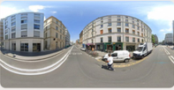
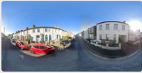

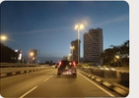
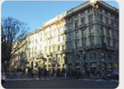
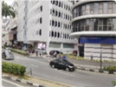


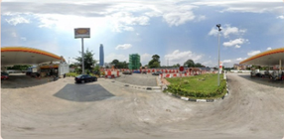
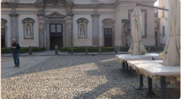

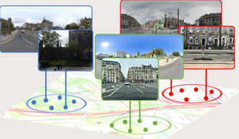












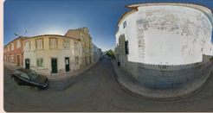
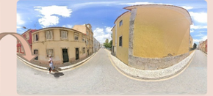
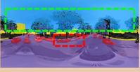
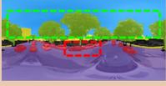
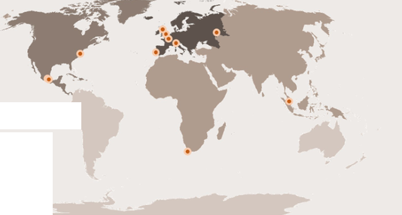

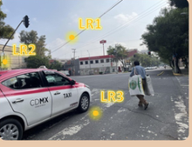



Data Collection & Pre-processing
Question Generation
MLLMs Inference & Quality Control
Download-source
Question Types
Input:
Image &
Question
Q: Determine whether image A and image B
Q: Which urban element has changed the most
are from the same location.
in terms of city development or renewal?
LLMs
⊕ Yes, same location.
Multiple
Road
Vehicle
Sky
Judgement
⊗ No, different location.
Choice
Vegetation
Building
Q: Judge if the image appears {Beautiful,
Q: Determine the chronological order of the
Output:
Answer &
Analysis
Wealthy, Safety, Lively} and explain why.
images from least to most developed.
A: The image is wealthy.
Open
Sorting
?
?
?
?
Because the building… the vegetation…
Generate Question
Image Grouping
Ruled Based
If D₁₂ < 50m:
Time
Distance=D₁₂
= same location
Reordering
Question: Determine whether two images are from the
Else:
same location.
(lat₁,lon₁) (lat₂,lon₂)
≠ different location
(A) Yes (B) No
Model Assistance & Manual Quality Inspection
Answer: A
Ground Truth: B
×
Error
43%
40%
○ Group the image in 50m
42%
30%
4%
19%
3%
Repair
4%
0%
3%
Manual Annotation
Question: Which category best describes the change
Local Reason 1
Global Comment
between the two time periods?
The sky has a lot of
intersecting power lines…
This scene is not
beautiful. The sky has
many cables obstructing
the view, traffic lights are
covered with posters,
and the road markings
are unclear. The greenery
is poorly developed.
(A)
Road Change
City Number
(B)
Building Façade Change
Local Reason 2
(C)
Building Presence Change
0
The traffic light poles are
covered with posters…
(D)
Vegetation Change
1-2
Local Reason 3
(E)
Mobility-Related Change
3-4
The road traffic markings
are heavily worn…
✓
5-6
Answer: B
Ground Truth: B
Correct
Notes:
ReFigure editable reconstruction — not author-provided PowerPoint.
Figure 3: fig3 benchmark construction pipeline
Source: https://arxiv.org/abs/2509.22228v1
Approved image: fig3_benchmark_construction_pipeline.png; SHA-256: 4d9b64f6f03530092c44c35585c2de1678b5dcb3442a3f4835568f9ea36d76c8
The reference PDF artwork is raster-only. Primary readable captions, stage/module labels, panels, category badges, statistical-sector geometry, bars and arrow paths are reconstructed native editable PowerPoint objects. Arrow paths are freeforms, not endpoint-bound connectors; sectors/bars are not data-bound charts. Original street-view photographs and panorama stacks, 3D city illustrations, maps, source logos, small pictograms and photograph-embedded annotations remain named independent raster objects (59); their internal pixels are not editable. No whole-figure screenshot or full-slide backdrop is used.
Source font identities are unavailable from flattened artwork. Installed Arial, Segoe UI Symbol approximate the source typefaces. Fine typography, statistical-sector geometry, small pictograms, decorative effects and antialiasing differ; this is not pixel-identical author source. Source crop boundaries and original evidence are preserved.
Final-file renderer: Artifact Tool PPTX roundtrip; this is not a PowerPoint application compatibility test.

