Slide 1




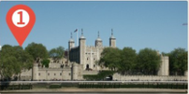
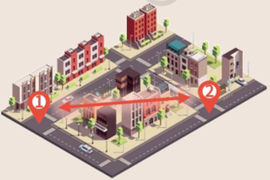
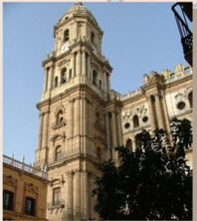









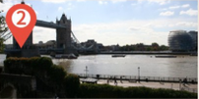




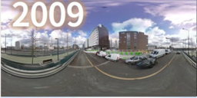
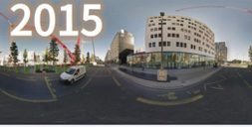
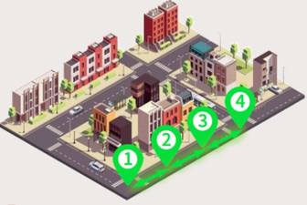
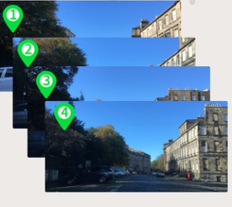
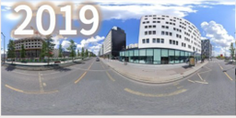
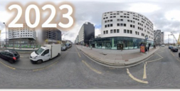


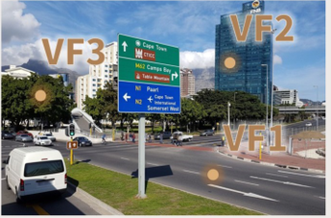



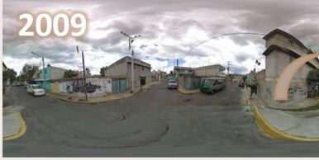
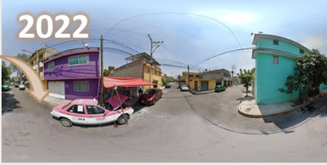

Existing Urban Scene Benchmark
Spatial Discontinuity
Short Time Span
Focus on Spatial Understanding
The images from the same area
The time span between images from
Q:
Where is this picture possibly taken?
are far apart.
the same area is short.
A Málaga
B Vancouver
C Córdoba
2023
D Granada
2022
UrbanFeel (Ours)
Spatial Continuity
Long Time Span
The images from the same area show
The time span between images from the same area is long.
sequential changes over time.
800
Image Number
400
0
Year
2007
2024
Perceptual Domain
Q: Please judge whether the city appears Beauty or not from a hu-
Q: The two scenes show the same place, one from 2009 and one
man perspective and find some VisualFactors(VF) that contribute to it.
from 2022. Please determine whether the scene has become
A: The city is beautiful, because:
more
wealthy, less
wealthy, or stayed the same.
<VF1>: The road is clean and tidy…
<VF2>: The buildings are diverse and
visually appealing…
<VF3>: High degree of greenery…
Notes:
ReFigure editable reconstruction — not author-provided PowerPoint.
Figure 1: fig1 urban benchmark comparison
Source: https://arxiv.org/abs/2509.22228v1
Approved image: fig1_urban_benchmark_comparison.png; SHA-256: 4bae6094128a075df1b749d9bd69281dae341111e242a8089b803b3017ace329
The reference PDF artwork is raster-only. Primary readable captions, stage/module labels, panels, category badges, statistical-sector geometry, bars and arrow paths are reconstructed native editable PowerPoint objects. Arrow paths are freeforms, not endpoint-bound connectors; sectors/bars are not data-bound charts. Original street-view photographs and panorama stacks, 3D city illustrations, maps, source logos, small pictograms and photograph-embedded annotations remain named independent raster objects (36); their internal pixels are not editable. No whole-figure screenshot or full-slide backdrop is used.
Source font identities are unavailable from flattened artwork. Installed Arial approximate the source typefaces. Fine typography, statistical-sector geometry, small pictograms, decorative effects and antialiasing differ; this is not pixel-identical author source. Source crop boundaries and original evidence are preserved.
Final-file renderer: Artifact Tool PPTX roundtrip; this is not a PowerPoint application compatibility test.

Slide 2
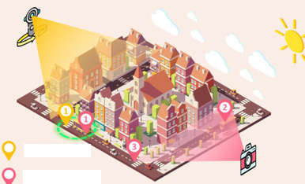



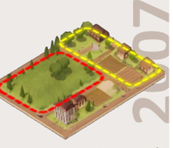













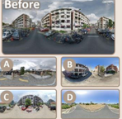
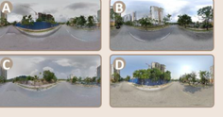


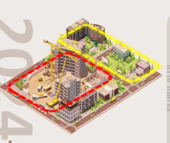


Subjective Environmental Perception
2008
2017
2024
Global Perception(GP)
Temporal Change Understanding
Beauty
✓
Reasoning: in the
Static Scene Perception
red region:
SCR
DEE
Wealthy
×
1. A high degree of
Temporal Co-location Recognition(TCR)
greenery and
2200
2000
Q: Determine whether two images are from
Safety
✓
vegetation coverage…
PCR
CR
the same location.
2. The view is
2200
1100
2000
2200
A: = Same Location
Lively
×
unobstructed…
Local Perception(LP)
Panorama
3. The ground is clean…
1100
2200
Single-View
Scene-Level Change Recognition(SCR)
Comparative Perceptual Analysis (CP)
Q: Which category best describes the
FSI
2200
596
SPM
Single-to-Pano Matching(SPM)
change between the two time periods?
Q: The two scenes show the same place, one from 2008 and one
1100
Single-view
298
Q: Determine whether
Road Change
Pixel-Level Change Recognition(PCR)
from 2024. Please determine whether the scene has become more
Panorama
and are from the
Vegetation Change
Q: Which urban element has changed
{Beauty, Wealthy, Safety, Lively}, less, or no significant change.
same location.
Building Façade Change
the most in terms of city development?
2004
Beauty
Wealthy
Safety
Lively
510
500
1918
523
A: = Same Location
Mobility-Related Change
Road
Vehicle
Sky
TCR
219
1922
GP
Co-location Recognition(CR)
Building Presence Change
Vegetation
Building
∨
∧
=
∧
1961
Q: Determine whether
Future Scene Identification(FSI)
2024
Beauty
Wealthy
Safety
Lively
876
323
and are from the same
1140
street.
Global Perception(GP)
TSR
LP
A: ≠ Different Street
Reasoning: in the
×
Beauty
CP
Dominant Element Extraction(DEE)
yellow region:
Answer Type
Image per Q
Q: Which element occupies the
1. The road infrastruc-
✓
Wealthy
View Type
most visible area in the image?
Temporal-Sequence Reasoning(TSR)
ture is well-developed.
MC
7961
1 image
5840
Q: Which image most likely
Q: Please rank the four street-view
2. Modern buildings
✓
Safety
Judgement
4916
mono-str
2600
2 images
7159
Road
Vehicle
Sky
shows the same location after
images in chronological order from
are prevalent…
Vegetation
Building
city development.
least to most developed.
Local Perception(LP)
3. The degree of urba-
✓
Lively
Open
1922
pano-str
11420
4 images
1100
A: Image C
A: C → A → D → B
nization is high…
Sorting
219
multi-str
298
5 images
1100
Static Scene Perception
Temporal Change Understanding
Subjective Environmental Perception
(a) UrbanFeel Data Statistics
(b) Overview of the 11 Types of Tasks in UrbanFeel
Notes:
ReFigure editable reconstruction — not author-provided PowerPoint.
Figure 2: fig2 urbanfeel task taxonomy and statistics
Source: https://arxiv.org/abs/2509.22228v1
Approved image: fig2_urbanfeel_task_taxonomy_and_statistics.png; SHA-256: 24c1016a570ee055d31f77df880b21c963aa9cd0882da13e4c947a854bdd1922
The reference PDF artwork is raster-only. Primary readable captions, stage/module labels, panels, category badges, statistical-sector geometry, bars and arrow paths are reconstructed native editable PowerPoint objects. Arrow paths are freeforms, not endpoint-bound connectors; sectors/bars are not data-bound charts. Original street-view photographs and panorama stacks, 3D city illustrations, maps, source logos, small pictograms and photograph-embedded annotations remain named independent raster objects (58); their internal pixels are not editable. No whole-figure screenshot or full-slide backdrop is used.
Source font identities are unavailable from flattened artwork. Installed Comic Sans MS, Times New Roman, Arial, Segoe UI Symbol approximate the source typefaces. Fine typography, statistical-sector geometry, small pictograms, decorative effects and antialiasing differ; this is not pixel-identical author source. Source crop boundaries and original evidence are preserved.
Final-file renderer: Artifact Tool PPTX roundtrip; this is not a PowerPoint application compatibility test.

Slide 3

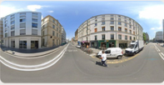
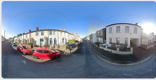


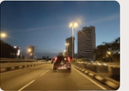
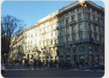
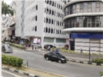

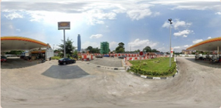
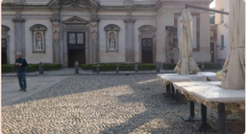

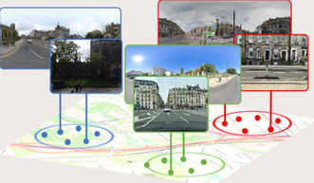












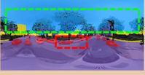
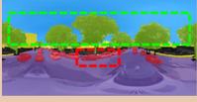
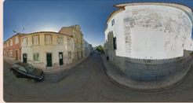
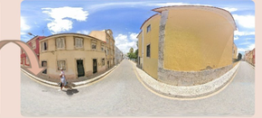
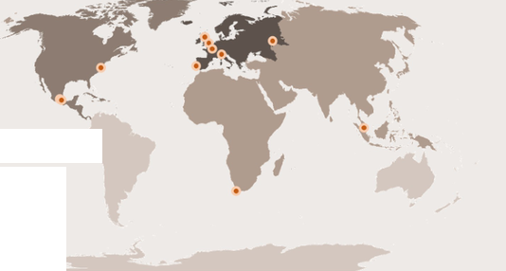

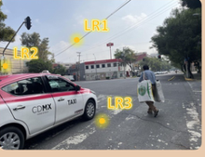



Data Collection & Pre-processing
Question Generation
MLLMs Inference & Quality Control
Download-source
Question Types
Input:
Image &
Question
Q: Determine whether image A and image B
Q: Which urban element has changed the most
are from the same location.
in terms of city development or renewal?
LLMs
⊕ Yes, same location.
Multiple
Road
Vehicle
Sky
Judgement
⊗ No, different location.
Choice
Vegetation
Building
Q: Judge if the image appears {Beautiful,
Q: Determine the chronological order of the
Output:
Answer &
Analysis
Wealthy, Safety, Lively} and explain why.
images from least to most developed.
A: The image is wealthy.
Open
Sorting
?
?
?
?
Because the building… the vegetation…
Generate Question
Image Grouping
Ruled Based
If D₁₂ < 50m:
Time
Distance=D₁₂
= same location
Reordering
Question: Determine whether two images are from the
Else:
same location.
(lat₁,lon₁) (lat₂,lon₂)
≠ different location
(A) Yes (B) No
Model Assistance & Manual Quality Inspection
Answer: A
Ground Truth: B
×
Error
43%
40%
○ Group the image in 50m
42%
30%
4%
19%
3%
Repair
4%
0%
3%
Manual Annotation
Question: Which category best describes the change
Local Reason 1
Global Comment
between the two time periods?
The sky has a lot of
intersecting power lines…
This scene is not
beautiful. The sky has
many cables obstructing
the view, traffic lights are
covered with posters,
and the road markings
are unclear. The greenery
is poorly developed.
(A)
Road Change
City Number
(B)
Building Façade Change
0
Local Reason 2
(C)
Building Presence Change
The traffic light poles are
covered with posters…
(D)
Vegetation Change
1-2
Local Reason 3
(E)
Mobility-Related Change
3-4
The road traffic markings
are heavily worn…
Answer: B
Ground Truth: B
✓
Correct
5-6
Notes:
ReFigure editable reconstruction — not author-provided PowerPoint.
Figure 3: fig3 benchmark construction pipeline
Source: https://arxiv.org/abs/2509.22228v1
Approved image: fig3_benchmark_construction_pipeline.png; SHA-256: 4d9b64f6f03530092c44c35585c2de1678b5dcb3442a3f4835568f9ea36d76c8
The reference PDF artwork is raster-only. Primary readable captions, stage/module labels, panels, category badges, statistical-sector geometry, bars and arrow paths are reconstructed native editable PowerPoint objects. Arrow paths are freeforms, not endpoint-bound connectors; sectors/bars are not data-bound charts. Original street-view photographs and panorama stacks, 3D city illustrations, maps, source logos, small pictograms and photograph-embedded annotations remain named independent raster objects (59); their internal pixels are not editable. No whole-figure screenshot or full-slide backdrop is used.
Source font identities are unavailable from flattened artwork. Installed Arial, Segoe UI Symbol approximate the source typefaces. Fine typography, statistical-sector geometry, small pictograms, decorative effects and antialiasing differ; this is not pixel-identical author source. Source crop boundaries and original evidence are preserved.
Final-file renderer: Artifact Tool PPTX roundtrip; this is not a PowerPoint application compatibility test.

