Slide 1

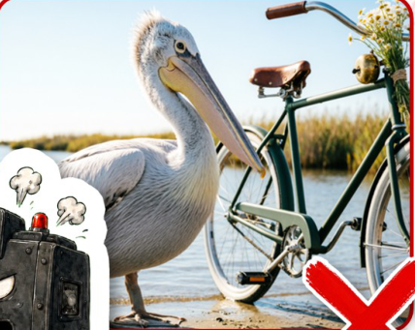
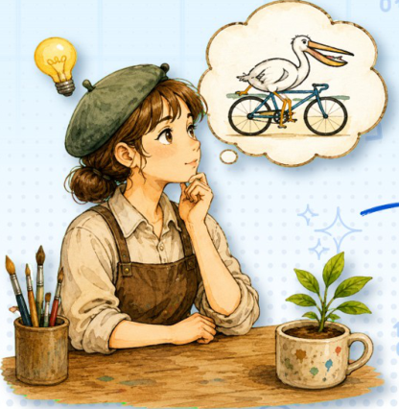
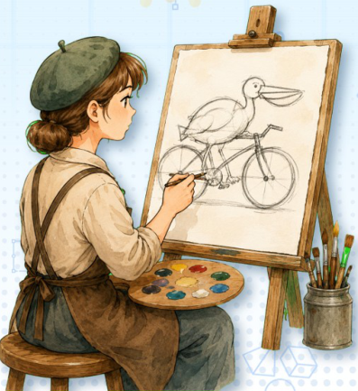
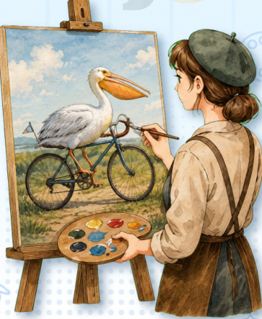
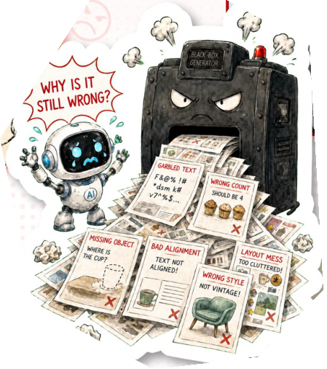

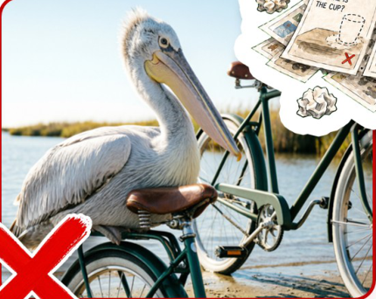
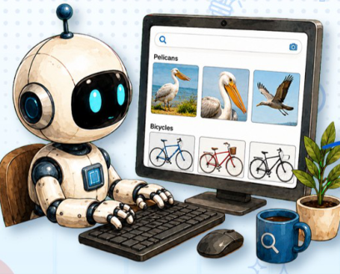
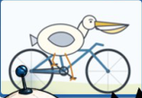
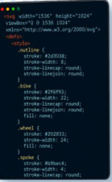
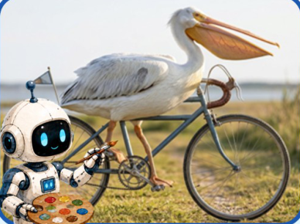
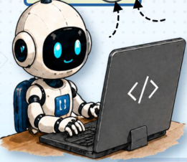
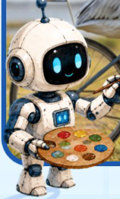
1. Text Prompt
2. Initial Generation
1. Conceptualize
2. Drawing a sketch
3. Coloring
100
1010
01
Generate an
Human
image of a white
Drawing
pelican riding a
bicycle on a road.
Process
Generate a realistic
image of a white
pelican riding a
Our
bicycle on a road.
GenClaw
Keep the full bicycle
Generation
visible and make the
Process
bird look natural.
4. Final Output
3. Review & Rewrite
1. Search & Reasoning
2. Code (SVG/HTML...)
3. Generate
Notes:
ReFigure reconstruction, not author-provided PowerPoint.
Code-driven agentic image-generation paradigm
Source: https://arxiv.org/abs/2605.30248v2
Approved PNG SHA-256: 6701c45ac3318618ab80e30395c7c3198d76d60197420e0b7e3df89893a114fd
Source figure is a single flattened illustration. All process labels, group containers, arrows and photo frames are native. Decorative brush-lettered headings are native contour outlines, not editable text. Original photographs/robot/artist illustrations and code-editor pixels are independent local raster objects. Faint decorative background texture, paper texture, tiny sticker shadows and font metrics are approximate. Arrow paths are not endpoint-bound connectors.
Local final-file renderer: Artifact Tool PPTX roundtrip. Microsoft PowerPoint application compatibility has not been tested.

