Slide 1










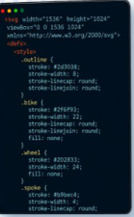
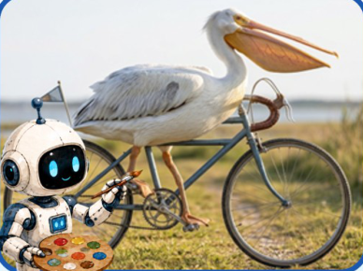


1. Text Prompt
2. Initial Generation
1. Conceptualize
100
2. Drawing a sketch
3. Coloring
1010
01
Generate an
Human
image of a white
Drawing
pelican riding a
Process
bicycle on a road.
Generate a realistic
image of a white
Our
pelican riding a
bicycle on a road.
GenClaw
Keep the full bicycle
Generation
visible and make the
Process
bird look natural.
4. Final Output
3. Review & Rewrite
1. Search & Reasoning
2. Code (SVG/HTML...)
3. Generate
Notes:
ReFigure reconstruction, not author-provided PowerPoint.
Code-driven agentic image-generation paradigm
Source: https://arxiv.org/abs/2605.30248v2
Approved PNG SHA-256: 6701c45ac3318618ab80e30395c7c3198d76d60197420e0b7e3df89893a114fd
Source figure is a single flattened illustration. All process labels, group containers, arrows and photo frames are native. Decorative brush-lettered headings are native contour outlines, not editable text. Original photographs/robot/artist illustrations and code-editor pixels are independent local raster objects. Faint decorative background texture, paper texture, tiny sticker shadows and font metrics are approximate. Arrow paths are not endpoint-bound connectors.
Local final-file renderer: Artifact Tool PPTX roundtrip. Microsoft PowerPoint application compatibility has not been tested.

Slide 2






















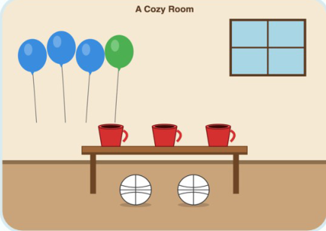

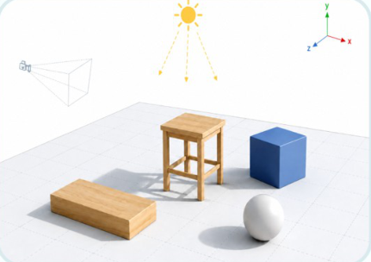
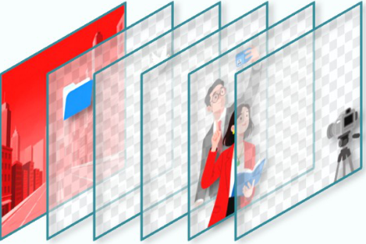
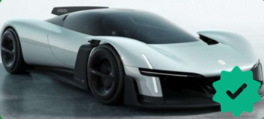
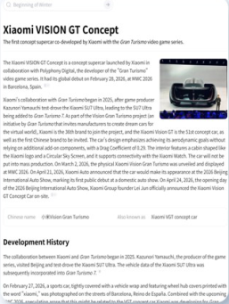
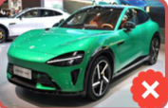
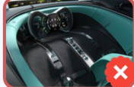




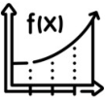

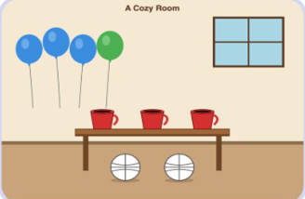









1
Cognitive Structuring
2
Executable Canvas Construction
Understanding, Searching & Reasoning
From Structured Plan to Code-Driven Canvas
User Prompt
Structured Plan (From Stage 1)
Create a depiction of
Xiaomi Vision Gran
Generate an image set in a room,
生成一张微博热搜图，热搜的榜
Generate an image featuring
Generate an image featuring
Turismo
positioned in a stunning
featuring three blue balloons
单分别为1. “XXX”，2.
a stool, a sphere, a blue
a stool, a sphere, a blue
landscape setting.
and one green balloon ... a
“XXX”，3. “XXX”
cube, ... sunlight coming from
cube, ... sunlight coming from
translucent window ...
45 degrees above and to ...
45 degrees above and to ...
Scene Composition
Text Rendering
Physics Simulation
Layered Editing
Intent Analysis
(SVG)
(HTML)
(three.js)
Image Generation
Image Editing
<g id="balloons">
<span class="topic">
const scene = new THREE.Scene();
<path d="M 80 180 Q 85 240 90 320"
<span class="title">GenClaw Agentic 图像生
const camera = new THREE.PerspectiveCamera(...);
fill="none" stroke="#666" stroke-width="1.5"/>
成新思路</span>
const mountain = new THREE.Mesh(geometry,
<path d="M 150 160 Q 155 220 160 320"
<span class="views">3666666</span>
material);
fill="none" stroke="#666" stroke-width="1.5"/>
</span>
const train = new THREE.Object3D();
<path d="M 220 180 Q 215 240 210 320"
<span class="tag new">新</span>
...
VLM-based
SAM3-Based
Occlusion Region
fill="none" stroke="#666" stroke-width="1.5"/>
</li>
renderer.render(scene, camera);
Hierarchization
Segmentation
Restoration
Tools & External Resources
...
<li>...
Image Search
Web Search
https://www.imgre.xiaomi ...
...
https://www.imgre ...
https://www.imgre ...
3
Visual Generation & Review
Reasoning Tools
Generate, Evaluate and Refine
......
Executable Canvas
Not Passed
Passed
1. Are the search results correct ?
URL checking...
2. Are the reasoning results correct ?
Invoked Tools
Uninvoked Tools
User & VLM Review
CoT reasoning process checking...
3. Are the SVG Syntax Correct ?
Structured Plan
User & VLM Review
<svg viewBox="0 0 512 512">
<rect width="512" height="512" fill="..."/>
<path d="M..." fill="#E6A946"/>
{"title": "Structured Understanding",
<circle cx="..." cy="..." r="..." />
"attributes": {
<text x="..." y="...">SWISS ALPS</text>
Generation
</svg>
"Key objects": [
...
"mountains",
4. Are all the elements Complete?
"train",
Image Editing
Elements position, number checking...
"lake",
...
"..."
5. Other Questions......
],
Image Generation
"Layout": ......
Generation Output
Notes:
ReFigure reconstruction, not author-provided PowerPoint.
Cognitive structuring, executable canvas and visual review
Source: https://arxiv.org/abs/2605.30248v2
Approved PNG SHA-256: e38a08a603bf0fcdd97fca697d2ba17c17f23ba1e9305611888980fc1b369849
Source Figure 3 is a single flattened raster. All phase/container labels, prompt text, module labels, branch arrows, readable code snippets, option labels and review checklist are native. Car photos, web article and example renderings, tool logos/icons, painter artwork and layered illustration remain separately positioned original local raster components. Source fonts are substituted by installed Calibri/Comic Sans MS/Microsoft YaHei/Courier New. Some miniature code content is transcribed to legible native text at the visible source fidelity, not executable author code. Shadows/gradients and faint decoration are approximate. Freeform arrows are not bound connectors.
Local final-file renderer: Artifact Tool PPTX roundtrip. Microsoft PowerPoint application compatibility has not been tested.

