Slide 1




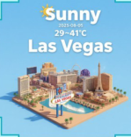
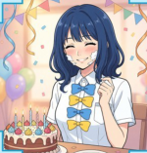
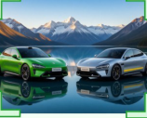
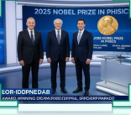








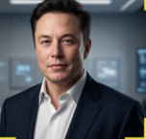
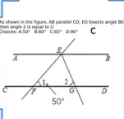







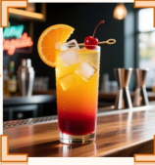
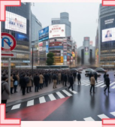
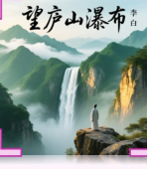
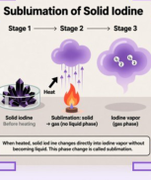

Object
Special Event
Weather
Character
Create a depiction of the Xiaomi YU7 and SU7
Generate an image of a news report scene featuring
Generate an image of isometric 3D miniature
Generate an image of Anna Yanami from 'Makeine:
Ultra positioned in a stunning landscape setting.
the winners of the 2025 Nobel Prize in Physics.
cartoon Las Vegas scene with weather in August 5.
Too Many Losing Heroines!' next to a birthday cake,
with cream smeared on her face.
The Xiaomi YU7 is a mid-size
The 2025 Nobel Prize in
The typical high and low
Anna Yanami has medium-length
crossover SUV, while the SU7
Physics was awarded to John
temperatures around August 15
wavy dark blue hair, wearing a
Ultra is a high-performance
Clarke, Michel H. Devoret, and
are about 41°C for the high and
short-sleeved white school blouse
full-size fastback sedan...
John M. Martinis...
29°C for the low in Las Vegas...
with four large bows...
T text
▧ images
T text
▧ images
T text
▧ images
T text
▧ images
Searching...
Searching...
Searching...
Searching...
World Knowledge
Math
Create a portrait of the world's richest person in
Generate an image showing the
2025.
instruction to write the answer to the
question in the corresponding position.
In 2025, Elon Musk once again
Angle 1 at F is 50°. Since AB is
became the wealthiest man in the
parallel to CD, angle BEF is
list after surpassing Arnault...
supplementary to angle 1, meaning
Wealthiest Elon Musk Net worth...
angle BEF = 180° − 50° = 130°. EG
T text
▧ images
bisects angle BEF, so the resulting
Searching...
reasoning...
angle measure is 130° / 2 = 65°. Angle
2 is an alternate interior angle to
the angle, so angle 2 = 65°.
Therefore, the correct choice is C.
T text
Life Reasoning
Geo Reasoning
Poem
Science & Logic
Generate an image of the cocktail
Draw the real-world content seen
This is a poem by Li Bai praising the magnificent
Generate an image showing the sublimation process
made from the following
from the red arrow.
scenery of the Lushan Waterfall... Generate the
of solid iodine.
ingredients: tequila, orange juice,
poem title and visualize the artistic conception.
and grenadine syrup.
Map with a red arrow indicating a
1) LEFT PANEL - Solid iodine: a
viewpoint for Shibuya Crossing
pile or small crystals of dark
A close-up of a vibrant tequila
area. No specific named person
Design a traditional Chinese-style
purple/black iodine...
cocktail made from tequila, orange
or object requested → only the
book cover featuring the title
2) MIDDLE - Heating and
juice, and grenadine syrup, shown in
environment. According to the
text '望庐山瀑布' and the poet
sublimation; under or directly
a tall highball glass. Distinct color
protocol, focus on the named
credit text '李白'. Illustrate the
beneath the container...
gradient from deep red at the
place as the main entity...
vast artistic conception of Lushan
3) RIGHT - Iodine vapor: above
bottom to bright orange and
Search & reasoning...
T text
reasoning...
Mountain with towering emerald
reasoning...
the solid, depict a visible cloud or
golden yellow near the top.
▧ images
peaks rising into a sky of deep
region of violet/purple gas.
reasoning...
Garnished with a fresh orange slice
azure, their summits half-veiled in
Use an arrow or sequence labels
on the rim and a maraschino cherry
drifting white clouds and
(1, 2, 3) to emphasize the
on a cocktail pick...
morning mist... Style it as a
process: (1) solid iodine, (2)
T text
Chinese ink-and-wash painting...
heating, (3) iodine gas...
T text
T text
Notes:
ReFigure editable reconstruction, not author-provided PowerPoint.
fig1 cognitive generation capability overview
Source: https://arxiv.org/abs/2602.01756v1
Approved image: fig1_cognitive_generation_capability_overview.png; SHA-256: 8fbc88250aa1a109cc053d83fe3cb5cb35af1cd369f8d2dd87c25d39dc70d3de.
Diagram containers, arrows and readable narrative labels are native editable PowerPoint objects. Arrows are editable freeform paths, not endpoint-bound connectors. Photographs, generated scientific example images, retrieved-image strips, maps, logos, heraldic artwork and complex pictograms remain 49 independent raster objects; their internal pixels and embedded example labels are not editable. Some central MindBrush logo lettering belongs to original logo artwork. The annotated scoreboard and geometry examples remain unmodified raster evidence, not native charts or recreated measurements.
Font approximation: Comic Sans MS. Chinese characters use platform font fallback. Mixed weight, dotted spacing, gradients, shadows, borders and antialiasing have minor visual approximations. This is not pixel-identical rendering or the authors' original source.
Final-file renderer: Artifact Tool PPTX export/import roundtrip. This is not a PowerPoint application compatibility test.
Paper: Mind-Brush: Integrating Agentic Cognitive Search and Reasoning into Image Generation.
Authors: Jun He, Junyan Ye, Zilong Huang, Dongzhi Jiang, Chenjue Zhang, Leqi Zhu, Renrui Zhang, Xiang Zhang, Weijia Li.
Paper license: CC BY 4.0, https://creativecommons.org/licenses/by/4.0/. Third-party imagery retains its own conditions; see paper Appendix B.3. ReFigure adaptation reconstructs the layout and editable diagram objects.

