Slide 1








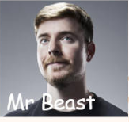

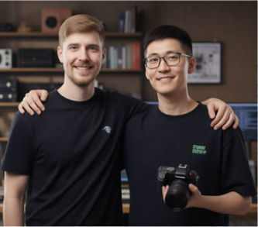



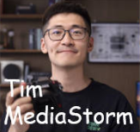























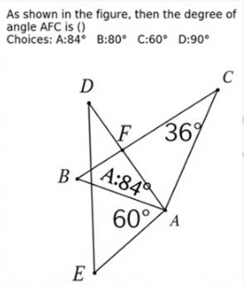


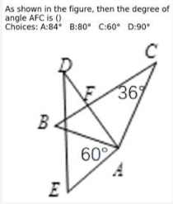



Input
Action
Intent Analysis
Keywords
Search
Review
Image Gen
Prompt
?
Question:
Text Queries:
Refined Prompt:
Generate an image of
1. What does the YouTuber MrBeast look like?
[None]
Capture a cinematic medium-shot
famous YouTuber Mr Beast
2. What does Tim from Mediastorm look like?
photo of two young adult men with
and Tim from Mediastorm
Image Queries:
their arms around each other’s
posing for a photo with
[
shoulders, smiling toward the camera...
their arms around each
Intent category:
“Mr Beast”,
Ref_img:
other’s shoulders.
“Tim MediaStorm”
“MrBeast.jpg”
Search_Generation
]
“Tim_MediaStorm.jpg”
Get user input, which
Planning the Action
Tool Box
includes
Flow by Tools...
Analysis
Search
Reasoning
Review
Image Gen
Others
Input
Intent Analysis
Knowledge Reasoning
Review
Image Gen
Action
Prompt
Image
?
Question:
Reasoning Knowledge:
Refined Prompt:
Generate an
What is the measure of angle
1
From the figure, ∠BAC = 60° and ∠ACB = 36°.
Create a educational diagram based on
image showing
2
Thus, in triangle ABC, ∠ABC = 180°−60°−36° = 84°.
the user input image... At the vertex
the answer
AFC in the geometric figure?
correspo-nding to angle AFC, add the
written in the
The lines from A and C through F form vertical opposite
final answer label text “A:84°” close
corr position
Intent Category:
3
angles with those at B, so ∠AFC equals ∠ABC.
to the angle arc in bold, dark-colored
based on the
4
Therefore, the measure of angle AFC is 84°, which
math font while matching the overall
question.
Reasoning_Generation
corresponds to choice A.
black-and-white line-art style.
Notes:
ReFigure editable reconstruction, not author-provided PowerPoint.
fig2 mind brush framework
Source: https://arxiv.org/abs/2602.01756v1
Approved image: fig2_mind_brush_framework.png; SHA-256: c774d1026df3ac246e2e84a469675ff5d5d90dfa5df4aaafe3a4350eb289939d.
Diagram containers, arrows and readable narrative labels are native editable PowerPoint objects. Arrows are editable freeform paths, not endpoint-bound connectors. Photographs, generated scientific example images, retrieved-image strips, maps, logos, heraldic artwork and complex pictograms remain 46 independent raster objects; their internal pixels and embedded example labels are not editable. Some central MindBrush logo lettering belongs to original logo artwork. The annotated scoreboard and geometry examples remain unmodified raster evidence, not native charts or recreated measurements.
Font approximation: Comic Sans MS. Chinese characters use platform font fallback. Mixed weight, dotted spacing, gradients, shadows, borders and antialiasing have minor visual approximations. This is not pixel-identical rendering or the authors' original source.
Final-file renderer: Artifact Tool PPTX export/import roundtrip. This is not a PowerPoint application compatibility test.
Paper: Mind-Brush: Integrating Agentic Cognitive Search and Reasoning into Image Generation.
Authors: Jun He, Junyan Ye, Zilong Huang, Dongzhi Jiang, Chenjue Zhang, Leqi Zhu, Renrui Zhang, Xiang Zhang, Weijia Li.
Paper license: CC BY 4.0, https://creativecommons.org/licenses/by/4.0/. Third-party imagery retains its own conditions; see paper Appendix B.3. ReFigure adaptation reconstructs the layout and editable diagram objects.

