Slide 1




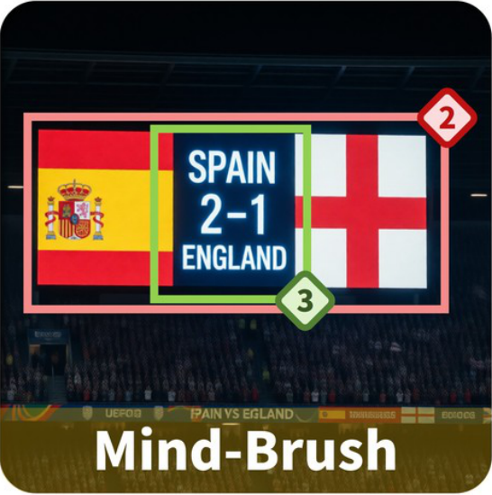
Spanish
Generate a photo of the live
Flag
scoreboard from the 2024 UEFA
Prompt
European Football
Reference
Championship final, showing
the national flags and the score.
England
Flag
Evaluation Checklist
1
A scoreboard is clearly visible in
the image.
2
The national flags of Spain and
England are visible.
3
The score is displayed as '2' for
Spain and '1' for England.
4
Text or logos referencing 'UEFA', 'Euro
2024', or the championship are visible.
Incorrect Generation (3 / 4)
Notes:
ReFigure editable reconstruction, not author-provided PowerPoint.
fig3 checklist based strict accuracy evaluation
Source: https://arxiv.org/abs/2602.01756v1
Approved image: fig3_checklist_based_strict_accuracy_evaluation.png; SHA-256: 96a0a48db8c6030015031b0c16a61874a33d543d4b4bb19c4e7f94339871047a.
Diagram containers, arrows and readable narrative labels are native editable PowerPoint objects. Arrows are editable freeform paths, not endpoint-bound connectors. Photographs, generated scientific example images, retrieved-image strips, maps, logos, heraldic artwork and complex pictograms remain 5 independent raster objects; their internal pixels and embedded example labels are not editable. Some central MindBrush logo lettering belongs to original logo artwork. The annotated scoreboard and geometry examples remain unmodified raster evidence, not native charts or recreated measurements.
Font approximation: Arial. Chinese characters use platform font fallback. Mixed weight, dotted spacing, gradients, shadows, borders and antialiasing have minor visual approximations. This is not pixel-identical rendering or the authors' original source.
Final-file renderer: Artifact Tool PPTX export/import roundtrip. This is not a PowerPoint application compatibility test.
Paper: Mind-Brush: Integrating Agentic Cognitive Search and Reasoning into Image Generation.
Authors: Jun He, Junyan Ye, Zilong Huang, Dongzhi Jiang, Chenjue Zhang, Leqi Zhu, Renrui Zhang, Xiang Zhang, Weijia Li.
Paper license: CC BY 4.0, https://creativecommons.org/licenses/by/4.0/. Third-party imagery retains its own conditions; see paper Appendix B.3. ReFigure adaptation reconstructs the layout and editable diagram objects.

