Slide 1
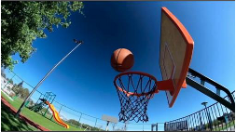
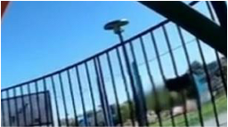













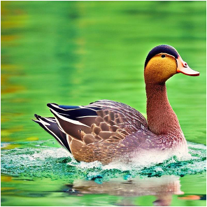
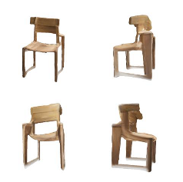
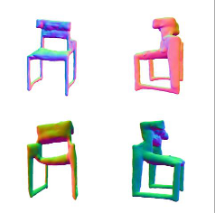





(a)
Overall
-
Abnormal
Legend
The
texture
and
geometry
of
the
background
Abnormal
Frame
railings
and
pole
sections
appear
distorted
Abnormal
Fragment
and
blurry.
Raw
Videos
0:05:63
0:06:78
0:07:89
0:08:14
0:00
8:52
Abnormal
Fragment
Abnormal
Fragment
When
the
basketball
passed
through
the
The
structure
of
the
basket
frame
was
hoop,
unexpected
flames
emerged
in
the
intact
and
undamaged,
yet
the
basketball
vicinity
of
the
basket.
passed
directly
through
it.
(b)
(c)
Overall
Abnormal
Area
1
The
surface
texture
of
the
duck
has
poor
clarity
and
fineness,
the
texture
is
blurred
and
there
are
large
differences
in
texture
between
different
areas.
The
overall
color
saturation
of
the
picture
is
Area
2
too
high,
the
color
is
distorted,
and
it
does
not
match
the
actual
situation.
Texture
Abnormal
Normal
Abnormal
Area
Abnormal
The
texture
characteristics
of
There
are
abnormal
bumps
Area
1
：
the
stool
vary
from
different
and
bulges
on
the
stool's
The
duck's
eye
texture
is
abnormal
and
does
not
match
the
real
angles.
The
wood
grain
on
the
geometric
surface,
and
the
eye
texture.
The
nose
structure
is
wrong.
side
of
the
stool
is
not
as
clear
geometric
shapes
on
both
as
the
front.
The
edges
of
the
sides
of
the
stool
are
Area
2
：
stool
texture
are
not
clear
and
asymmetrical,
which
does
not
In
calm
water
areas,
the
reflection
on
the
water
surface
is
not
cannot
be
identified.
There
are
conform
to
the
actual
symmetrical
with
the
duck
above
the
water
surface,
and
there
is
a
abnormal
white
textures
on
situation
of
a
stool.
clear
mismatch
between
the
reflection
and
the
duck
itself.
the
legs
of
the
stool.
Notes:
ReFigure editable reconstruction — not author-provided PowerPoint.
Multimodal synthetic-data annotation process
Source: https://arxiv.org/abs/2410.09732v2
Approved image: fig11_annotation_process_details.png; SHA-256: 04f86d3e577a011fc45d99ba9e8e8d7a3c3ea838dede80ec75ea25b53d6a6682
Readable diagram labels and vector geometry are native editable PowerPoint objects. Some equations, small ticks, and unavailable font symbols are exact or traced native vector outlines rather than typeable text/live equations. Arrow paths are not endpoint-bound connectors; plot paths are not data-bound charts. Photos/screenshots/complex illustrations and local effects remain independent raster objects (26), whose internal pixels are not editable.
Font substitution: source PDF families mapped to Times New Roman, Consolas, Arial, DengXian, Calibri (installed Windows fonts). Some shadows, gradients, and antialiasing are approximate; this is not pixel-identical author source. Source crop boundaries are preserved.
Final-file renderer: Artifact Tool PPTX roundtrip; this is not a PowerPoint application compatibility test.

