Slide 1
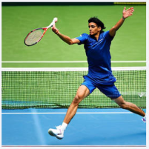
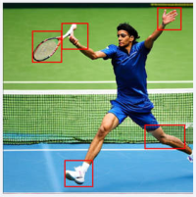





Task Description:
We request your assistance in
Instructions
evaluating the response of an
AI assistant to the question ...
Evaluation Dimensions:
GPT-4o
Score
Global Score ;
Reference Image
Synthetic Image
Evaluator
Final Scoring:
Completeness ;
Global Score (4-Good)
: The assistant effectively
captured the overall visual inconsistencies, such as
Correctness ;
(4-4-4-5) Total: 17
unnatural poses and lighting issues, …
Reason:
Completeness (4-Good)
: The assistant identified
Plausibility ;
most of the regions marked by the human annotators,
Data
Overall, the image appears
including the athlete’s pose, racket and hand …
Scoring Range:
inauthentic primarily due
Answer
Correctness (4-Good)
: The assistant’s explanations
to slight distortions and
were mostly aligned with the annotations. It correctly
1 - Poor 2 - Fair 3 - Average
identified issues with … However, it did not fully capture
unnatural poses that are
4 - Good 5 - Excellent
often characteristic of AI-
the blending issues with the shoe and sock …
Plausibility (5-Excellent)
: The assistant did not
Example: ...
generated images …
incorrectly identify authentic regions as inauthentic. It
also avoided adding regions beyond those marked.
Notes:
ReFigure editable reconstruction — not author-provided PowerPoint.
GPT-4o evaluation pipeline
Source: https://arxiv.org/abs/2410.09732v2
Approved image: fig12_gpt4o_evaluation_pipeline.png; SHA-256: 501a6e99fcbd2c6e6c7982e5cb51557cad5112343f9ae88684af0dfa96752938
Readable diagram labels and vector geometry are native editable PowerPoint objects. Some equations, small ticks, and unavailable font symbols are exact or traced native vector outlines rather than typeable text/live equations. Arrow paths are not endpoint-bound connectors; plot paths are not data-bound charts. Photos/screenshots/complex illustrations and local effects remain independent raster objects (7), whose internal pixels are not editable.
Font substitution: source PDF families mapped to Times New Roman, Calibri (installed Windows fonts). Some shadows, gradients, and antialiasing are approximate; this is not pixel-identical author source. Source crop boundaries are preserved.
Final-file renderer: Artifact Tool PPTX roundtrip; this is not a PowerPoint application compatibility test.

