Slide 1
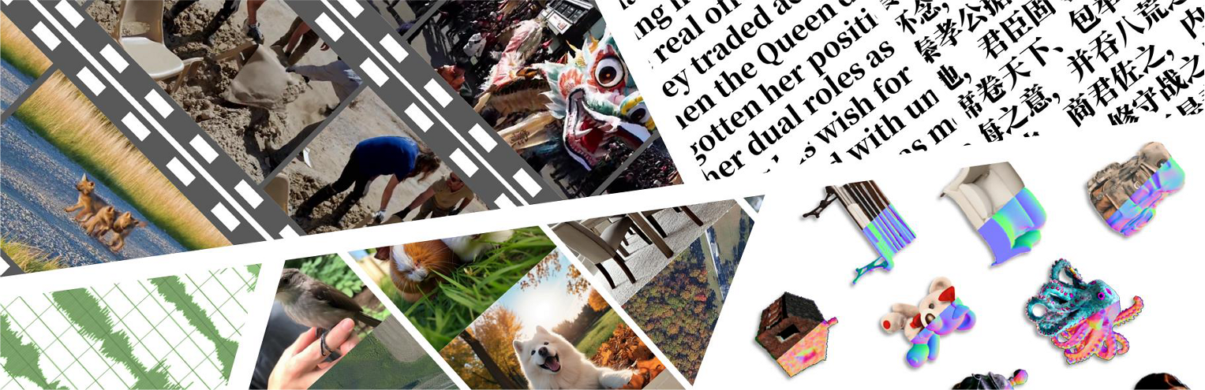


























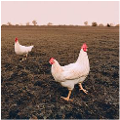

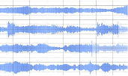


Diverse
Modalities
Heterogeneous
Domain
Multi
-
level
Annotations
Synthetic
Detection
Evaluation
Framework
Video
Scenery
Human
Synthesis
or
Real
Label:
Video
“Is
the
given
audio
a
generated
audio?
/
Image
Please
select
a
real
audio.”
Portrait
Scenery
Animals
Judgement
Accuracy
Image
Documents
Satellite
…
Yes
No
Video
3D
Image
Multiple
Choice
<A>
<B>
Wikipedia
Scientific
Papers
“Synthesis
Audio”
Mainstream
Recall
News
…
Fine
-
grained
Anomaly
A
nnotations
:
Text
models
…
Text
Philosophy
Abnormal
Details
Selection
(>
2
5
)
Text
Audio
Singing
Voice
Music
<A>
...
<B>
…
GPT
-
Eval
These
are
the
Rights
…
Audio
…
Score
which
make
the
Essence
Audio
Environmental
Sound
…
<C>
…
<D>
…
…
of
…
and
which
are
the
Nerf
-
based
Others
Abnormal
Explanation
markes
,
whereby
a
man
…
,
Metric
or
Assembly
of
men,
the
<Answer>
...
3D
Soveraign
Power
is
placed
…
3D
Gaussian
-
based
and
resideth
.
For
these
are
…
Notes:
ReFigure editable reconstruction — not author-provided PowerPoint.
LOKI benchmark overview
Source: https://arxiv.org/abs/2410.09732v2
Approved image: fig1_benchmark_overview.png; SHA-256: 284b51be9f93788870ee2a128734ef64910b50937f0ce421705376143cb6a52a
Readable diagram labels and vector geometry are native editable PowerPoint objects. Some equations, small ticks, and unavailable font symbols are exact or traced native vector outlines rather than typeable text/live equations. Arrow paths are not endpoint-bound connectors; plot paths are not data-bound charts. Photos/screenshots/complex illustrations and local effects remain independent raster objects (56), whose internal pixels are not editable.
Font substitution: source PDF families mapped to Cambria, Gadugi, Times New Roman, Segoe Print (installed Windows fonts). Some shadows, gradients, and antialiasing are approximate; this is not pixel-identical author source. Source crop boundaries are preserved.
Final-file renderer: Artifact Tool PPTX roundtrip; this is not a PowerPoint application compatibility test.

