Slide 1


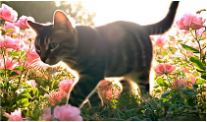

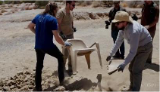



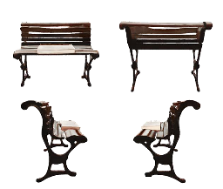
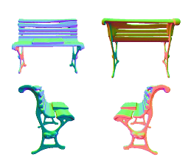

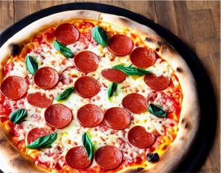
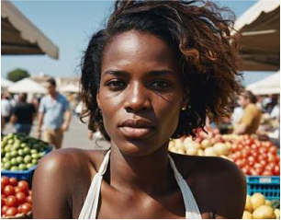
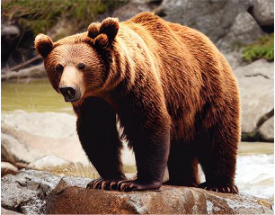

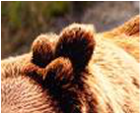
(a)
Video
Abnormal
Frame
Raw
Videos
0:00
0:02:54
0:06:27
0:12:51
0:16:13
0:20
Overall
Abnormal
“1.
The
sand
in
the
video
Abnormal
Fragment
A
Abnormal
Fragment
B
transforms
into
plastic
and
“In
the
extracted
video
segment,
a
piece
of
“In
the
extracted
video
segment,
the
chair
then
into
a
chair.
plastic
seemingly
grows
out
of
the
ground
detaches
from
people's
hands
and
floats
in
2.
The
chair
floats
and
from
thin
air
and
then
gradually
transforms
mid
-
air,
which
contradicts
the
reality
of
moves
in
mid
-
air
without
into
a
chair.
This
process
does
not
align
with
gravity.
Additionally,
the
shape
of
the
chair
anyone
holding
it.”
how
things
occur
in
reality.”
changes
over
time.”
(b)
Image
(b)
3D
Object
Overall
Abnormal
“The
overall
saturation
of
the
image
is
relatively
high,
the
Texture
Normal
shadow
expression
is
incorrect,
and
there
is
a
certain
degree
of
distortion
in
the
image.”
Abnormal
Area
Abnormal
Texture
Abnormal
Normal
Abnormal
“The
ears
of
the
bear
“The
surface
texture
of
the
“The
surface
normals
of
the
are
asymmetrical
chair
and
the
book
is
slightly
chair
and
the
book
are
and
the
number
is
blurred,
and
there
is
some
relatively
smooth,
…,
where
Raw
Images
incorrect.”
blending
of
the
edges
of
the
the
shapes
of
the
book
and
book
and
the
chair
…
”
the
chair
merge
together.
Notes:
ReFigure editable reconstruction — not author-provided PowerPoint.
Multimodal anomaly annotation schema
Source: https://arxiv.org/abs/2410.09732v2
Approved image: fig3_multimodal_annotation_schema.png; SHA-256: 1fddfd439f3c5f5381c747063d209b2c31e69a0001c6c888d784b0eeacbe8792
Readable diagram labels and vector geometry are native editable PowerPoint objects. Some equations, small ticks, and unavailable font symbols are exact or traced native vector outlines rather than typeable text/live equations. Arrow paths are not endpoint-bound connectors; plot paths are not data-bound charts. Photos/screenshots/complex illustrations and local effects remain independent raster objects (20), whose internal pixels are not editable.
Font substitution: source PDF families mapped to Times New Roman, Segoe Print (installed Windows fonts). Some shadows, gradients, and antialiasing are approximate; this is not pixel-identical author source. Source crop boundaries are preserved.
Final-file renderer: Artifact Tool PPTX roundtrip; this is not a PowerPoint application compatibility test.

