Slide 1
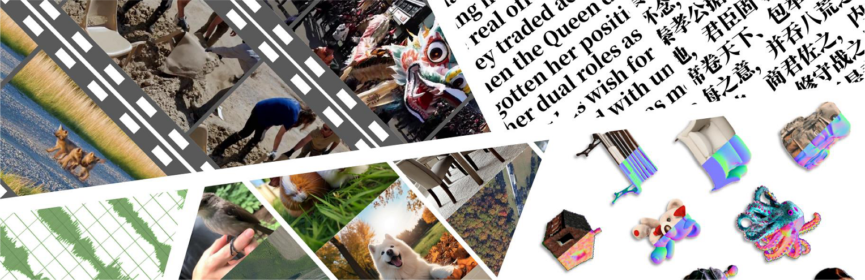


























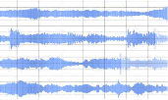
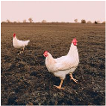



Diverse
Modalities
Heterogeneous
Domain
Multi
-
level
Annotations
Synthetic
Detection
Evaluation
Framework
Video
Scenery
Human
Synthesis
or
Real
Label:
Video
“Is
the
given
audio
a
generated
audio?
/
Image
Portrait
Scenery
Animals
Please
select
a
real
audio.”
Accuracy
Image
3D
Image
Documents
Satellite
…
Judgement
Yes
No
Video
Wikipedia
Scientific
Papers
Multiple
Choice
<A>
<B>
“Synthesis
Audio”
Mainstream
Recall
…
News
Philosophy
…
Fine
-
grained
Anomaly
A
nnotations
:
Text
models
Text
Abnormal
Details
Selection
(>
2
5
)
Text
Audio
Singing
Voice
Music
<A>
...
<B>
…
Audio
…
GPT
-
Eval
These
are
the
Rights
…
Score
which
make
the
Essence
Audio
Environmental
Sound
…
<C>
…
<D>
…
…
of
…
and
which
are
the
Nerf
-
based
Others
Abnormal
Explanation
markes
,
whereby
a
man
…
,
Metric
or
Assembly
of
men,
the
<Answer>
...
3D
Soveraign
Power
is
placed
…
3D
Gaussian
-
based
and
resideth
.
For
these
are
…
Notes:
ReFigure editable reconstruction — not author-provided PowerPoint.
LOKI benchmark overview
Source: https://arxiv.org/abs/2410.09732v2
Approved image: fig1_benchmark_overview.png; SHA-256: 284b51be9f93788870ee2a128734ef64910b50937f0ce421705376143cb6a52a
Readable diagram labels and vector geometry are native editable PowerPoint objects. Some equations, small ticks, and unavailable font symbols are exact or traced native vector outlines rather than typeable text/live equations. Arrow paths are not endpoint-bound connectors; plot paths are not data-bound charts. Photos/screenshots/complex illustrations and local effects remain independent raster objects (56), whose internal pixels are not editable.
Font substitution: source PDF families mapped to Cambria, Gadugi, Times New Roman, Segoe Print (installed Windows fonts). Some shadows, gradients, and antialiasing are approximate; this is not pixel-identical author source. Source crop boundaries are preserved.
Final-file renderer: Artifact Tool PPTX roundtrip; this is not a PowerPoint application compatibility test.

Slide 2


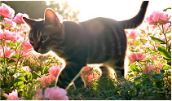

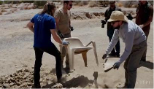




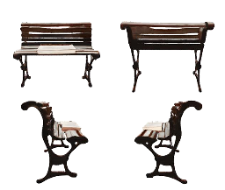
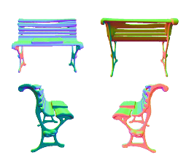
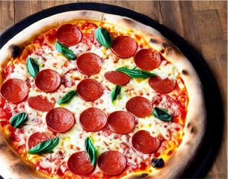
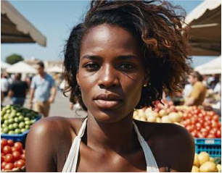
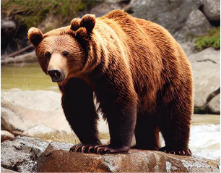

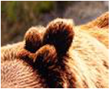
(a)
Video
Abnormal
Frame
Raw
Videos
0:00
0:02:54
0:06:27
0:12:51
0:16:13
0:20
Overall
Abnormal
Abnormal
Fragment
A
Abnormal
Fragment
B
“1.
The
sand
in
the
video
transforms
into
plastic
and
“In
the
extracted
video
segment,
a
piece
of
“In
the
extracted
video
segment,
the
chair
then
into
a
chair.
and
plastic
seemingly
grows
out
of
the
ground
detaches
from
people's
hands
and
floats
in
2.
The
chair
floats
from
thin
air
and
then
gradually
transforms
mid
-
air,
which
contradicts
the
reality
of
moves
in
mid
-
air
without
into
a
chair.
This
process
does
not
align
with
gravity.
Additionally,
the
shape
of
the
chair
anyone
holding
it.”
how
things
occur
in
reality.”
changes
over
time.”
(b)
Image
(b)
3D
Object
Overall
Abnormal
“The
overall
saturation
of
the
image
is
relatively
high,
the
Texture
Normal
shadow
expression
is
incorrect,
and
there
is
a
certain
degree
of
distortion
in
the
image.”
Abnormal
Area
Abnormal
Texture
Abnormal
Normal
Abnormal
“The
ears
of
the
bear
“The
surface
texture
of
the
“The
surface
normals
of
the
are
asymmetrical
chair
and
the
book
is
slightly
chair
and
the
book
are
and
the
number
is
blurred,
and
there
is
some
relatively
smooth,
…,
where
Raw
Images
incorrect.”
blending
of
the
edges
of
the
the
shapes
of
the
book
and
book
and
the
chair
…
”
the
chair
merge
together.
Notes:
ReFigure editable reconstruction — not author-provided PowerPoint.
Multimodal anomaly annotation schema
Source: https://arxiv.org/abs/2410.09732v2
Approved image: fig3_multimodal_annotation_schema.png; SHA-256: 1fddfd439f3c5f5381c747063d209b2c31e69a0001c6c888d784b0eeacbe8792
Readable diagram labels and vector geometry are native editable PowerPoint objects. Some equations, small ticks, and unavailable font symbols are exact or traced native vector outlines rather than typeable text/live equations. Arrow paths are not endpoint-bound connectors; plot paths are not data-bound charts. Photos/screenshots/complex illustrations and local effects remain independent raster objects (20), whose internal pixels are not editable.
Font substitution: source PDF families mapped to Times New Roman, Segoe Print (installed Windows fonts). Some shadows, gradients, and antialiasing are approximate; this is not pixel-identical author source. Source crop boundaries are preserved.
Final-file renderer: Artifact Tool PPTX roundtrip; this is not a PowerPoint application compatibility test.

Slide 3
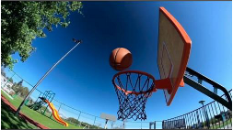
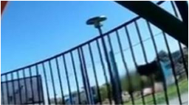













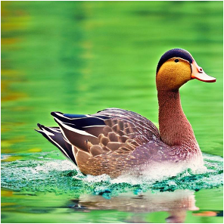
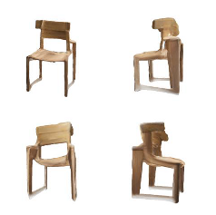
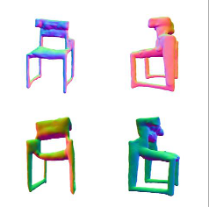





(a)
Overall
-
Abnormal
Legend
The
texture
and
geometry
of
the
background
Abnormal
Frame
railings
and
pole
sections
appear
distorted
Abnormal
Fragment
and
blurry.
Raw
Videos
0:05:63
0:06:78
0:07:89
0:08:14
0:00
8:52
Abnormal
Fragment
Abnormal
Fragment
When
the
basketball
passed
through
the
The
structure
of
the
basket
frame
was
hoop,
unexpected
flames
emerged
in
the
intact
and
undamaged,
yet
the
basketball
vicinity
of
the
basket.
passed
directly
through
it.
(b)
(c)
Overall
Abnormal
Area
1
The
surface
texture
of
the
duck
has
poor
clarity
and
fineness,
the
texture
is
blurred
and
there
are
large
differences
in
texture
between
different
areas.
The
overall
color
saturation
of
the
picture
is
Area
2
too
high,
the
color
is
distorted,
and
it
does
not
match
the
actual
situation.
Texture
Abnormal
Normal
Abnormal
Area
Abnormal
The
texture
characteristics
of
There
are
abnormal
bumps
Area
1
：
the
stool
vary
from
different
and
bulges
on
the
stool's
The
duck's
eye
texture
is
abnormal
and
does
not
match
the
real
angles.
The
wood
grain
on
the
geometric
surface,
and
the
eye
texture.
The
nose
structure
is
wrong.
side
of
the
stool
is
not
as
clear
geometric
shapes
on
both
as
the
front.
The
edges
of
the
sides
of
the
stool
are
Area
2
：
stool
texture
are
not
clear
and
asymmetrical,
which
does
not
In
calm
water
areas,
the
reflection
on
the
water
surface
is
not
cannot
be
identified.
There
are
conform
to
the
actual
symmetrical
with
the
duck
above
the
water
surface,
and
there
is
a
abnormal
white
textures
on
situation
of
a
stool.
clear
mismatch
between
the
reflection
and
the
duck
itself.
the
legs
of
the
stool.
Notes:
ReFigure editable reconstruction — not author-provided PowerPoint.
Multimodal synthetic-data annotation process
Source: https://arxiv.org/abs/2410.09732v2
Approved image: fig11_annotation_process_details.png; SHA-256: 04f86d3e577a011fc45d99ba9e8e8d7a3c3ea838dede80ec75ea25b53d6a6682
Readable diagram labels and vector geometry are native editable PowerPoint objects. Some equations, small ticks, and unavailable font symbols are exact or traced native vector outlines rather than typeable text/live equations. Arrow paths are not endpoint-bound connectors; plot paths are not data-bound charts. Photos/screenshots/complex illustrations and local effects remain independent raster objects (26), whose internal pixels are not editable.
Font substitution: source PDF families mapped to Times New Roman, Consolas, Arial, DengXian, Calibri (installed Windows fonts). Some shadows, gradients, and antialiasing are approximate; this is not pixel-identical author source. Source crop boundaries are preserved.
Final-file renderer: Artifact Tool PPTX roundtrip; this is not a PowerPoint application compatibility test.

Slide 4
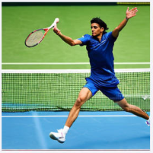
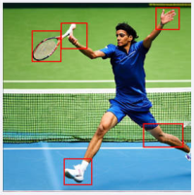





Task Description:
We request your assistance in
Instructions
evaluating the response of an
AI assistant to the question ...
Evaluation Dimensions:
Score
Global Score ;
GPT-4o
Reference Image
Synthetic Image
Completeness ;
Evaluator
Final Scoring:
Global Score (4-Good)
: The assistant effectively
Correctness ;
(4-4-4-5) Total: 17
captured the overall visual inconsistencies, such as
Reason:
unnatural poses and lighting issues, …
Plausibility ;
Completeness (4-Good)
: The assistant identified
Data
Overall, the image appears
most of the regions marked by the human annotators,
Scoring Range:
inauthentic primarily due
including the athlete’s pose, racket and hand …
Answer
to slight distortions and
Correctness (4-Good)
: The assistant’s explanations
1 - Poor 2 - Fair 3 - Average
were mostly aligned with the annotations. It correctly
unnatural poses that are
identified issues with … However, it did not fully capture
4 - Good 5 - Excellent
often characteristic of AI-
the blending issues with the shoe and sock …
Example: ...
generated images …
Plausibility (5-Excellent)
: The assistant did not
incorrectly identify authentic regions as inauthentic. It
also avoided adding regions beyond those marked.
Notes:
ReFigure editable reconstruction — not author-provided PowerPoint.
GPT-4o evaluation pipeline
Source: https://arxiv.org/abs/2410.09732v2
Approved image: fig12_gpt4o_evaluation_pipeline.png; SHA-256: 501a6e99fcbd2c6e6c7982e5cb51557cad5112343f9ae88684af0dfa96752938
Readable diagram labels and vector geometry are native editable PowerPoint objects. Some equations, small ticks, and unavailable font symbols are exact or traced native vector outlines rather than typeable text/live equations. Arrow paths are not endpoint-bound connectors; plot paths are not data-bound charts. Photos/screenshots/complex illustrations and local effects remain independent raster objects (7), whose internal pixels are not editable.
Font substitution: source PDF families mapped to Times New Roman, Calibri (installed Windows fonts). Some shadows, gradients, and antialiasing are approximate; this is not pixel-identical author source. Source crop boundaries are preserved.
Final-file renderer: Artifact Tool PPTX roundtrip; this is not a PowerPoint application compatibility test.

