Slide 1


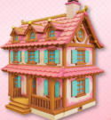

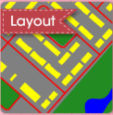
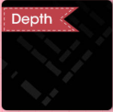
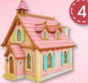
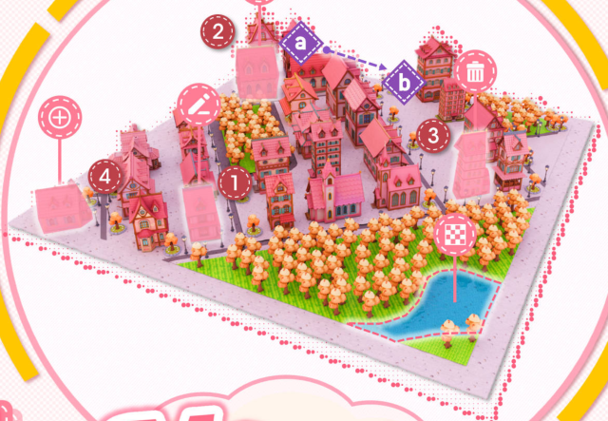






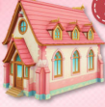




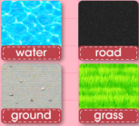
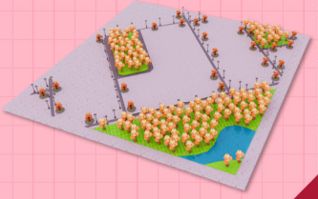





CITY AGENT
INPUT:
An autumn anime-style scene with pink buildings
1
in a land with sunset pink and purple lighting.
Edit
edit to
Step 1:
Layout/Height map Generation
4
Add
add
to scene
Step 2:
Assets Generation
3
Del
delete
1
2
3
from scene
Move
2
from
Step 3:
Terrain Generation
to
Replace
replace
INPUT:
Please EDIT / ADD / DEL / MOVE / REPL-
CITY GENERATION
ACE the asset X ...
Notes:
ReFigure editable reconstruction — not author-provided PowerPoint.
MajutsuCity fig1
Source: https://arxiv.org/abs/2511.20415v2
Approved image: fig1_language_driven_city_generation_and_editing.png; SHA-256: 1cbdfa73e0934a1136e155e3782ec03c58697d79755139ff4541b3c387db199e
The reference PDF artwork is raster-only. Primary readable captions, stage/module labels, panels, category badges, arrow paths and diagram geometry are reconstructed native editable PowerPoint objects. Arrow paths are freeforms, not endpoint-bound connectors. Original 3D buildings/cities, maps, noise tensors, materials, skyboxes, source logos, small pictograms and embedded local illustration annotations remain named independent raster objects (29); their internal pixels are not editable. No whole-figure screenshot or full-slide backdrop is used.
Source font identities are unavailable from flattened artwork. Installed Arial, Calibri approximate the source typefaces. Pattern frequency, shadows, some decorative icons and antialiasing differ; this is not pixel-identical author source. Source crop boundaries and original evidence are preserved.
Final-file renderer: Artifact Tool PPTX roundtrip; this is not a PowerPoint application compatibility test.

