Slide 1




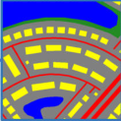
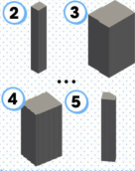
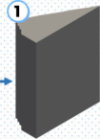





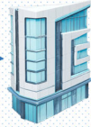






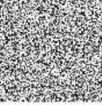
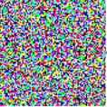

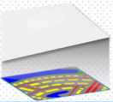
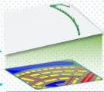
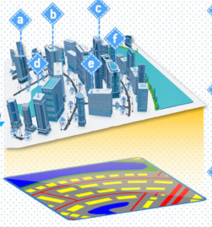
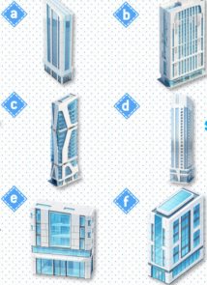
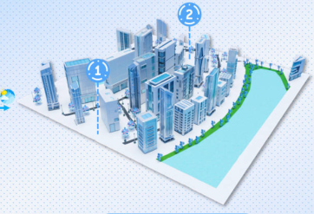




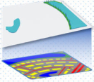
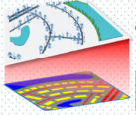





1
SCENE DESIGN
LEGEND
INPUT:
A technological scene with white-blue buildings
Frozen
stand atop a white marble floor, and the leaves of the
Layout Planning
Assets Design
Materials Design
Skymap Design
trees have glassy texture. The sky is blue with white clouds.
Tunable
2
LAYOUT GENERATION
3
ASSETS/MATERIALS GENERATION
A radial
road network (red)
× T
MATERIALS GENERATION
with prominent concentric
Diffusion
optional
curves. Rectangular
buildings
LongCLIP
surface
(yellow)...
Vegetation (green)
U-Net
Materials Design
is in the northeast, bordering
sampling
a large
water body (blue)
in
the north...
Ground
Road
Layout Map
Grass
Water
Condition
Assets Design
condition
3D generation
360° Skybox
Encoder
material generation
Diffusion
U-Net
× T
Height Map
ASSETS GENERATION
4
SCENE GENERATION
add
to
Add Asset
A
Step 1: add
delete
to
Del Asset
D
1
Terrain Generation
Step 2: add
2
Nature Generation
Step 5: add
Step 4: add
edit
to
Edit Asset
E
Step 3: add
move
to
Move Asset
M
6
Skybox Adding
replace
to
Replace
R
3
Water Generation
4
Road Generation
5
Assets Placing
Material
Notes:
ReFigure editable reconstruction — not author-provided PowerPoint.
MajutsuCity fig2
Source: https://arxiv.org/abs/2511.20415v2
Approved image: fig2_majutsucity_framework.png; SHA-256: 41d26b9436e0026cab14b96ed8f371246b724bd9fcf86d8075192a21f566be0f
The reference PDF artwork is raster-only. Primary readable captions, stage/module labels, panels, category badges, arrow paths and diagram geometry are reconstructed native editable PowerPoint objects. Arrow paths are freeforms, not endpoint-bound connectors. Original 3D buildings/cities, maps, noise tensors, materials, skyboxes, source logos, small pictograms and embedded local illustration annotations remain named independent raster objects (78); their internal pixels are not editable. No whole-figure screenshot or full-slide backdrop is used.
Source font identities are unavailable from flattened artwork. Installed Arial approximate the source typefaces. Pattern frequency, shadows, some decorative icons and antialiasing differ; this is not pixel-identical author source. Source crop boundaries and original evidence are preserved.
Final-file renderer: Artifact Tool PPTX roundtrip; this is not a PowerPoint application compatibility test.

