Slide 1


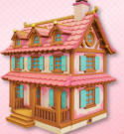

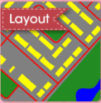
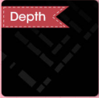
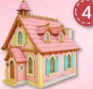
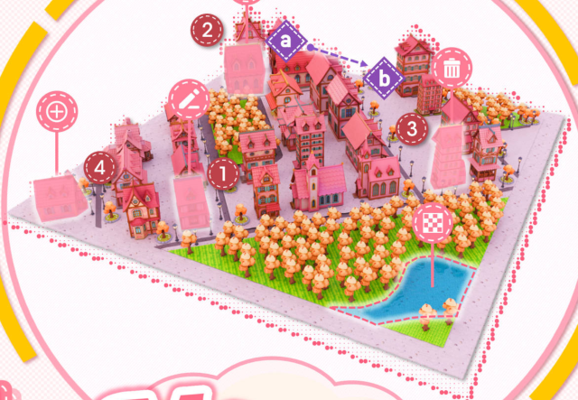




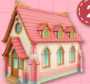

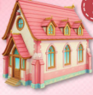



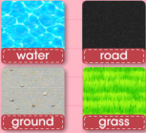

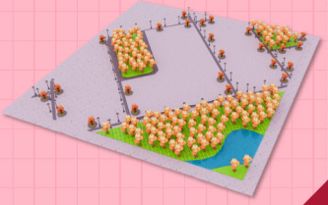





CITY AGENT
INPUT:
An autumn anime-style scene with pink buildings
1
in a land with sunset pink and purple lighting.
Edit
edit to
Step 1:
Layout/Height map Generation
4
Add
add
to scene
Step 2:
Assets Generation
3
Del
delete
1
2
3
from scene
Move
2
from
Step 3:
Terrain Generation
to
Replace
replace
INPUT:
Please EDIT / ADD / DEL / MOVE / REPL-
CITY GENERATION
ACE the asset X ...
Notes:
ReFigure editable reconstruction — not author-provided PowerPoint.
MajutsuCity fig1
Source: https://arxiv.org/abs/2511.20415v2
Approved image: fig1_language_driven_city_generation_and_editing.png; SHA-256: 1cbdfa73e0934a1136e155e3782ec03c58697d79755139ff4541b3c387db199e
The reference PDF artwork is raster-only. Primary readable captions, stage/module labels, panels, category badges, arrow paths and diagram geometry are reconstructed native editable PowerPoint objects. Arrow paths are freeforms, not endpoint-bound connectors. Original 3D buildings/cities, maps, noise tensors, materials, skyboxes, source logos, small pictograms and embedded local illustration annotations remain named independent raster objects (29); their internal pixels are not editable. No whole-figure screenshot or full-slide backdrop is used.
Source font identities are unavailable from flattened artwork. Installed Arial, Calibri approximate the source typefaces. Pattern frequency, shadows, some decorative icons and antialiasing differ; this is not pixel-identical author source. Source crop boundaries and original evidence are preserved.
Final-file renderer: Artifact Tool PPTX roundtrip; this is not a PowerPoint application compatibility test.

Slide 2




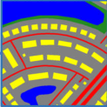
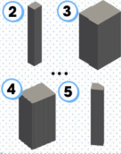
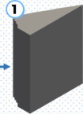





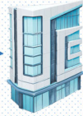





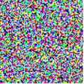

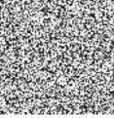

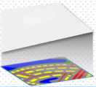
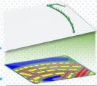
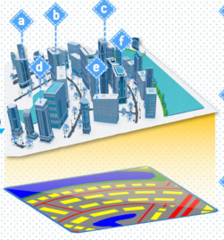
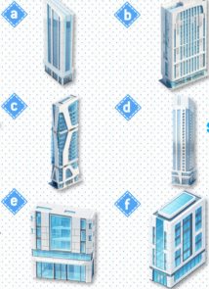
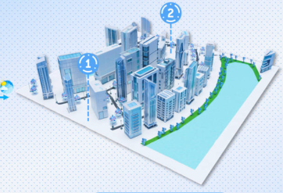




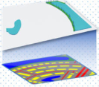
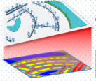





1
SCENE DESIGN
LEGEND
INPUT:
A technological scene with white-blue buildings
Frozen
stand atop a white marble floor, and the leaves of the
Layout Planning
Assets Design
Materials Design
Skymap Design
trees have glassy texture. The sky is blue with white clouds.
Tunable
2
LAYOUT GENERATION
3
ASSETS/MATERIALS GENERATION
A radial
road network (red)
× T
MATERIALS GENERATION
with prominent concentric
Diffusion
optional
curves. Rectangular
buildings
LongCLIP
surface
(yellow)...
Vegetation (green)
U-Net
Materials Design
is in the northeast, bordering
sampling
a large
water body (blue)
in
the north...
Ground
Road
Layout Map
Grass
Water
Condition
Assets Design
condition
3D generation
360° Skybox
Encoder
material generation
Diffusion
U-Net
× T
Height Map
ASSETS GENERATION
4
SCENE GENERATION
add
to
Add Asset
A
Step 1: add
delete
to
Del Asset
D
1
Terrain Generation
Step 2: add
2
Nature Generation
Step 5: add
Step 4: add
edit
to
Edit Asset
E
Step 3: add
move
to
Move Asset
M
6
Skybox Adding
replace
to
Replace
R
3
Water Generation
4
Road Generation
5
Assets Placing
Material
Notes:
ReFigure editable reconstruction — not author-provided PowerPoint.
MajutsuCity fig2
Source: https://arxiv.org/abs/2511.20415v2
Approved image: fig2_majutsucity_framework.png; SHA-256: 41d26b9436e0026cab14b96ed8f371246b724bd9fcf86d8075192a21f566be0f
The reference PDF artwork is raster-only. Primary readable captions, stage/module labels, panels, category badges, arrow paths and diagram geometry are reconstructed native editable PowerPoint objects. Arrow paths are freeforms, not endpoint-bound connectors. Original 3D buildings/cities, maps, noise tensors, materials, skyboxes, source logos, small pictograms and embedded local illustration annotations remain named independent raster objects (78); their internal pixels are not editable. No whole-figure screenshot or full-slide backdrop is used.
Source font identities are unavailable from flattened artwork. Installed Arial approximate the source typefaces. Pattern frequency, shadows, some decorative icons and antialiasing differ; this is not pixel-identical author source. Source crop boundaries and original evidence are preserved.
Final-file renderer: Artifact Tool PPTX roundtrip; this is not a PowerPoint application compatibility test.

Slide 3



















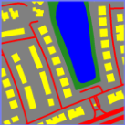


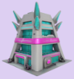








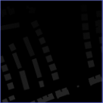
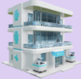





The road network centers on a
main north-south road and a
curving southeast route, lined with
dense rectangular buildings. An
elongated central water body,
likely a pond or small lake...
Caption
NewYear
Van Gogh
Halloween
Christmas
Materials
Layout Map
MC
Anime
Ghibli
CyberPunk
Hitem3D
Hyper3D
Hunyuan3D
Meshy
Technology
Tripo3D
Middle Ages
Height Map
Skybox
OSM
3D BUILDING MODELS
TEXTURE MAP
Notes:
ReFigure editable reconstruction — not author-provided PowerPoint.
MajutsuCity fig3
Source: https://arxiv.org/abs/2511.20415v2
Approved image: fig3_majutsudataset_component_overview.png; SHA-256: f4df300deade11671b3ccf0f89149a49bdaf37c96508e994d1ffb6ee8eb015c2
The reference PDF artwork is raster-only. Primary readable captions, stage/module labels, panels, category badges, arrow paths and diagram geometry are reconstructed native editable PowerPoint objects. Arrow paths are freeforms, not endpoint-bound connectors. Original 3D buildings/cities, maps, noise tensors, materials, skyboxes, source logos, small pictograms and embedded local illustration annotations remain named independent raster objects (53); their internal pixels are not editable. No whole-figure screenshot or full-slide backdrop is used.
Source font identities are unavailable from flattened artwork. Installed Arial approximate the source typefaces. Pattern frequency, shadows, some decorative icons and antialiasing differ; this is not pixel-identical author source. Source crop boundaries and original evidence are preserved.
Final-file renderer: Artifact Tool PPTX roundtrip; this is not a PowerPoint application compatibility test.

