Slide 1


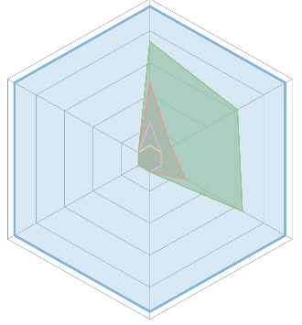

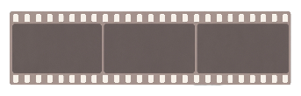
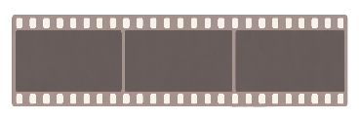













This
is
a
basketball
player
moving
along
the
court
.
(1)
Player
#6
dribbles
right
and
releases
a
three-point
shot
at
t
=
0.8s
.The
ball
METEOR
At
t
1
,
he
is
at
[x
1
,
y
1
,
z
1
]
.
At
t
2
,
he
is
at
[x
2
,
y
2
,
z
2
]
…
is
intercepted
by
#4
at
t
=
1.1s
(2)
#6
's
3D
trajectory
(world
coords,
meters):
smooth
curve
from
(x=2.1,
y=4.3,
z=0.0)
at
0.5s
→
(4.8,
5.7,
0.0)
at
1.2s
.
z
#ball
45.3
Large
Language
Model
Large
Language
Model
#6
TAcc
CIDEr
Tracjetory
@0.5m
69.8
(C@0.5)
Decoder
y
61.9
x
…
[x]
[y]
[z]
[t]
…
…
[x]
[y]
[z]
[t]
[TRK]
[TRK]
…
Vision
4D
Coordinate
Vision
Ray-
Time
Geometry
turn
1
Encoder
Encoder
Where
is
the
Encoder
Encoder
Who
scored
the
three-
32.2
basketball
pointer
around
t
=
0.8s,
TrajAcc
62.6
BLEU
-4
and
what
happened
to
the
@1.0m
(B@4)
player
on
the
ball
afterward?
court
at
frames
turn
2
[TRK]
75.8
t
,
t
,
t
?
#ball
Now
plot
#6
's
SAcc
1
2
3
#ball
#ball
continuous
3D
trajectory
@0.5m
from
t
=
0.5s
to
t
=
1.2s
.
Video-3D-LLM
Qwen2.5-VL-7B
LLaVA-Video
Multi-View
Instruction
Multi-View
Instruction
Qwen3.5-9B
LMM-Track4D
(a)
4D
LMM
(b)
LMM-Track4D
(Ours)
(c)
Perfor
mance
Radar
(1)
Multi-turn
Trajectory
QA
(2)
Occlusion
Recovery
(3)
Identity-Preserving
Multi-Object
Dialog
#6
Q(turn
1):
Who
scored
the
three-pointer
#1
at
t=0.8s?
Q(turn
1):
Is
there
a
cyclist
near
the
van
Q(turn
1):
Who
are
the
foreground
#ball
Q(turn
2):
Show
his
trajectory
from
0.5s
at
t=1.0s?
pedestrians?
to
1.2s
Q(turn
2):
Where
is
the
cyclist
during
Q(turn
2):
Trajectory
of
the
one
with
1.0–2.0s
when
occluded
by
the
car
?
…
the
backpack
.
4D
LMM
T1:
A
player
at
t=0.8s,
[x,y,z].
✗
4D
LMM
T1:
Cyclist
at
t=1.0s,
[x
₁
,y
₁
,z
₁
]
.
✗
T1:
Three
pedestrians
at
t=0.5s.
✗
T2:
Identity
lost;
new
player
at
t=0.8s.
T2:
Position
at
t=2.0s
unknown.
4D
LMM
T2:
ID
lost
between
turns.
T1:
Player
#6
scored
the
3-pointer
at
t=0.8s
.
✓
T1:
Cyclist
#1
beside
the
van
at
t=1.0s,
(5.4,
−1.2,
✓
T1:
#1
(backpack),
#2
(dark
coat),
#3
(squatting).
✓
Ours
T2:
#6
's
trajectory
0.5
→
1.2s
:
smooth
right-
Ours
0.0)
.T2:
#1
tracked
through
occlusion
via
[TRK]
state;
Ours
T2:
#1
trajectory
0.5
→
2.0s:
smooth
path
across
wing
curve
toward
arc,
peak
z=2.1m
at
0.9s
.
continuous
trajectory
1.0–2.0s,
re-emerges
at
(8.2,
plaza,
(1.2,
3.4,
0.0)
→
(3.0,
5.6,
0.0)
.
−1.3,
0.0)
at
t=2.0s
.
(d)
Task
Showcases
Notes:
ReFigure editable reconstruction — not author-provided PowerPoint.
Figure 1: fig1 task and model overview
Source: https://arxiv.org/abs/2605.19390v1
Approved image: fig1_task_and_model_overview.png; SHA-256: d63355c64046df6710ca282dfe1cb27a2fa706f334bcd226cc02878cc5cd1ffc
Readable diagram labels and vector geometry are native editable PowerPoint objects. Some equations, small ticks, and unavailable font symbols are exact or traced native vector outlines rather than typeable text/live equations. Arrow paths are not endpoint-bound connectors; plot paths are not data-bound charts. Photos/screenshots/complex illustrations and local effects remain independent raster objects (24), whose internal pixels are not editable.
Font substitution: source PDF families mapped to Times New Roman, Arial (installed Windows fonts). Some shadows, gradients, and antialiasing are approximate; this is not pixel-identical author source. Source crop boundaries are preserved.
Final-file renderer: Artifact Tool PPTX roundtrip; this is not a PowerPoint application compatibility test.

