Slide 1





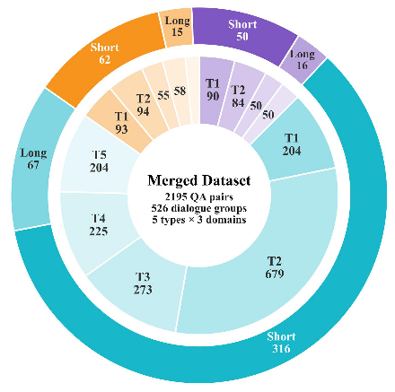




















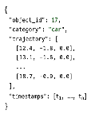






















(
a
)
Track4D-Bench
Statistics
(
b
)
Type
of
Dialogue
Questions
(
c
)
Track4D-Bench
Construction
APIDIS(14.6%)
WildTrack(12.5%)
Type
1-
Identity
Stage
1
:
State
Preparation
77
dialogue
groups
66
dialogue
groups
Who
is
near
(18.2,
4.5,
0.3)
?
ID
Trajectory
Time
336
QA
pairs
274
QA
pairs
A
young
man
in
a
light
blue
shirt,
standing
nearly
still.
Multi-view
2D
3D
Grounding
Camera
3D
Multi-View
Type
2
-
Trajectory
Stage
2
:
Clip
Formation
Track
that
man
from
10s
to
15s?
Short
Here
is
the
track:
[Trajectory]
.
The
man
stays
nearly
in
place
.
Long
Type
3
-
Relation
t
1
t
n
How
do
the
two
people
near
Stage
3
:
Dialogue
Construction
(
18.2,
4.5,
0.3)
relate?
Clip
Package
Query-conditioned
Multi-turn
Dialogue
They
stay
very
close
but
do
not
move
together.
KITTI(72.8%)
Type
4
-
Motion
Trend
Various
Types
of
Dialogue
Questions
383
dialogue
groups
How
does
the
silver
car
move
Object-Centric
Visual
Evidence
1585
QA
pairs
over
the
clip?
(
d
)
Track4D-Bench
Diagnostic
Scope
It
moves
steadily
forward
with
Stage
4
:
Quality
Control
a
slight
leftward
drift
.
Human
Verify
Continuous
state
History-conditioned
Judge
grounding
identity
consistency
Type
5
-
Scene
Level
428
Short
Can
you
sum
the
traffic
scene?
VLM
+
98
Long
Geometry-grounded
Long-horizon
A
multi-lane
highway
with
steady
LLM
4D
reasoning
continuity
traffic
flow.
Notes:
ReFigure editable reconstruction — not author-provided PowerPoint.
Figure 2: fig2 track4d benchmark construction
Source: https://arxiv.org/abs/2605.19390v1
Approved image: fig2_track4d_benchmark_construction.png; SHA-256: ca7aac804626a9a0c8d0783ea40fb8395cf5b95918aae04154cf5657ace24897
Readable diagram labels and vector geometry are native editable PowerPoint objects. Some equations, small ticks, and unavailable font symbols are exact or traced native vector outlines rather than typeable text/live equations. Arrow paths are not endpoint-bound connectors; plot paths are not data-bound charts. Photos/screenshots/complex illustrations and local effects remain independent raster objects (84), whose internal pixels are not editable.
Font substitution: source PDF families mapped to Times New Roman (installed Windows fonts). Some shadows, gradients, and antialiasing are approximate; this is not pixel-identical author source. Source crop boundaries are preserved.
Final-file renderer: Artifact Tool PPTX roundtrip; this is not a PowerPoint application compatibility test.

