Slide 1
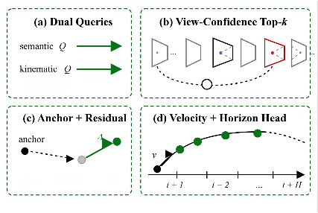
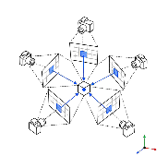
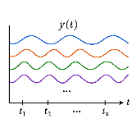



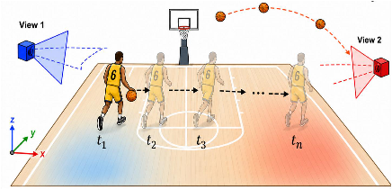
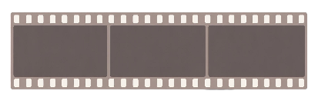








a
t
t
1
1
1
t
2
2
2
Player
#6
dribbles
right
and
releases
three-poin
shot
at
0.8s.Trajectory:at
=
[x
,y
,z1
],
=
[x
,y
,
z
2]
,
...
,
tn
=
[xn
,
yn
,z
n]
Pretrained Large Language Model (Qwen3.5-9B)
Projector
Projector
Projector
★
Visual Tokens
[TRK]Tokens
Linguistic Tokens
★
OSK-RA Decoder
(State-Memory Slots)
...
[
TRK
]
[
TRK
]
[
TRK
]
Cross-Attention Fusion
Ray-Time Geometry Encoding(RTGE)
[TRK]State-Memory
Language Embedding
[
TRK
]
Player
#6
Word
Position
Time
TrackID
[
TRK
]
Ball
Word Encoder
Position Encoder
Time Encoder
[
TRK
]
Player
#4
Text Tokenizer
Vision Encoder
4D Coordinate Encoder
Multi-turn Language Instruction
Multi-view 2D Input
4D Coordinate
W
h
o
s
core
d
the
t
h
re
e-pointer
at
View
1
View
2
Vi
e
w
3
0.8s
?
Sh
o
w
the
tra
j
ect
or
y
o
f
p
l
aye
r
#6
f
r
om
0.5s
to
1
.2
s
.
Notes:
ReFigure editable reconstruction — not author-provided PowerPoint.
Figure 3: fig3 lmm track4d method overview
Source: https://arxiv.org/abs/2605.19390v1
Approved image: fig3_lmm_track4d_method_overview.png; SHA-256: e8973f09714ce2216b93275b61f2a45eaf271ea22bbbcf3007c083403787c262
Readable diagram labels and vector geometry are native editable PowerPoint objects. Some equations, small ticks, and unavailable font symbols are exact or traced native vector outlines rather than typeable text/live equations. Arrow paths are not endpoint-bound connectors; plot paths are not data-bound charts. Photos/screenshots/complex illustrations and local effects remain independent raster objects (23), whose internal pixels are not editable.
Font substitution: source PDF families mapped to Times New Roman, Arial (installed Windows fonts). Some shadows, gradients, and antialiasing are approximate; this is not pixel-identical author source. Source crop boundaries are preserved.
Final-file renderer: Artifact Tool PPTX roundtrip; this is not a PowerPoint application compatibility test.

