Slide 1


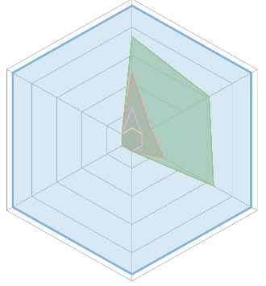

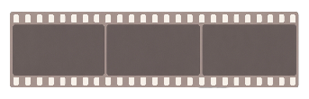
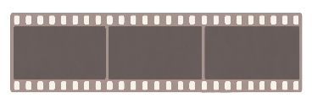













This
is
a
basketball
player
moving
along
the
court
.
(1)
Player
#6
dribbles
right
and
releases
a
three-point
shot
at
t
=
0.8s
.The
ball
METEOR
At
t
1
,
he
is
at
[x
1
,
y
1
,
z
1
]
.
At
t
2
,
he
is
at
[x
2
,
y
2
,
z
2
]
…
is
intercepted
by
#4
at
t
=
1.1s
(2)
#6
's
3D
trajectory
(world
coords,
meters):
smooth
curve
from
(x=2.1,
y=4.3,
z=0.0)
at
0.5s
→
(4.8,
5.7,
0.0)
at
1.2s
.
z
#ball
45.3
Large
Language
Model
Large
Language
Model
#6
TAcc
CIDEr
Tracjetory
@0.5m
61.9
69.8
(C@0.5)
Decoder
x
y
…
[x]
[y]
[z]
[t]
…
…
[x]
[y]
[z]
[t]
[TRK]
[TRK]
…
Vision
4D
Coordinate
Vision
Ray-
Time
Geometry
turn
1
Encoder
Encoder
Where
is
the
Encoder
Encoder
Who
scored
the
three-
62.6
32.2
basketball
pointer
around
t
=
0.8s,
TrajAcc
BLEU
-4
and
what
happened
to
the
@1.0m
(B@4)
player
on
the
ball
afterward?
court
at
frames
turn
2
[TRK]
75.8
t
,
t
,
t
?
#ball
#ball
Now
plot
#6
's
SAcc
1
2
3
#ball
continuous
3D
trajectory
@0.5m
from
t
=
0.5s
to
t
=
1.2s
.
Video-3D-LLM
Qwen2.5-VL-7B
LLaVA-Video
Multi-View
Instruction
Multi-View
Instruction
Qwen3.5-9B
LMM-Track4D
(a)
4D
LMM
(b)
LMM-Track4D
(Ours)
(c)
Perfor
mance
Radar
(1)
Multi-turn
Trajectory
QA
(2)
Occlusion
Recovery
(3)
Identity-Preserving
Multi-Object
Dialog
#6
Q(turn
1):
Who
scored
the
three-pointer
#1
there
cyclist
are
foreground
at
t=0.8s?
Q(turn
1):
Is
a
near
the
van
Q(turn
1):
Who
the
#ball
Q(turn
2):
Show
his
trajectory
from
0.5s
at
t=1.0s?
Where
cyclist
during
pedestrians?
Trajectory
to
1.2s
Q(turn
2):
is
the
…
Q(turn
2):
of
the
one
with
1.0–2.0s
when
occluded
by
the
car
?
the
backpack
.
4D
LMM
T1:
A
player
at
t=0.8s,
[x,y,z].
✗
4D
LMM
T1:
Cyclist
at
t=1.0s,
[x
₁
,y
₁
,z
₁
]
.
✗
T1:
Three
pedestrians
at
t=0.5s.
✗
T2:
Identity
lost;
new
player
at
t=0.8s.
T2:
Position
at
t=2.0s
unknown.
4D
LMM
T2:
ID
lost
between
turns.
T1:
Player
#6
scored
the
3-pointer
at
t=0.8s
.
✓
T1:
Cyclist
#1
beside
the
van
at
t=1.0s,
(5.4,
−1.2,
✓
T1:
#1
(backpack),
#2
(dark
coat),
#3
(squatting).
✓
Ours
T2:
#6
's
trajectory
0.5
→
1.2s
:
smooth
right-
Ours
0.0)
.T2:
#1
tracked
through
occlusion
via
[TRK]
state;
Ours
T2:
#1
trajectory
0.5
→
2.0s:
smooth
path
across
wing
curve
toward
arc,
peak
z=2.1m
at
0.9s
.
continuous
trajectory
1.0–2.0s,
re-emerges
at
(8.2,
plaza,
(1.2,
3.4,
0.0)
→
(3.0,
5.6,
0.0)
.
−1.3,
0.0)
at
t=2.0s
.
(d)
Task
Showcases
Notes:
ReFigure editable reconstruction — not author-provided PowerPoint.
Figure 1: fig1 task and model overview
Source: https://arxiv.org/abs/2605.19390v1
Approved image: fig1_task_and_model_overview.png; SHA-256: d63355c64046df6710ca282dfe1cb27a2fa706f334bcd226cc02878cc5cd1ffc
Readable diagram labels and vector geometry are native editable PowerPoint objects. Some equations, small ticks, and unavailable font symbols are exact or traced native vector outlines rather than typeable text/live equations. Arrow paths are not endpoint-bound connectors; plot paths are not data-bound charts. Photos/screenshots/complex illustrations and local effects remain independent raster objects (24), whose internal pixels are not editable.
Font substitution: source PDF families mapped to Times New Roman, Arial (installed Windows fonts). Some shadows, gradients, and antialiasing are approximate; this is not pixel-identical author source. Source crop boundaries are preserved.
Final-file renderer: Artifact Tool PPTX roundtrip; this is not a PowerPoint application compatibility test.

Slide 2






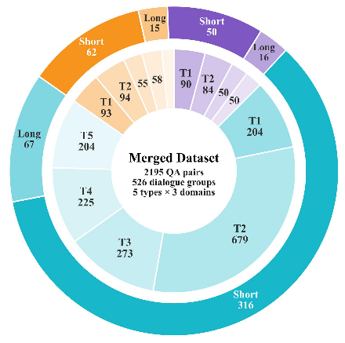




















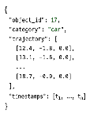





















(
a
)
Track4D-Bench
Statistics
(
b
)
Type
of
Dialogue
Questions
(
c
)
Track4D-Bench
Construction
APIDIS(14.6%)
WildTrack(12.5%)
Type
1-
Identity
Stage
1
:
State
Preparation
77
dialogue
groups
66
dialogue
groups
Who
is
near
(18.2,
4.5,
0.3)
?
ID
Trajectory
Time
336
QA
pairs
274
QA
pairs
A
young
man
in
a
light
blue
shirt,
standing
nearly
still.
Type
Multi-view
2D
3D
Grounding
Camera
3D
Multi-View
2
-
Trajectory
Stage
2
:
Clip
Formation
Track
that
man
from
10s
to
15s?
Short
Here
is
the
track:
[Trajectory]
.
The
man
stays
nearly
in
place
.
Long
Type
3
-
Relation
t
1
t
n
How
do
the
two
people
near
Stage
3
:
Dialogue
Construction
(
18.2,
4.5,
0.3)
relate?
Clip
Package
Query-conditioned
Multi-turn
Dialogue
They
stay
very
close
but
do
not
move
together.
KITTI(72.8%)
Type
4
-
Motion
Trend
Various
Types
of
Dialogue
Questions
383
dialogue
groups
How
does
the
silver
car
move
Object-Centric
Visual
Evidence
1585
QA
pairs
over
the
clip?
(
d
)
Track4D-Bench
Diagnostic
Scope
It
moves
steadily
forward
with
Stage
4
:
Quality
Control
Continuous
state
History-conditioned
a
slight
leftward
drift
.
Human
Verify
grounding
identity
consistency
Type
5
-
Scene
Level
Judge
428
Short
Can
you
sum
the
traffic
scene?
VLM
+
98
Long
Geometry-grounded
Long-horizon
A
multi-lane
highway
with
steady
LLM
4D
reasoning
continuity
traffic
flow.
Notes:
ReFigure editable reconstruction — not author-provided PowerPoint.
Figure 2: fig2 track4d benchmark construction
Source: https://arxiv.org/abs/2605.19390v1
Approved image: fig2_track4d_benchmark_construction.png; SHA-256: ca7aac804626a9a0c8d0783ea40fb8395cf5b95918aae04154cf5657ace24897
Readable diagram labels and vector geometry are native editable PowerPoint objects. Some equations, small ticks, and unavailable font symbols are exact or traced native vector outlines rather than typeable text/live equations. Arrow paths are not endpoint-bound connectors; plot paths are not data-bound charts. Photos/screenshots/complex illustrations and local effects remain independent raster objects (84), whose internal pixels are not editable.
Font substitution: source PDF families mapped to Times New Roman (installed Windows fonts). Some shadows, gradients, and antialiasing are approximate; this is not pixel-identical author source. Source crop boundaries are preserved.
Final-file renderer: Artifact Tool PPTX roundtrip; this is not a PowerPoint application compatibility test.

Slide 3
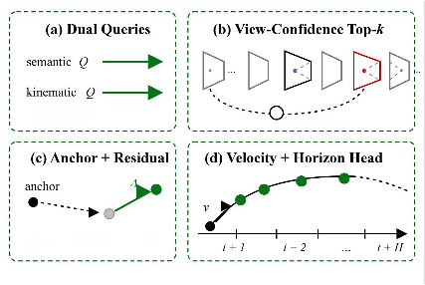
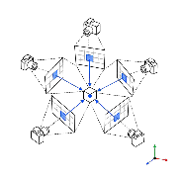
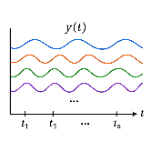



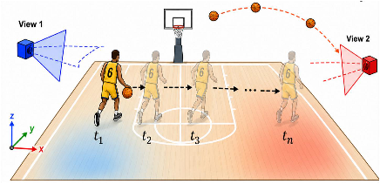
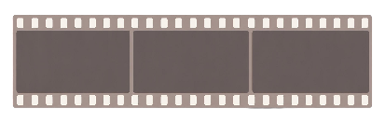








a
t
t
1
1
1
t
2
2
2
Player
#6
dribbles
right
and
releases
three-poin
shot
at
0.8s.Trajectory:at
=
[x
,y
,z1
],
=
[x
,y
,
z
2]
,
...
,
tn
=
[xn
,
yn
,z
n]
Pretrained Large Language Model (Qwen3.5-9B)
Projector
Projector
Projector
★
Visual Tokens
[TRK]Tokens
(State-Memory Slots)
Linguistic Tokens
★
OSK-RA Decoder
...
[
TRK
]
[
TRK
]
[
TRK
]
Cross-Attention Fusion
Ray-Time Geometry Encoding(RTGE)
[TRK]State-Memory
Language Embedding
[
TRK
]
Player
#6
Word
Position
Time
TrackID
[
TRK
]
Ball
Word Encoder
Position Encoder
Time Encoder
[
TRK
]
Player
#4
Text Tokenizer
Vision Encoder
4D Coordinate Encoder
Multi-turn Language Instruction
Multi-view 2D Input
4D Coordinate
W
h
o
s
core
d
the
t
h
re
e-pointer
at
View
1
View
2
Vi
e
w
3
0.8s
?
Sh
o
w
the
tra
j
ect
or
y
o
f
p
l
aye
r
#6
f
r
om
0.5s
to
1
.2
s
.
Notes:
ReFigure editable reconstruction — not author-provided PowerPoint.
Figure 3: fig3 lmm track4d method overview
Source: https://arxiv.org/abs/2605.19390v1
Approved image: fig3_lmm_track4d_method_overview.png; SHA-256: e8973f09714ce2216b93275b61f2a45eaf271ea22bbbcf3007c083403787c262
Readable diagram labels and vector geometry are native editable PowerPoint objects. Some equations, small ticks, and unavailable font symbols are exact or traced native vector outlines rather than typeable text/live equations. Arrow paths are not endpoint-bound connectors; plot paths are not data-bound charts. Photos/screenshots/complex illustrations and local effects remain independent raster objects (23), whose internal pixels are not editable.
Font substitution: source PDF families mapped to Times New Roman, Arial (installed Windows fonts). Some shadows, gradients, and antialiasing are approximate; this is not pixel-identical author source. Source crop boundaries are preserved.
Final-file renderer: Artifact Tool PPTX roundtrip; this is not a PowerPoint application compatibility test.

