Slide 1









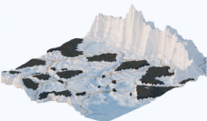
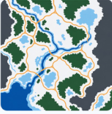








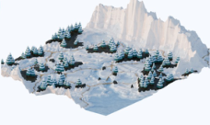







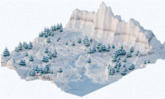







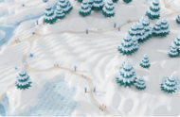
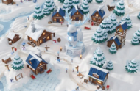
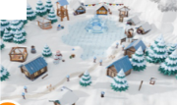
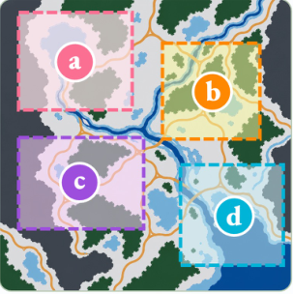
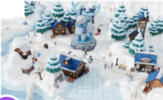
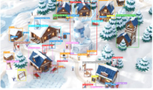




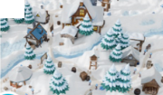
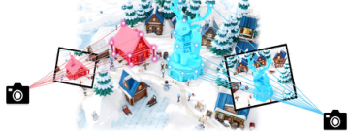
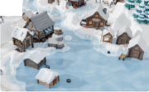

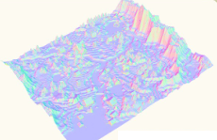
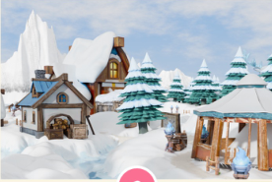
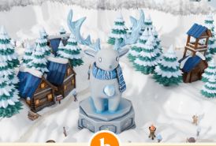
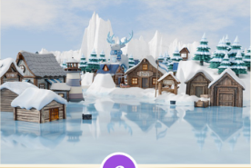
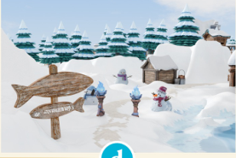
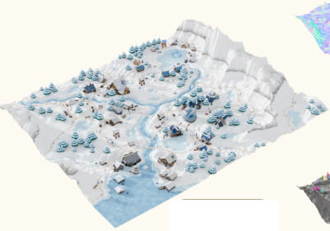
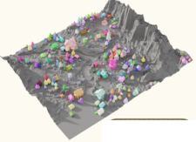
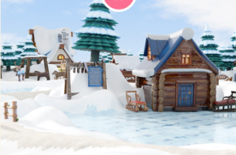
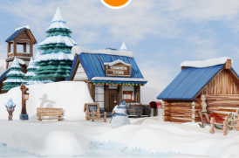
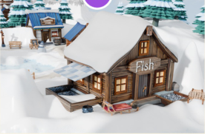
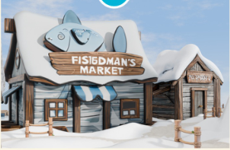
USER INPUT
STAGE 1: INTENT ANALYSIS & PLANNING
Generate a cartoon-style snowy
Scene Type
Spatial Layout
Visual Style
Main Objects
Terrain Categories
landscape featuring mountains flanking
snow and ice
surround by
cartoon
tree, house,
forest, ice, snow,
both sides and diverse terrain types.
mountain...
NPR
stone, fence...
hill, road...
STAGE 2. GLOBAL TERRAIN GENERATION
1
Prompt Planning
2
Scene Assets Generation
3
Scene Terrain Generation & Refinement
(a) layout design
gen image
(prompt: scene_plan.yaml; script: img_gen.py)
terrain generation
(script: terrain.py)
... a cold biome with
frozen
read
(filename: terrain_param.yaml)
lake,
forests,
road path...
(optional)
exec_py_scr
(script: import bpy ...)
(b) material & assets design
layout map
object images
texture map
3d assets scatter
(script: scatter.py)
forest:
deep green-brown...
read
(filename: scatter_plan.yaml)
road path:
dark gray-brown...
3d gen
(script: img_to_3d.py)
tex gen
(script: tex.py)
3d assets: snow-covered tree,
a. proc texture
b. texture map
exec_py_scr
(script: import bpy ...)
stone, ice, blue flame torch...
Image
scene refinement
(post: VLM model)
(c) terrain design
3D Gen
mesh & texture
OR
/loop
(3/5)
running...
frozen lake:
hmap(x0, y0)...
render
(filename: preview_03.png)
forests:
hmap(x1, y1) + rise...
3D
road path:
width(x2, y2) * p...
exec_py_scr
(script: import bpy ...)
STAGE 3. REGIONAL OBJECT GENERATION & PLACEMENT
1
Region Planning
2
Terrain-Aware Rendering
a
3
Scene Refinement
divide regions
region design
(script: img_edit.py)
render image
composition image
for ( ) in
a
b
c
d
render
(filename: region_b.png)
/loop
(6/15)
running...
exec_py_scr
(script: import ...)
b
closeup render
3d gen
detection
(filename: render_06.png)
(script: img_to_3d.py --det)
3d cartoon object list
objects refine
detect
(file_path: objects/)
c
Refine
(current: object_07.glb)
exec_py_scr
(script: import ...)
obj 1
obj 2
obj 3
...
obj 50
pose (t, r)
place model
placement determination
scale (dim, s)
Region
(script: 3d_placement.py)
d
quality (mesh, tex)
a
Festival Plaza
b
Cabin Village
read
(file_path: 3d_models/ cam_param)
terrain refine
↓ 4.8k
c
d
exec_py_scr
(script: call placement skills )
collision (c, p)
Supply Site
Fishing Village
quality (mesh)
placement determination
FINAL 3D SCENE
normal
region render
a
b
c
d
scene
instance
Notes:
ReFigure editable reconstruction — not author-provided PowerPoint.
WorldClaw: Agentic 3D Open-World Generation at Scale
Source: https://arxiv.org/abs/2608.05248v1
Approved image: fig1_global_to_regional_framework.png; SHA-256: d25526325e0b0bcea35b6fe50db292ddb4b6a5b6f51542ec585149d7038d296a
Source paper artwork is flattened raster. Readable diagram labels, containers, arrows, bullets, code examples and vector geometry were manually reconstructed as native editable PowerPoint objects. Arrow paths are editable freeforms, not endpoint-bound connectors.
Complex 3D terrain/object illustrations, scene renderings, semantic layout maps, original application screenshots and small pictogram icons remain independent local raster objects (86), whose internal pixels and embedded tiny raster annotations are not editable. No whole-figure or whole-panel screenshot backdrop is used.
Source font metadata is not recoverable from flattened diagrams. Visually matched installed substitutes: Times New Roman. Minor spacing, dashed line and antialiasing differences remain; this is not pixel-identical author source.
Final-file renderer: Artifact Tool PPTX roundtrip; this is not a PowerPoint application compatibility test.

