Slide 1
ChIP-Seq data analysis
Edited from Babraham Bioinformatics materials
http://www.bioinformatics.babraham.ac.uk/training/ChIP-Seq_Analysis/

Slide 2
What is ChIP-Seq
ChIP-Seq is a technology which uses high-throughput sequencing to infer the positions of any mark associated with DNA which can be captured by an antibody.

Slide 3
Types of antibody
Transcription factors / repressors
nanog, CTCF
Histones and histone modifications
H3, H3K4me3
DNA modifications
Methyl-Cytosine, Formyl cytosine
Chromatin remodelling proteins
BMI1, EZH2
Transcription machinery
Pol2

Slide 4
How Does ChIP-Seq work
DNA
Cross-link proteins to DNA
DNA
Fragment DNA (sonication, MNase etc)
Capture
Y
Y
Y
Y
Y
Y
Y
Y
Elute
Remove Crosslinks
Size Select
Add Adapters
Sequence

Slide 5
What can you sequence?
Y
Y
Y
Y
Y
Y
Y
Y
Y
Y
Y
Y
Y
Y
Y
Y
ChIP Material
Mock (IgG)ChIP Material
Input Material (sonicated / Mnase / H3 etc)

Slide 6
Sequencing for ChIP
Barcode
Adapter
ChIP Fragment
Adapter
Barcode
Read 1
Primer
Adapter
ChIP Fragment
Read 2
Primer
ChIP Fragment
Adapter
Barcode Read

Slide 7
What you end up with

Slide 8
Single End vs Paired End
Insert
Read 1
Read 2
Paired
(= >$£€¥)
Inferred
Read 1
Single
(= Cheaper!)
Inferred

Slide 9
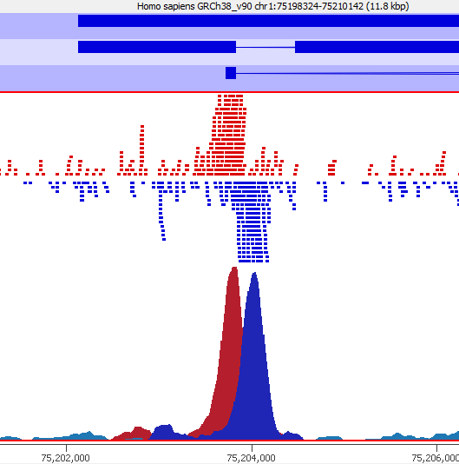
Extending reads if necessary
Peak Width
For point enrichment, insert size is roughly peak width/2

Slide 10
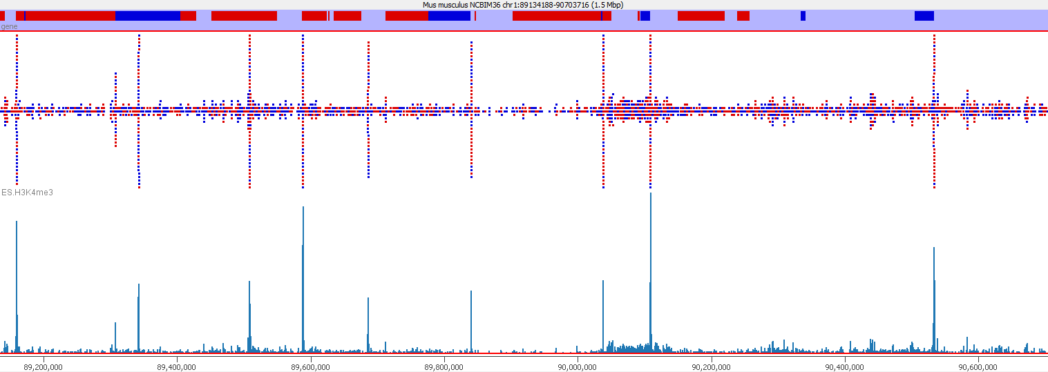
Types of Enrichment
Single points (typical TF, some histone marks)

Slide 11
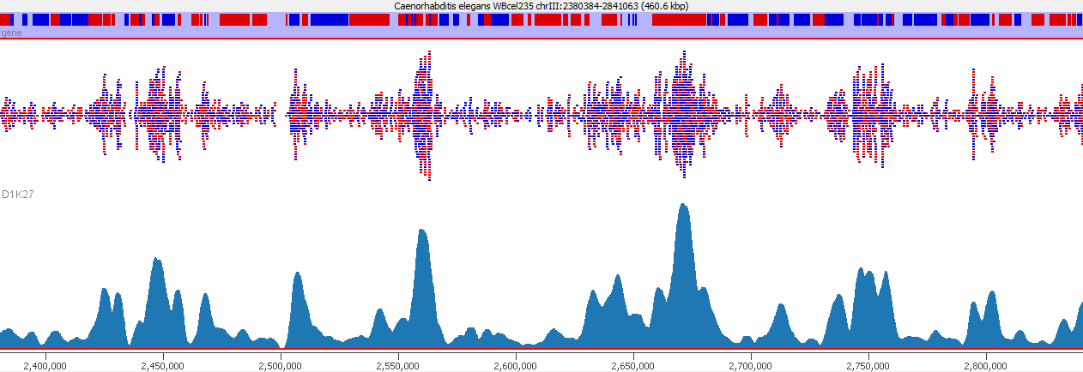
Types of Enrichment
Broad Regions (some histone marks, PolII)

Slide 12
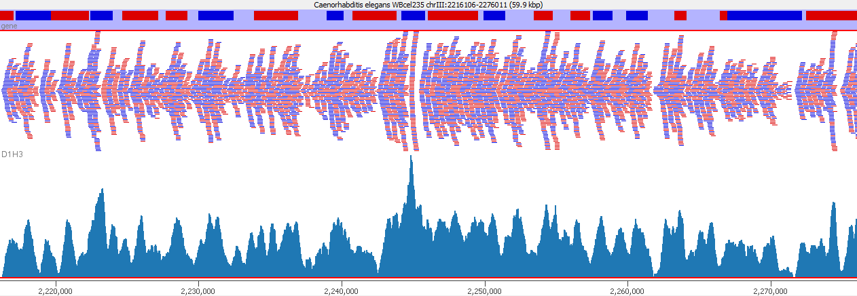
Types of Enrichment
Virtually everywhere (h3)

Slide 13
Data Creation and Processing
Starting DNA
Fragmented DNA
ChIPped DNA
Mapped BAM File
FastQ Sequence File
Sequence Library
Filtered BAM File
Exploration
Analysis

Slide 14
Some Basic Questions
Is there any enrichment?
What is the size / patterning of enrichment?
How well are my controls behaving?
What is the best way to quantitate this data?
Are there any technical artefacts?

Slide 15
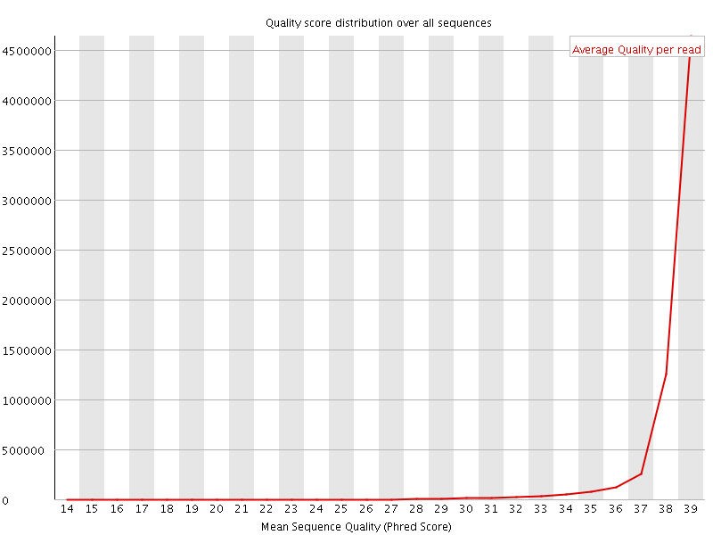

QC of raw sequence Base Call Quality

Slide 16
QC of raw sequence Sequence Composition

Slide 17
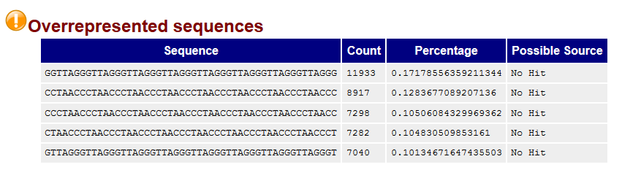
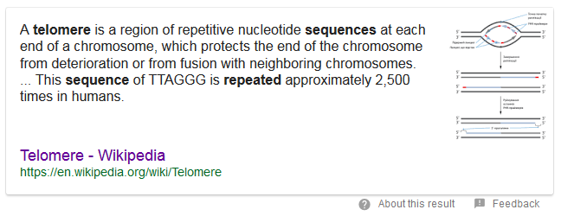
QC of raw sequence Sequence Composition

Slide 18
QC of raw sequence Adapter Contamination
Barcode
Adapter
ChIP Fragment
Adapter
Barcode
Read
Trim Galore!
Quality and Adapter Trimming

Slide 19
Mapping ChIP Data
All regions should be linear genomic stretches
Standard genomic aligners are fine
Bowtie2 http://bowtie-bio.sourceforge.net/bowtie2/
BWA http://bio-bwa.sourceforge.net/

Slide 20
Example Bowtie2 Mapping
Create Genome Index (once - slow!)
Map a single FastQ file
bowtie2-build yeast_genome.fa yeast_index
bowtie \
-x yeast_index \
-U data.fastq.gz \
| samtools view \
-bS \
-o data.bam

Slide 21
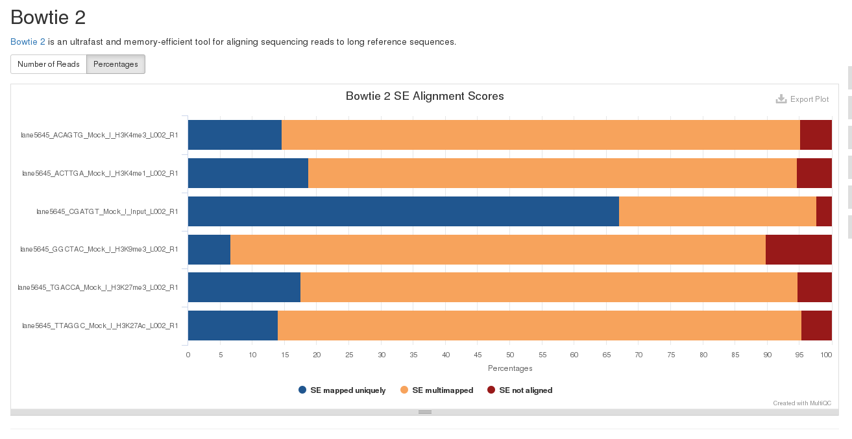

Post Alignment QC Mapping Statistics
sample1: 2264052 (14.66%) aligned exactly 1 time
sample2: 2698005 (18.79%) aligned exactly 1 time
sample3: 13434392 (67.08%) aligned exactly 1 time
sample4: 1108477 (6.70%) aligned exactly 1 time
sample5: 2143911 (17.58%) aligned exactly 1 time
sample6: 2980154 (13.98%) aligned exactly 1 time

Slide 22
Post Alignment Processing MAPQ Filtering
ChIP-Seq relates sequences to positions in a reference genome
You need to be confident that the reported position is correct
Filtering on MAPQ value (likelihood of reported position being incorrect) is an easy way to do this
MAPQ filtering should be performed in most cases
samtools view -q 20 -b -o filtered.bam data.bam

Slide 23
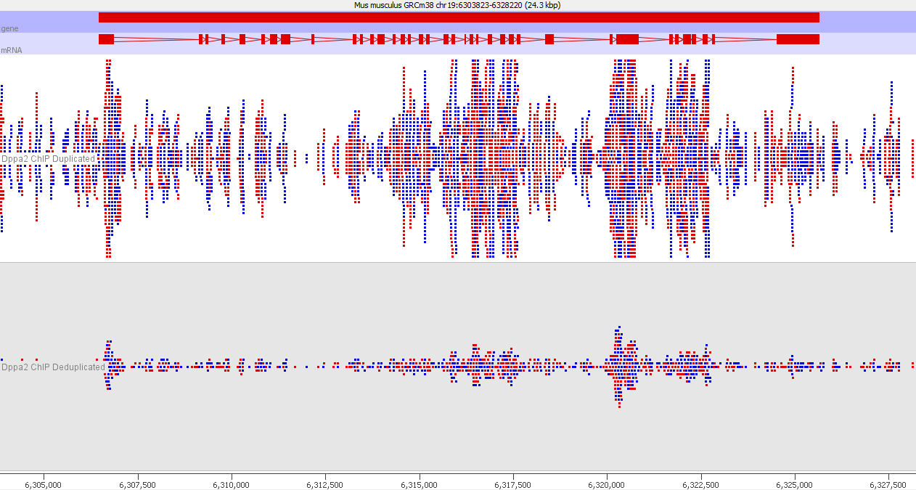
Deduplication

