Slide 1



GIT Version Control System (moving from SVN)

Slide 2

Why Version Control ?
Purposes:
revert files to previous state
single document or snippet of code to be edited by a team, the members of which may be geographically dispersed and may pursue different and even contrary interests
Types:
Local (files, RCS)
Centralized (CVS, Subversion, Perforce, VSS)
Distributed (Git, Mercurial, Bazaar, Darcs)

Slide 3
Version Control Systems Use
Name | 2015 | 2017 | 2018
Git | 69.3% | 69.2% | 87.2%
Subversion | 36.9% | 9.1% | 16.1%
Microsoft Team Foundation Server | 12.2% | 7.3% | 10.9%
Mercurial | 7.9% | 1.9% | 3.6%
CVS | 4.2% | ^{[i]} | ^{[i]}
Perforce | 3.3% | ^{[i]} | ^{[i]}
Microsoft Visual SourceSafe | ^{[i]} | 0.6% | ^{[i]}
Rational ClearCase | ^{[i]} | 0.4% | ^{[i]}
Zip file backups | ^{[i]} | 2.0% | 7.9%
Copying and pasting files to network shares | ^{[i]} | 1.7% | 7.9%
Other | 5.8% | 3.0% | ^{[i]}
None | 9.3% | 4.8% | 4.8%

Slide 4

Git History
(git means unpleasant person in British English slang)
The development of Git began on 3 April 2005. Torvalds announced the project on 6 April; The first merge of multiple branches took place on 18 April. Torvalds achieved his performance goals; on 29 April, the nascent Git was benchmarked recording patches to the Linux kernel tree at the rate of 6.7 patches per second.
0.99 | 2005-07-11
2.25 | 2020-01-13 | 2.25.0 | 2020-01-13

Slide 5
SVN and Git Comparison
SVN | Git
Centralised | Distributed
Better performance on larger/binary files | Optimised for faster branching
Access Control per directory level | Less sophisticated rights model
Popularity is waning | Integrated with Bitbucket
Easier learning | More sophisticated operations (rebase vs. merge)

Slide 6
GIT concepts for SVN users
Every copy is a repository
You track a remote repository (master origin)
You work on a branch (git status)
Push vs Commit (you commit all your changes locally)
Checkout means switching to another branch
Merge means adding incremental changes from another branch (creates commit as opposed to SVN merge)
…
It might look complicated but fortunately you can start working NOW and understand the concepts later!

Slide 7

Git Book All you need to know is the Branch Workflow
Installation
Clone Repository
Create Branch from master (pull the latest)
Commit to the Branch
Push and create pull request
Merge and Delete Branch

Slide 8
Installation
Google: git for windows and download git command line
https://git-scm.com/download/win
Clients for git:
https://git-scm.com/downloads/guis
SourceTree
GitHub Desktop
Tortoise Git
PyCharm

Slide 9
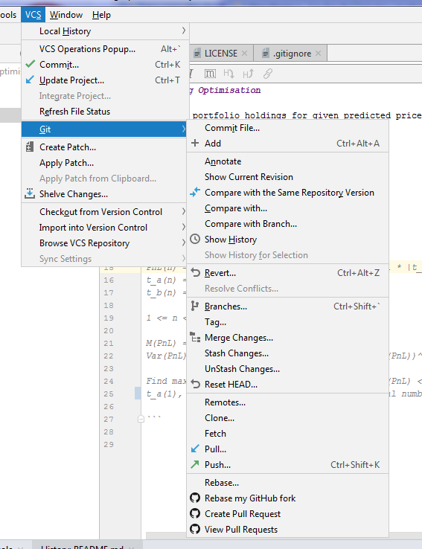
PyCharm Extention (VCS -> Git)

Slide 10
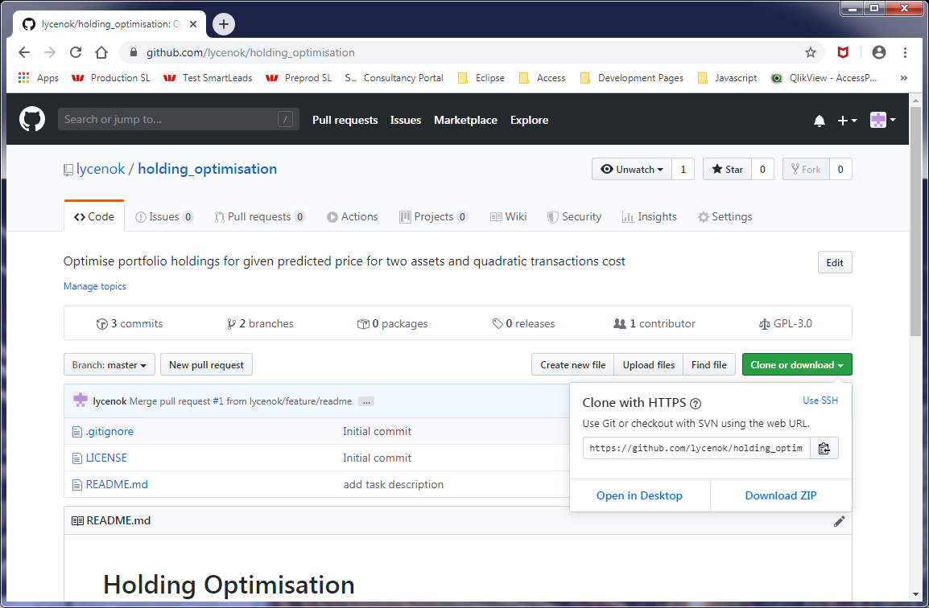
Git clone

Slide 11
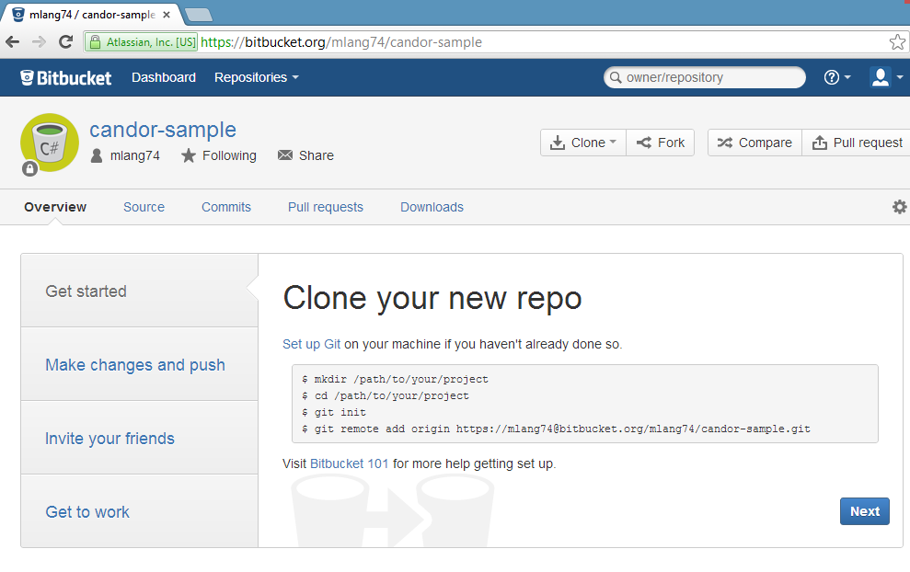
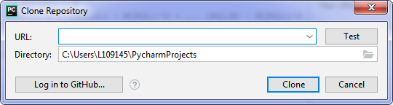
Git clone

Slide 12
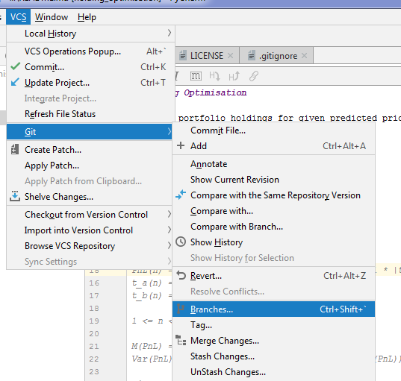
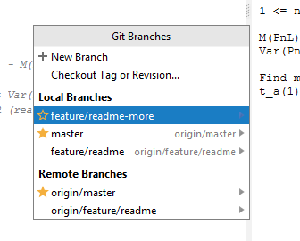
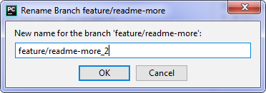
Create a new-branch from master (PyCharm)

Slide 13
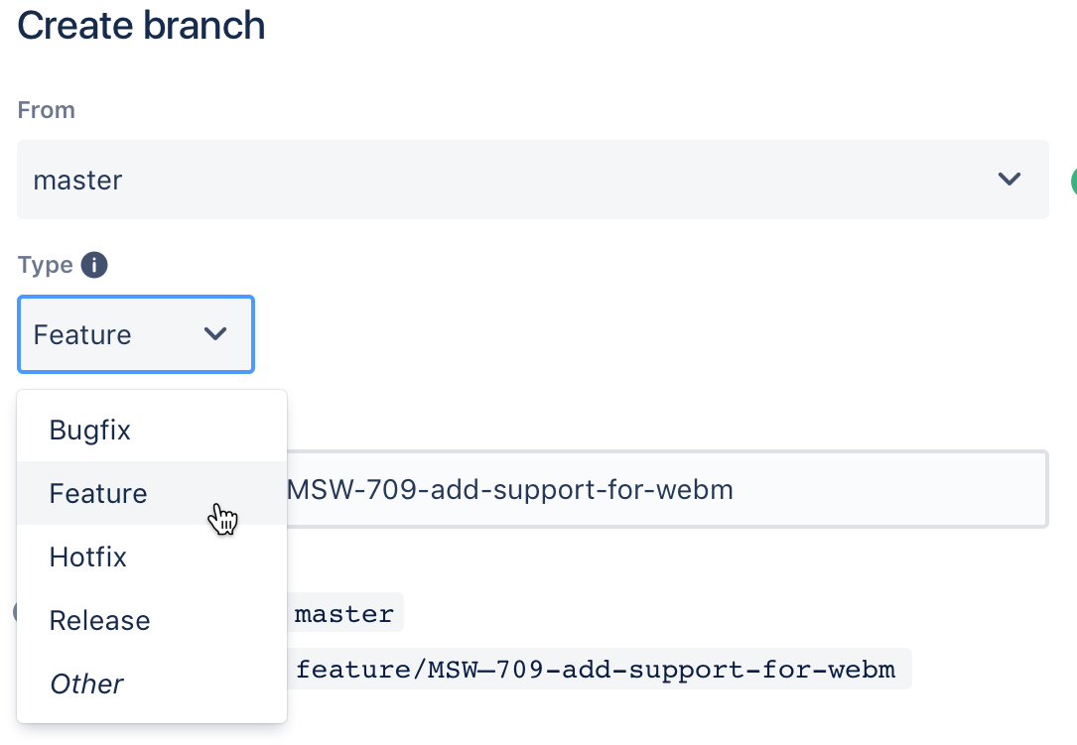
Create a new-branch (other tools)
git checkout -b feature/<Jira>-new-feature

Slide 14
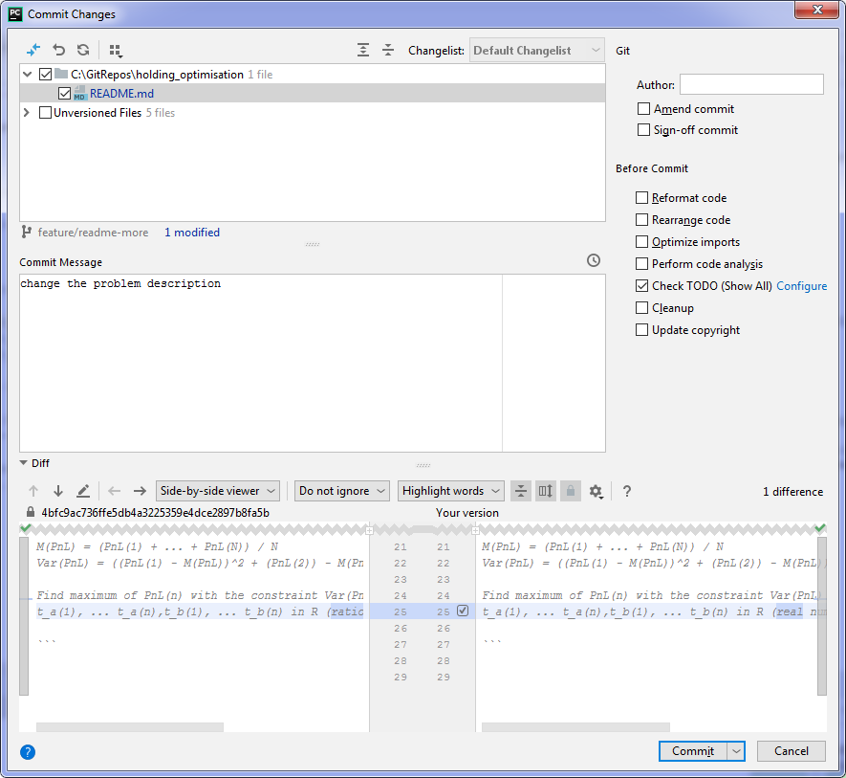
Git Commit (PyCharm)

Slide 15
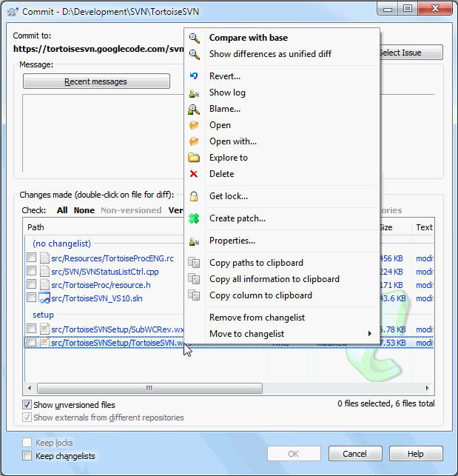
Git Commit (other tools)
git status
git add <some-file> git commit
Commit Conventions:
type of commit (feat, test, chore)
Imperative mood

Slide 16
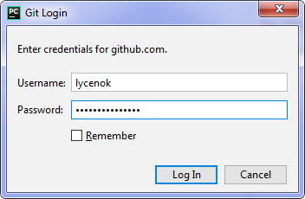
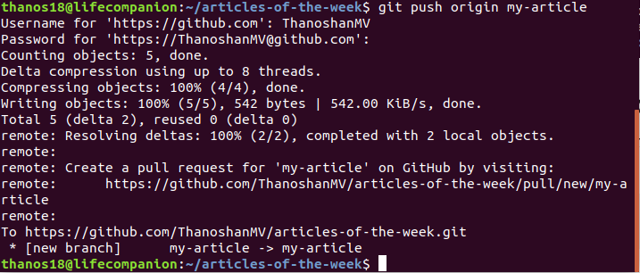
Push feature branch to remote
In PyCharm (VCS -> Git -> Push)
git push -u origin new-feature

Slide 17
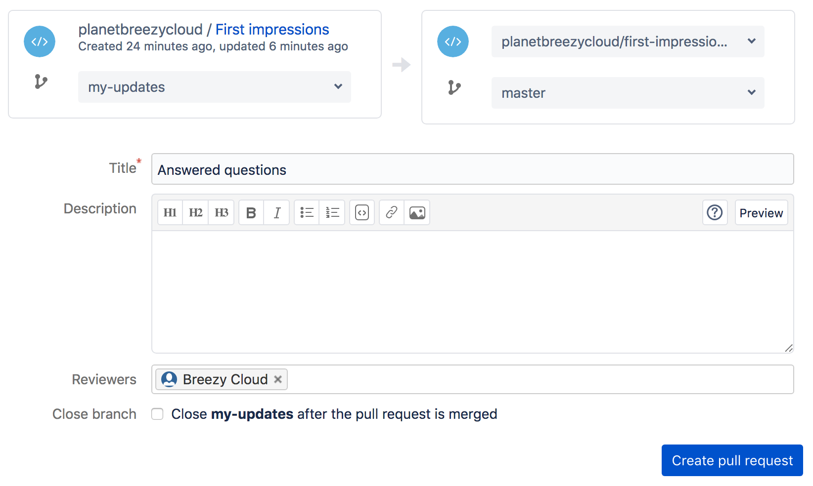
Create a pull request / add reviewers

Slide 18
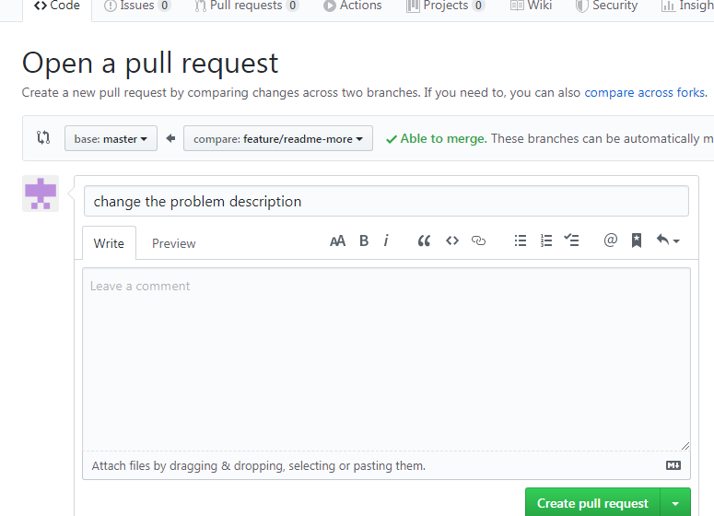
Create a pull request / add reviewers (github)

Slide 19
Create a pull request / add reviewers

Slide 20
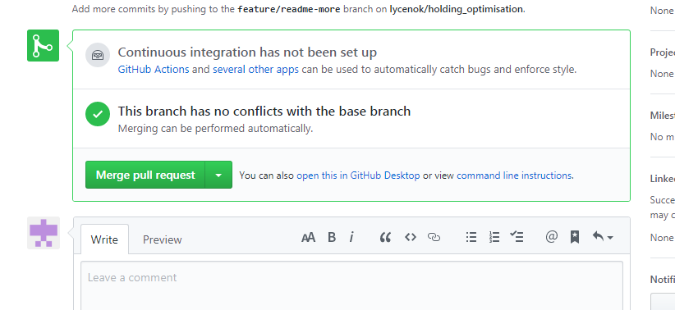
Merge feature branch / pull master

Slide 21
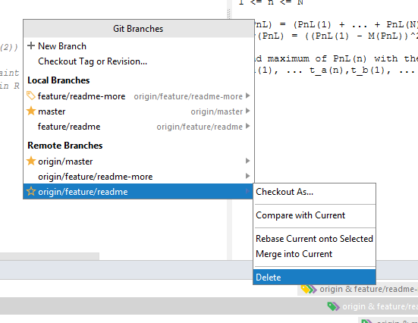
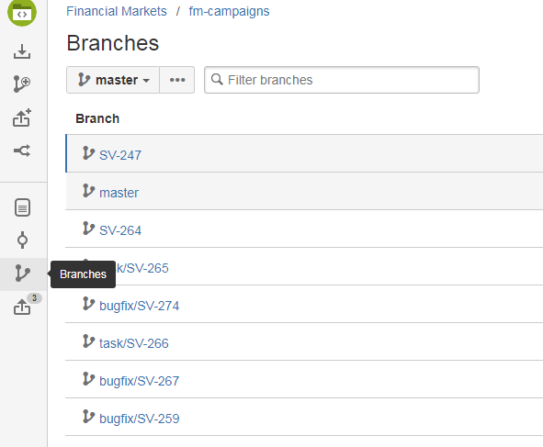
Delete branch

Slide 22
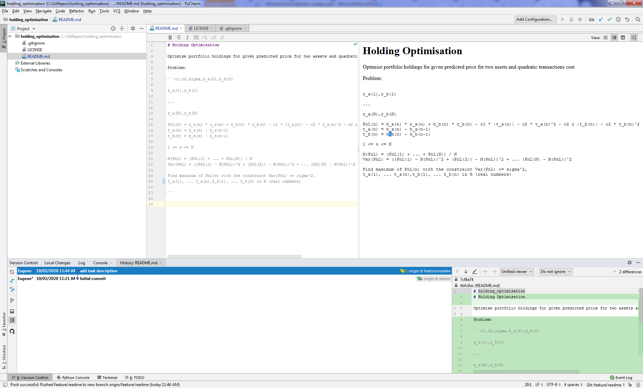
Day-to-day use. Show history (VCS -> Git -> Show History)

Slide 23

Useful Links
Git For Windows
Git Book
SVN to GIT preparing your team
Branch Workflow
Comparing Workflows (bitbucket)

