Slide 1
Low-Switching-Cost Reinforcement Learning on Robot Control Environments
Yancheng Liang
Yushuo Chen
Part of the paper
“Beyond Information Gain: An Empirical Benchmark for Low-Switching-Cost Reinforcement Learning”

Slide 2
Typical Off-Policy RL Framework
The agent selects an action, interacts with the environment, and receives feedback from it.
Environment
Collect data with new policy
Agent
The agent samples data from the replay buffer and updates the policy.
The agent sends the collected data to the replay buffer.
Experience Replay Buffer
Interaction
Updating

Slide 3
Switching Cost: a Two-Agent Deployment Framework
The agent directly interacting with the environment is called the deployed agent.
If the criterion rejects, do not update the deployed policy.
Environment
Agent
Deployed
The agent interacting with the environment updates its policy here.
This is called a switch.
We only learn the online policy.
When some switching criterion is met, switch the deployed policy.
Another agent that keeps the newest trained policy, the online agent.
The online agent doesn’t interact with the environment directly.
Online
Experience Replay Buffer
Interaction
Updating
Switch

Slide 4
Why Low-Switch-Cost?
Goal: switch rarely, and maintain the performance
Cost: high cost to deploy the newest policy
Risk: in medical, robotics …

Slide 5
MuJoCo: Environments for Robot Control Tasks
High dimensional states
Continuous action space
Infinite number of possible states
SOTA: soft actor-critic[1] (SAC)
Actor: actual policy
Critic: an auxiliary model to help the learning of the actor

Slide 6
Specific Settings for SAC
Environment
Deployed Actor
Online Actor
Critic
Experience Replay Buffer
Interaction
Updating
Switch

Slide 7
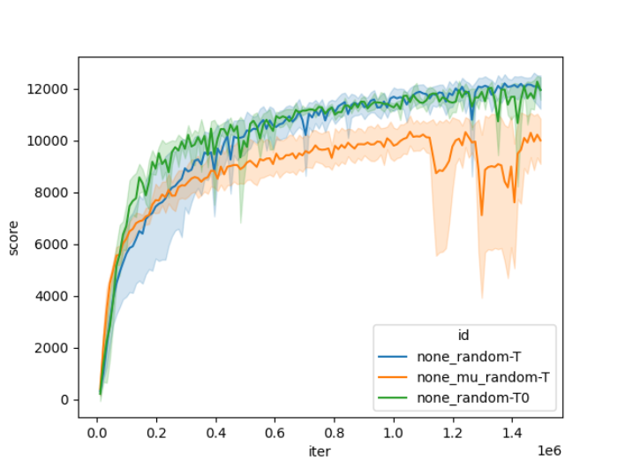
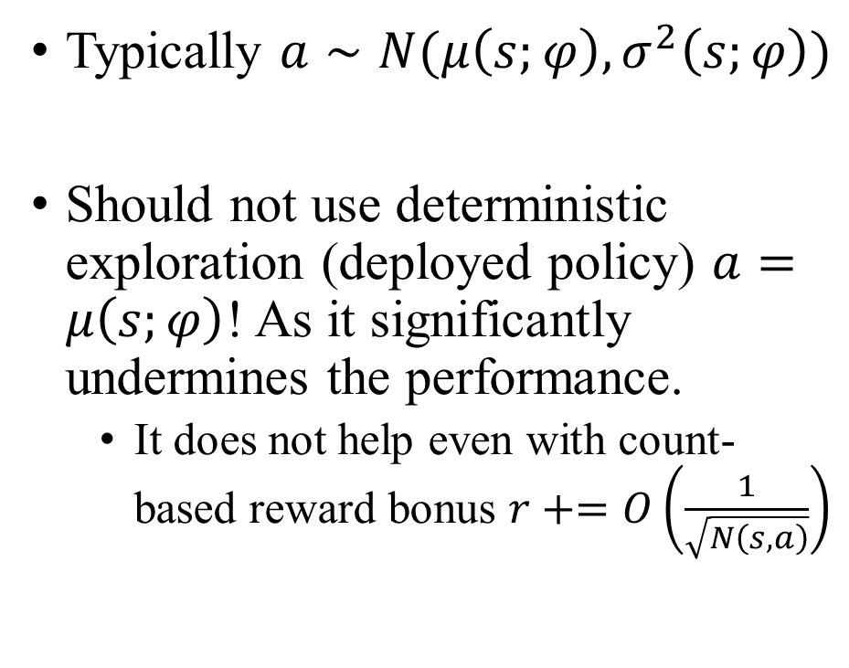
For SAC and MuJoCo
Typically $a∼N(μ\left(s;φ\right), σ^{2}\left(s;φ\right))$
Should not use deterministic exploration (deployed policy) $a=μ\left(s;φ\right)$! As it significantly undermines the performance.
It does not help even with count-based reward bonus $r+=O\left(\frac{1}{\sqrt{N\left(s,a\right)}}\right)$

Slide 8
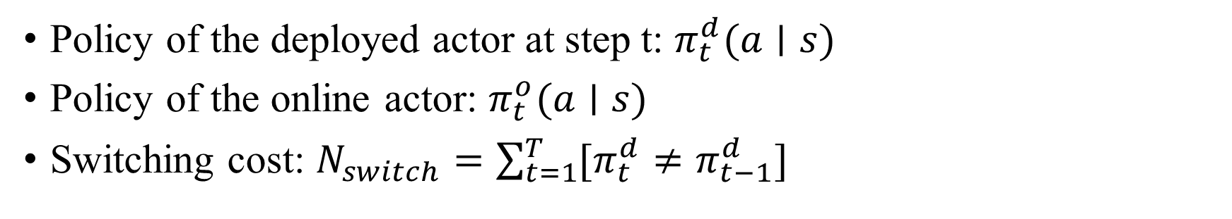
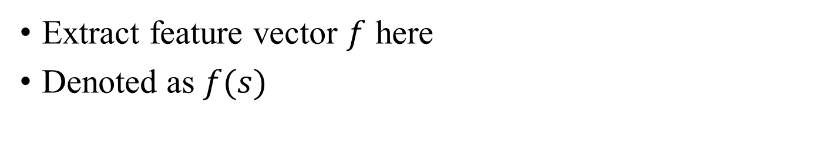
Specific Settings for SAC
Policy of the deployed actor at step t: $π_{t}^{d}(a∣s)$
Policy of the online actor: $π_{t}^{o}(a∣s)$
Switching cost: $N_{switch}=\sum_{t=1}^{T}{[π_{t}^{d}≠π_{t−1}^{d}]}$
State
Hidden Layers 1
$π\left(⋅ ∣ s\right)=softmax(W_{θ}f\left(s;φ\right)+b_{θ})$
Hidden Layers 2
Extract feature vector $f$ here
Denoted as $f(s)$
Policy

Slide 9
Core: Switching Criterion
Environment
Deployed Actor
Online Actor
Critic
Experience Replay Buffer
Interaction
Updating
Switch

Slide 10
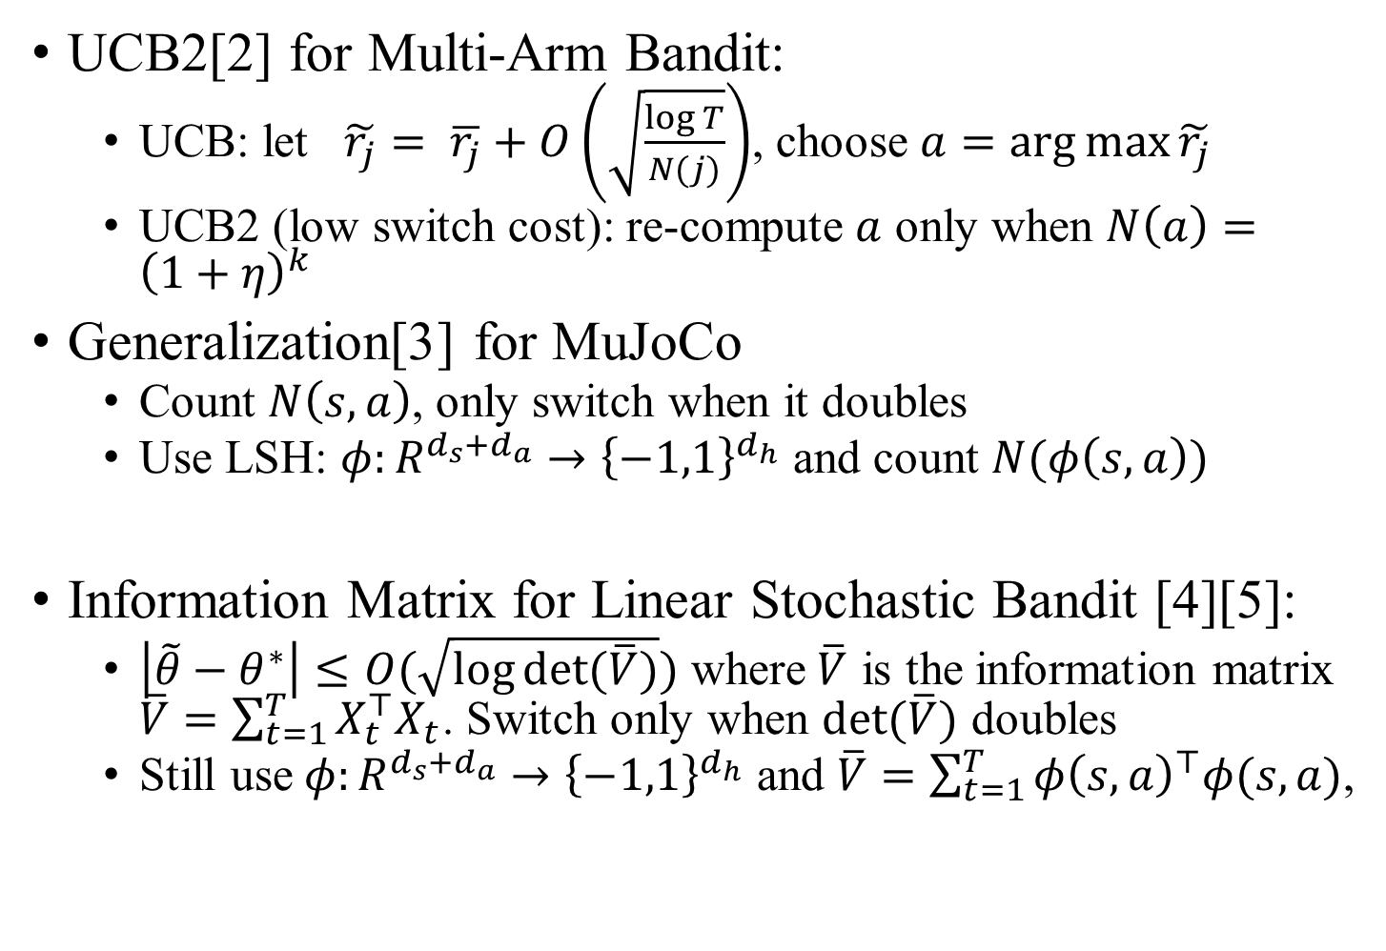
Intuition from the Theory: Information Gain as Switching Criteria
UCB2[2] for Multi-Arm Bandit:
UCB: let $\tilde{r_{j}}= \overline{r_{j}}+O\left(\sqrt{\frac{\log{T}}{N(j)}}\right)$, choose $a=\arg{\max{\tilde{r_{j}}}}$
UCB2 (low switch cost): re-compute $a$ only when $N\left(a\right)={\left(1+η\right)}^{k}$
Generalization[3] for MuJoCo
Count $N\left(s, a\right)$, only switch when it doubles
Use LSH: $φ:R^{d_{s}+d_{a}}→{\left\{−1,1\right\}}^{d_{h}}$ and count $N(φ\left(s, a\right))$
Information Matrix for Linear Stochastic Bandit [4][5]:
$\left|\tilde{θ}−θ^{∗}\right|≤O(\sqrt{\log{det⁡(\overline{V})}})$ where$\overline{V}$ is the information matrix $\overline{V}=\sum_{t=1}^{T}{X_{t}^{⊤}X_{t}}$. Switch only when $det⁡(\overline{V})$ doubles
Still use$φ:R^{d_{s}+d_{a}}→{\left\{−1,1\right\}}^{d_{h}}$ and $\overline{V}=\sum_{t=1}^{T}{φ{\left(s, a\right)}^{⊤}φ(s, a)}$,
Works poorly:
Too many switches!
(UCB assume all arms are independent)
Visitation
Info

Slide 11
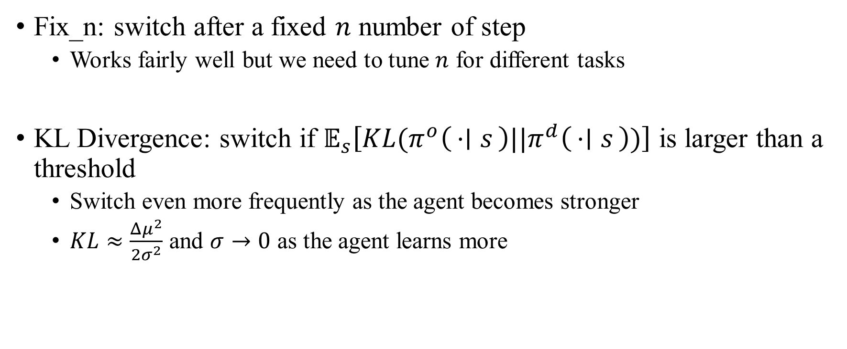
Naïve Switching Criteria
Fix_n: switch after a fixed $n$ number of step
Works fairly well but we need to tune $n$ for different tasks
KL Divergence: switch if $𝔼_{s}\left[KL(π^{o}\left(⋅ ∣ s\right)||π^{d}\left(⋅ ∣ s\right))\right]$ is larger than a threshold
Switch even more frequently as the agent becomes stronger
$KL≈\frac{Δμ^{2}}{2σ^{2}}$ and $σ→0$ as the agent learns more
KL Divergence

Slide 12
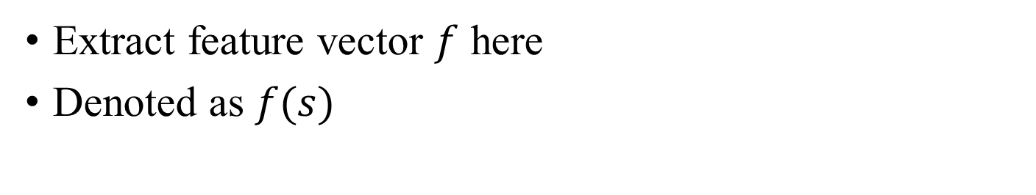

Feature-Based Switching Criteria
Switch based on cos-similarity of the features$𝔼_{s}\left[\left\langle \hat{f^{d}\left(s\right)}, \hat{f^{o}\left(s\right)}\right\rangle \right]$
$\hat{n}=\frac{n}{{\left|\left|n\right|\right|}_{2}}$
Feature
State
Hidden Layers 1
Extract feature vector $f$ here
Denoted as $f(s)$
Hidden Layers 2
Policy

Slide 13
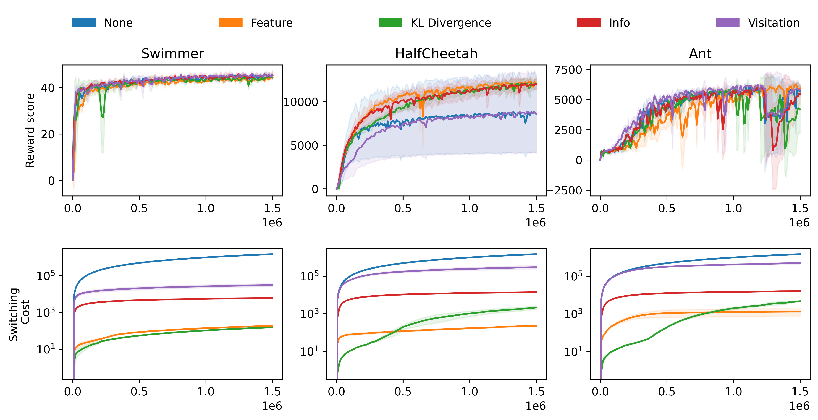
“Feature”: best performance, lowest switching cost
Information Gain: high switching cost
“KL”: switch more as learning more

Slide 14
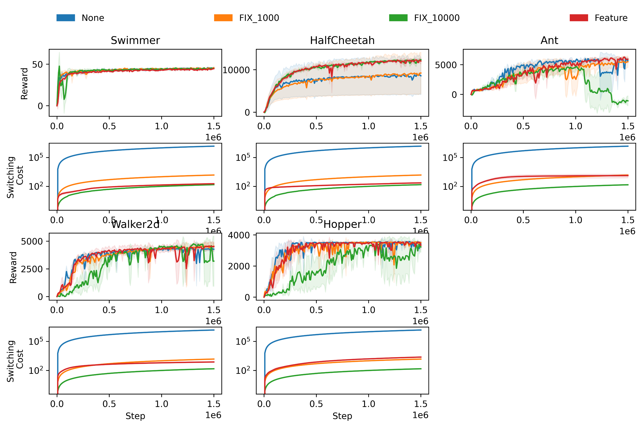
“Feature” automatically adjusts the switching frequency.

Slide 15
Future Work
Best switching cost for fix_n of different environments
More on better switching criteria

Slide 16
Thank You for Listening! Q & A

Slide 17
Acknowledgement
Work with Prof. Wu, Prof.Du and our TAs, Shusheng Xu and Yunfei Li.

Slide 18
References
[1] Haarnoja, Tuomas, et al. "Soft actor-critic algorithms and applications." arXiv preprint arXiv:1812.05905 (2018).
[2] P. Auer, N. Cesa-Bianchi, and P. Fischer. Finite-time analysis of the multiarmed bandit problem. Machine learning, 47(2-3):235–256, (2002).
[3] Bai, Yu, et al. "Provably efficient q-learning with low switching cost." arXiv preprint arXiv:1905.12849 (2019).
[4] Yasin Abbasi-yadkori, D´avid P´al, and Csaba Szepesv´ari. Improved algorithms for linear stochastic bandits. In J. Shawe-Taylor, R. Zemel, P. Bartlett, F. Pereira, and K. Q. Weinberger, editors, Advances in Neural Information Processing Systems, volume 24, pages 2312–2320. Curran Associates, Inc., (2011).
[5] Ruan, Yufei, Jiaqi Yang, and Yuan Zhou. "Linear bandits with limited adaptivity and learning distributional optimal design." arXiv preprint arXiv:2007.01980 (2020).

