Slide 1
Low-Switching-Cost Reinforcement Learning
Environment
Agent
Deployed
Online
Experience Replay Buffer
Interaction
Updating
Switch

Slide 2
AI + Finance: Deep Learning Framework For Risk Prediction
Sequential Data
Sequential Model
Credit Report
Joint Model
Data pre-processing
Labal Selection
Model Fusion
Non-sequential Data
Non-sequential Model

Slide 3
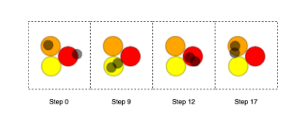
Multi-Agent Meta-Exploration by Exploiting State-Action Space

Slide 4
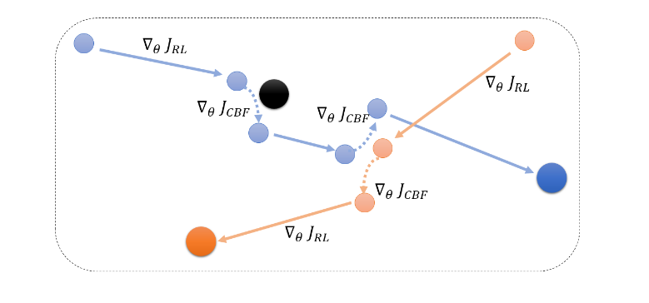
Learning Decentralized Control Barrier Functions to Certificate Multi-agent Reinforcement Learning

