Slide 1
Busker Project Final Demo
Lachlan, Tram, Triani

Slide 2
Project Overview
Connect street performers with prospective audiences
  Busker profiles
  Schedule performances
  Performance location sharing
  Tipping
  Performance pictures

Slide 3
Scope of the Project
Changes:
  No Follower system
  User profile reduced
    Simple authentication
  Maps is more limited
  tips/payments
    Doesn’t work without merchant id

Slide 4
Roles and Contributions
Lachlan
  Database
  Map
Tram
  GUI
  Profiles
Triani
  GUI

Slide 5
Lessons Learnt
More communication
Skill level awareness
If other people can’t do it, try to do it instead of waiting
Account for time conflicts
Learned Android Studio, Android apps

Slide 6
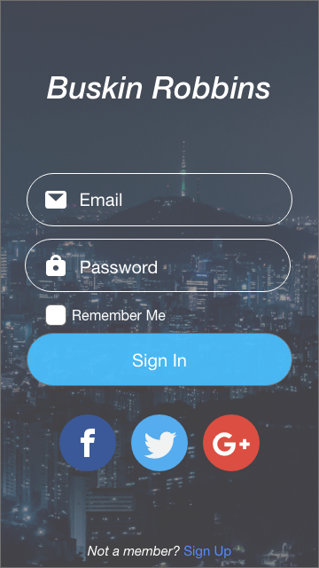
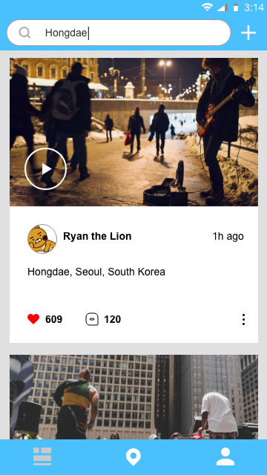
Mockups

Slide 7
Technical Details
Tools
  Google Maps
  Firebase
  Google Pay
  Camera

Slide 8
Technical Details
Technical challenges
  A lot
  Maps and accurate location
  database
  Resources were limited, Google Pay

Slide 9
Demo

