Slide 1

LOAN DEFAULT
PREDICTION
An interpretable credit-scoring model for home-equity lending
MIT Applied AI & Data Science Program
Capstone Project — Final Presentation
Lycias Zembe | September 2026
Problem → Data → Methods → Models → Results → Impact

Slide 2
Key Findings at a Glance
Dataset: 5,960 applicants, 12 predictors and a 19.95% default rate
Validation design: 60% training, 20% validation and 20% untouched test
Leakage control: preprocessing and SMOTE fitted inside every training fold
Final candidates: tuned Random Forest and tuned XGBoost
Selection: highest validation precision with recall of at least 85%
Final test: XGBoost at 0.239; ROC-AUC 0.954, AP 0.878, recall 0.824
Illustrative value: $1.50M–$5.20M per 1,000 applications under hypothetical assumptions
EXECUTIVE
SUMMARY
Loan Default Prediction
RECOMMENDED MODEL: Tuned XGBoost | Test ROC-AUC 0.954 | AP 0.878 | Threshold 0.239 | Test recall 0.824
02
Loan Default Prediction | MIT AAIDSP Capstone
Notes:
Source: capstone_final_Notebook_Final_Corrected.html, executive summary and final locked test results.

Slide 3
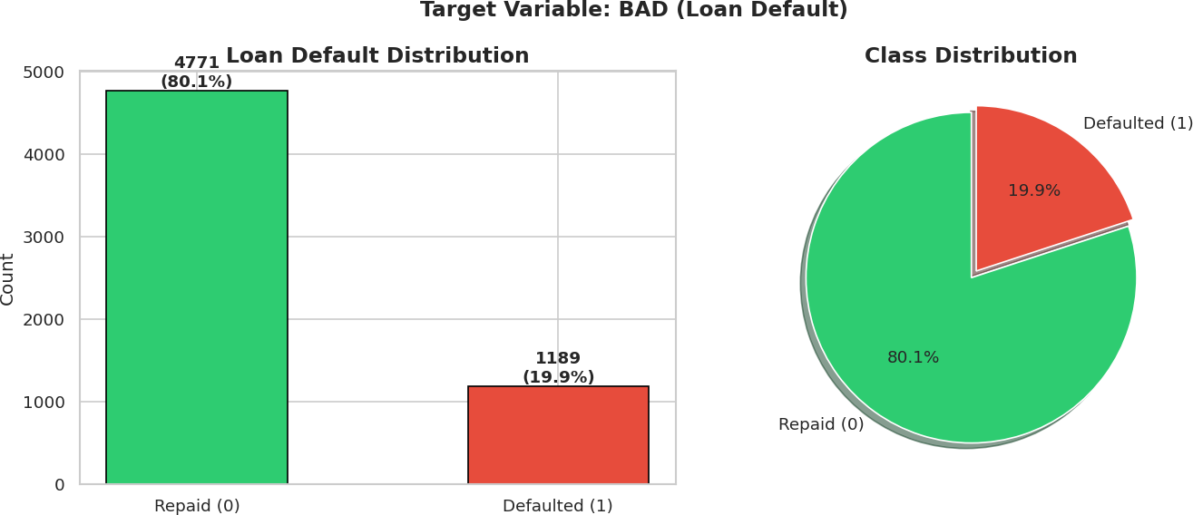
Only ~1 in 5 loans default → optimise for Recall
BUSINESS
PROBLEM,
OBJECTIVE
& DATA
Profit at risk: interest on home-equity loans drives profit, but defaults (NPAs) erode it — manual approval is slow and biased.
Objective: predict which applicants will default and identify the features to weigh at approval.
Constraint (ECOA): under the Equal Credit Opportunity Act, every rejection must be explainable.
Why this matters
5,960
19.95%
loan applicants
default rate (imbalanced)
12 predictors: credit behaviour (DELINQ, DEROG, CLAGE, NINQ, CLNO), capacity (DEBTINC, YOJ), loan/collateral (LOAN, MORTDUE, VALUE), context (REASON, JOB)
03
Loan Default Prediction | MIT AAIDSP Capstone

Slide 4
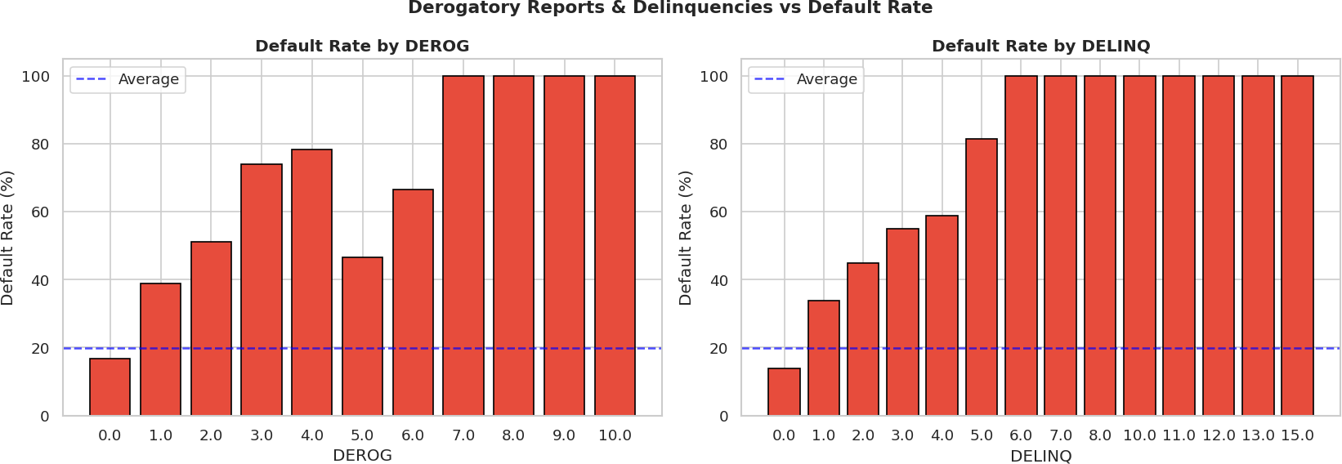
Methodology principles
Inspect
Business rule: maximize validation precision while maintaining recall of at least 85%.
Leakage control: preprocessing and SMOTE occur inside each training fold.
Locked evaluation: validation selects the model and threshold; the test set is used once.
Reproducible: random seed 42 governs splits, resampling and model searches.
ANALYTICAL
APPROACH
& KEY EDA
EDA
Preprocess
& Engineer
Strongest signal: prior credit trouble
Balance
(SMOTE)
Methodology & findings
Model
& Tune
Interpret
& Threshold
04
Loan Default Prediction | MIT AAIDSP Capstone

Slide 5
Leakage control
Validation design
Model ladder
60/20/20 stratified split
Median/mode imputation inside folds
One-hot encoding for categories
Scaling fitted inside folds
SMOTE fitted inside folds
Five-fold cross-validation
Tune on Average Precision
Validation selects threshold
Recall requirement at least 85%
Test set evaluated once
Final candidates
Tuned Random Forest
Tuned XGBoost
Selection based on validation
Test confirms generalisation
PREPROCESSING,
FEATURES &
MODELLING
Depth of analysis
Final pipelines fit every preprocessing and SMOTE step inside the training folds. XGBoost provides the strongest validation trade-off. Explanations support review but do not establish compliance.
05
Loan Default Prediction | MIT AAIDSP Capstone

Slide 6
Performance Summary — Test Set
Model / operating point | Recall | F1 | ROC-AUC
XGBoost, locked 0.239 | 0.824 | 0.786 | 0.954
Random Forest, locked 0.408 | 0.815 | 0.782 | 0.962
XGBoost, standard 0.50 | 0.714 | 0.782 | 0.954
Random Forest, standard 0.50 | 0.723 | 0.751 | 0.962
MODEL
SELECTION
Selected: tuned XGBoost based on validation precision at the 85% recall requirement.
Untouched test: ROC-AUC 0.954, Average Precision 0.878, recall 0.824, precision 0.751 and F1 0.786.
SHAP can support explanations; compliance also requires governance, fairness testing and legal review.
Understanding the solution
06
Loan Default Prediction | MIT AAIDSP Capstone

Slide 7
Key Insights
Tuned XGBoost remains the selected model under leakage-resistant validation.
Validation selected the locked threshold of 0.239, reported as 0.24.
Test recall is 0.824, below validation recall of 0.853 because of normal sampling variation.
A bank cost matrix and external temporal validation should precede deployment.
DECISION
THRESHOLD
& KEY INSIGHTS
Locked cutoff 0.239 identifies 196 of 238 defaulters
Turning the model into a business lever
0.71 → 0.82
0.954
07
Loan Default Prediction | MIT AAIDSP Capstone
test recall
ROC-AUC

Slide 8
Operational Recommendations
Illustrative business value
Pilot tuned XGBoost as a first-pass screen at threshold 0.239.
Validate the cutoff using actual default-loss and false-rejection costs.
Route flagged cases to documented human review.
Monitor calibration, subgroup fairness and drift before retraining.
Sensitivity per 1,000 applications; not confirmed ROI
$1.50M
RECOMMENDATIONS
& BUSINESS
IMPACT
conservative scenario
$3.38M
Decision workflow
base illustration
FLAG
Probability ≥ 0.239 → documented human review
What the bank should do and gain
CHECK
Assess affordability, collateral and applicable policy
$5.20M
TRACK
Track calibration, fairness and performance drift
favourable scenario
08
Loan Default Prediction | MIT AAIDSP Capstone
Notes:
Source: capstone_final_Notebook_Final_Corrected.html, Section 6 Illustrative Business Value. Values use hypothetical assumptions and do not represent a forecast, savings guarantee or confirmed ROI.

Slide 9
Risks & limitations
Further analysis
SMOTE samples may not reflect emerging default patterns.
Imputation of ~21% DEBTINC can bias despite the missingness flag.
Survivorship bias — only approved applicants in the training data.
Concept drift — economic shifts change default behaviour over time.
LightGBM / CatBoost + probability calibration.
Cost-sensitive learning with an explicit cost matrix.
Richer data — credit-bureau & macroeconomic indicators.
Real-time scoring API with data-drift monitoring.
RISKS,
LIMITATIONS
& NEXT STEPS
Honest limits and the road ahead
Recommendation: pilot tuned XGBoost at threshold 0.239 with documented human review. Complete cost, calibration, fairness, governance and legal checks before deployment.
09
Loan Default Prediction | MIT AAIDSP Capstone

Slide 10
THANK YOU
Pilot tuned XGBoost at threshold 0.239; validate costs, calibration and fairness before deployment.
Lycias Zembe | MIT Applied AI & Data Science Program | 2026
10

Slide 11
APPENDIX
Appendix
Additional Resource Slides
Available on request during Q&A
Q&A backup slides
11
Loan Default Prediction | MIT AAIDSP Capstone

Slide 12
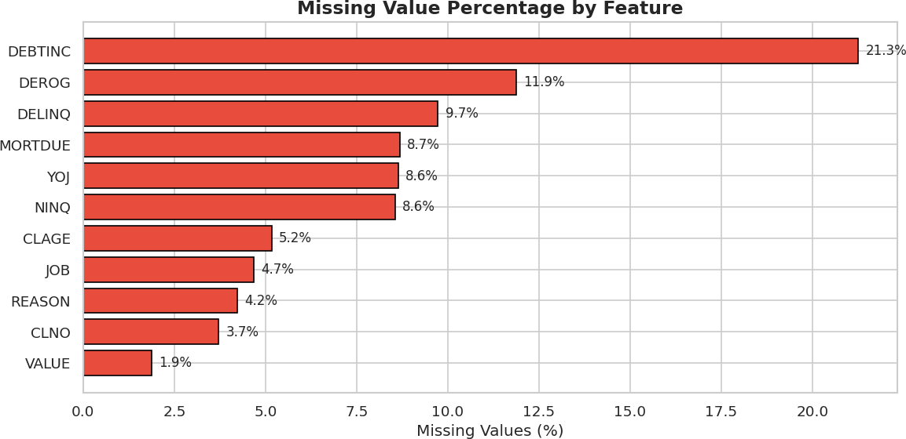
Missing Value Analysis
DATA
QUALITY
Missing values
Key Finding: DEBTINC missing 21.3%, MORTDUE missing 6.2%, VALUE missing 6.4%. Variables with >30% missing were excluded from modelling.
Source: Original HMEQ home-equity loan dataset (n = 5,960 observations)
12
Loan Default Prediction | MIT AAIDSP Capstone

Slide 13
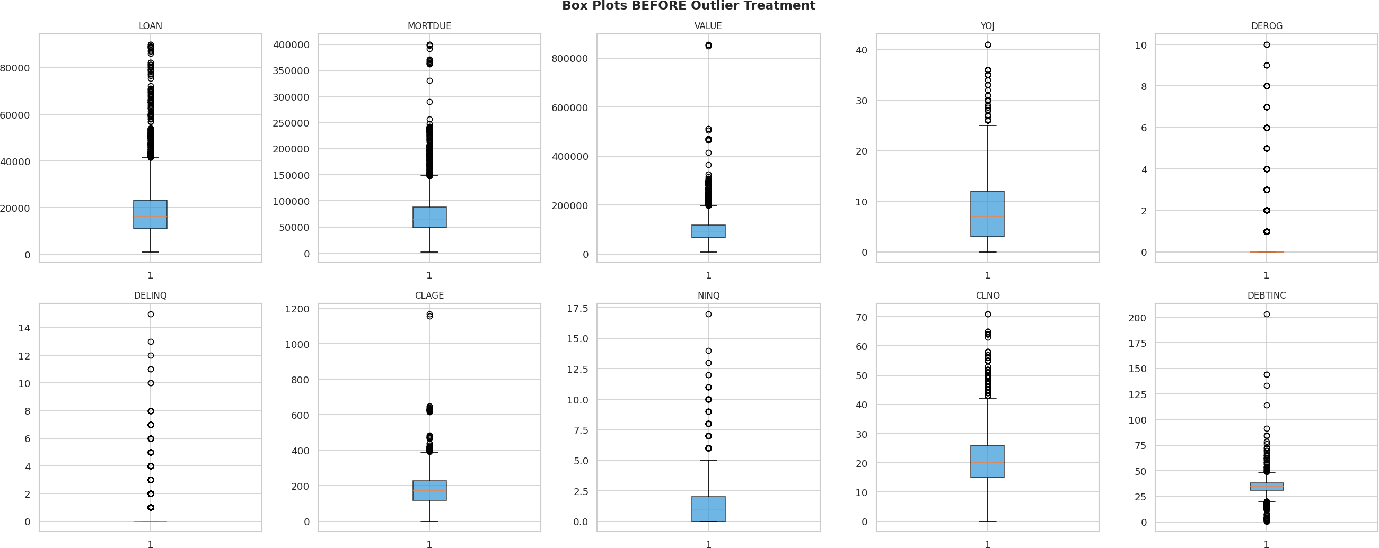
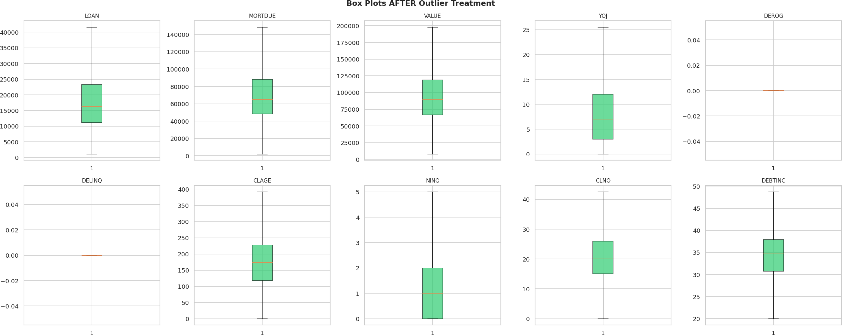
Outlier Detection & Treatment
DATA
QUALITY
Before Treatment
After IQR Capping
Outlier treatment
Outliers capped at 1.5×IQR boundaries to preserve distributional shape while eliminating extreme values that would distort model training.
13
Loan Default Prediction | MIT AAIDSP Capstone

Slide 14
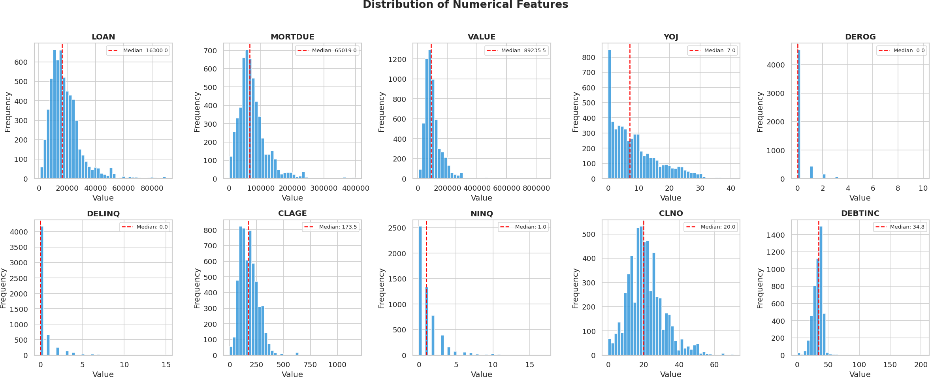
Variable Distributions (Key Predictors)
EDA
Univariate analysis
Right-skewed distributions in financial variables (LOAN, MORTDUE, VALUE, DEBTINC) suggest log-transformation opportunity. Normal distributions in credit history length (CLAGE).
14
Loan Default Prediction | MIT AAIDSP Capstone

Slide 15
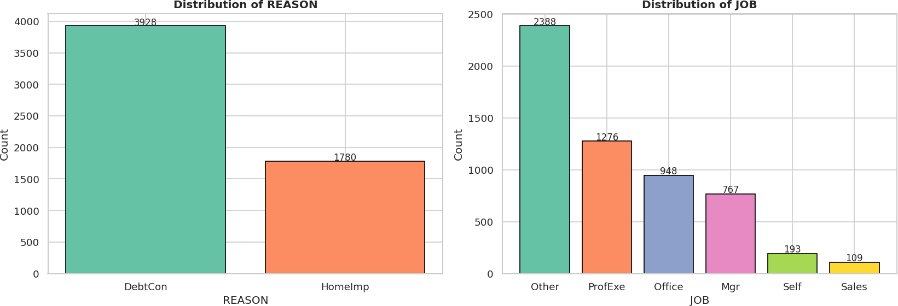
Categorical Feature Analysis
EDA
Categorical features
Loan purpose and job category show strong segmentation patterns relevant to default risk probability.
15
Loan Default Prediction | MIT AAIDSP Capstone

Slide 16
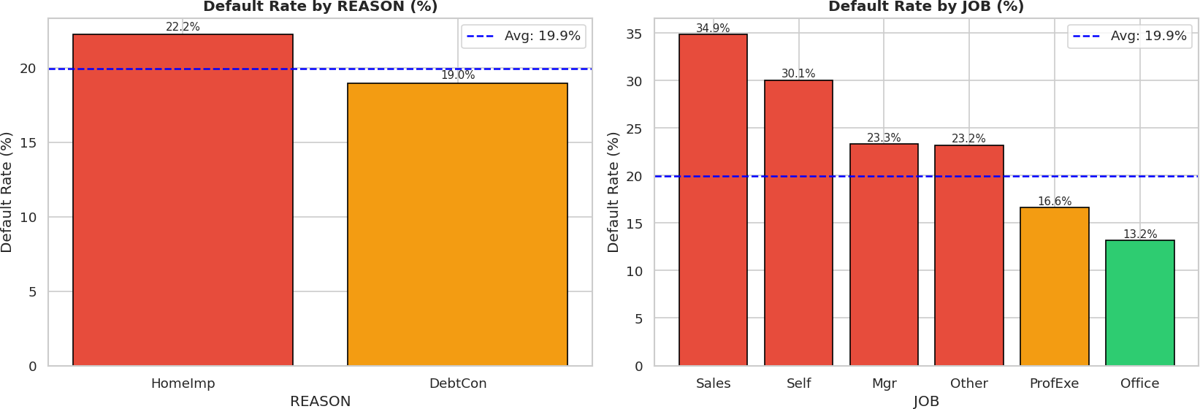
Default Rate Variation Across Categories
EDA
Default by category
Derogatory marks and delinquencies show the strongest category-level signal for default risk across all segmentation variables.
16
Loan Default Prediction | MIT AAIDSP Capstone

Slide 17
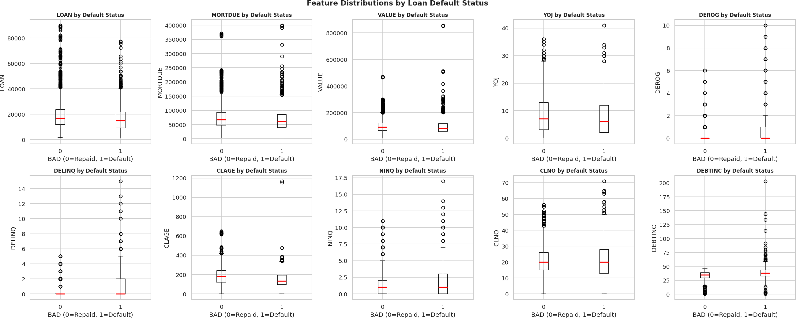
Feature Distributions by Default Status
EDA
Bivariate analysis
Box plots reveal clear separation in debt-to-income ratio and loan amount between default / non-default groups; CLAGE and DEBTINC show strongest separation.
17
Loan Default Prediction | MIT AAIDSP Capstone

Slide 18
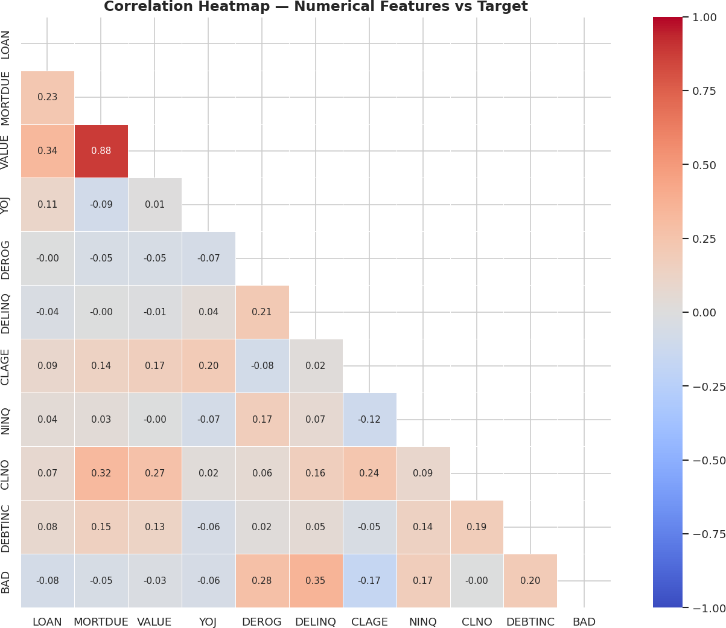
Feature Correlation Matrix
EDA
Correlation heatmap
Moderate positive correlations between derogatory marks and delinquencies (r ≈ 0.4). No severe multicollinearity detected (all VIF values acceptable).
18
Loan Default Prediction | MIT AAIDSP Capstone

Slide 19
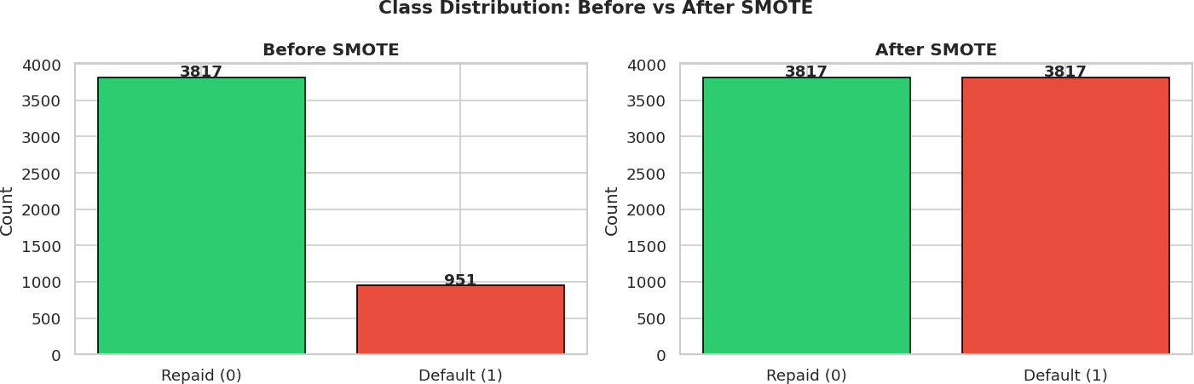
Handling Class Imbalance: SMOTE
Before SMOTE
METHODOLOGY
Class imbalance handling
After SMOTE
SMOTE (Synthetic Minority Over-sampling Technique) applied to training set only, preventing data leakage into the test set.
19
Loan Default Prediction | MIT AAIDSP Capstone

Slide 20
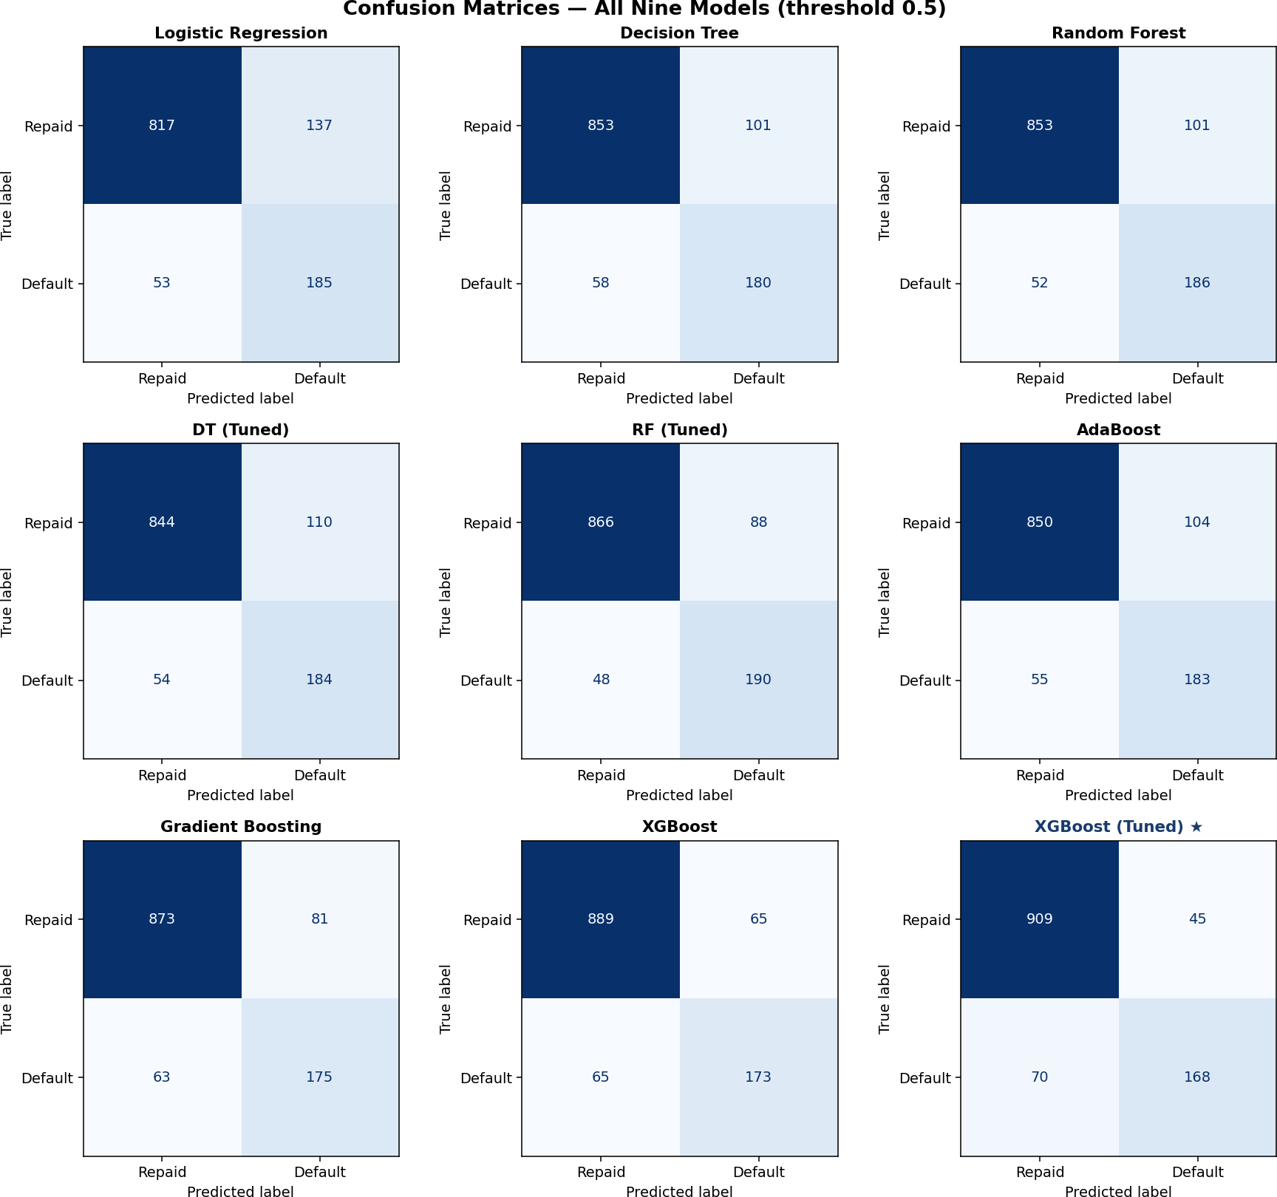
Confusion Matrices — All Models
MODELS
All confusion matrices
★ Final selected model — Tuned XGBoost
20
Loan Default Prediction | MIT AAIDSP Capstone

Slide 21
Untouched Test Set: Discrimination Metrics
MODELS
TEST METRICS
On the untouched test set, XGBoost achieves ROC-AUC 0.954 and Average Precision 0.878. Random Forest has slightly higher ROC-AUC, while XGBoost has higher Average Precision and wins the validation decision rule.
21
Loan Default Prediction | MIT AAIDSP Capstone

Slide 22
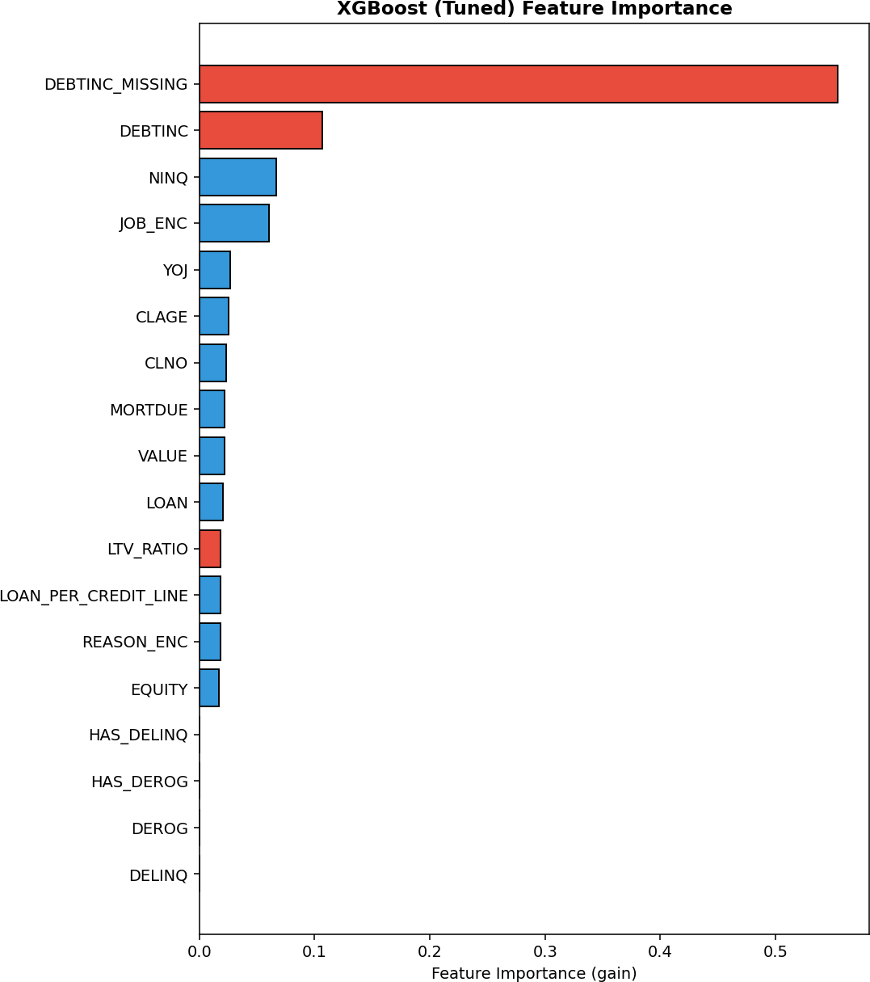
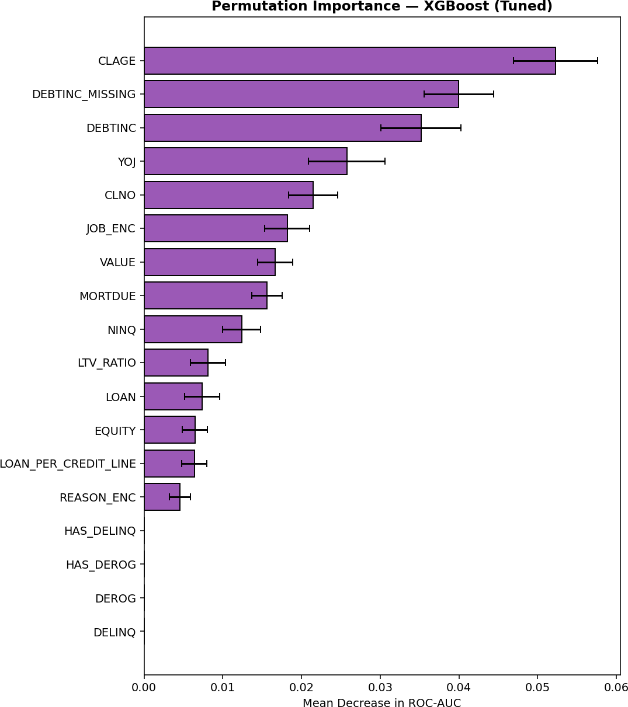
Feature Importance: MDI vs Permutation
EXPLAINABILITY
Feature importance
Gain Importance (XGBoost)
Permutation Importance (Test Set)
Both methods agree: debt-to-income disclosure (DEBTINC_MISSING), the DEBTINC value, and recent inquiries (NINQ) are the top predictors of loan default.
22
Loan Default Prediction | MIT AAIDSP Capstone

Slide 23
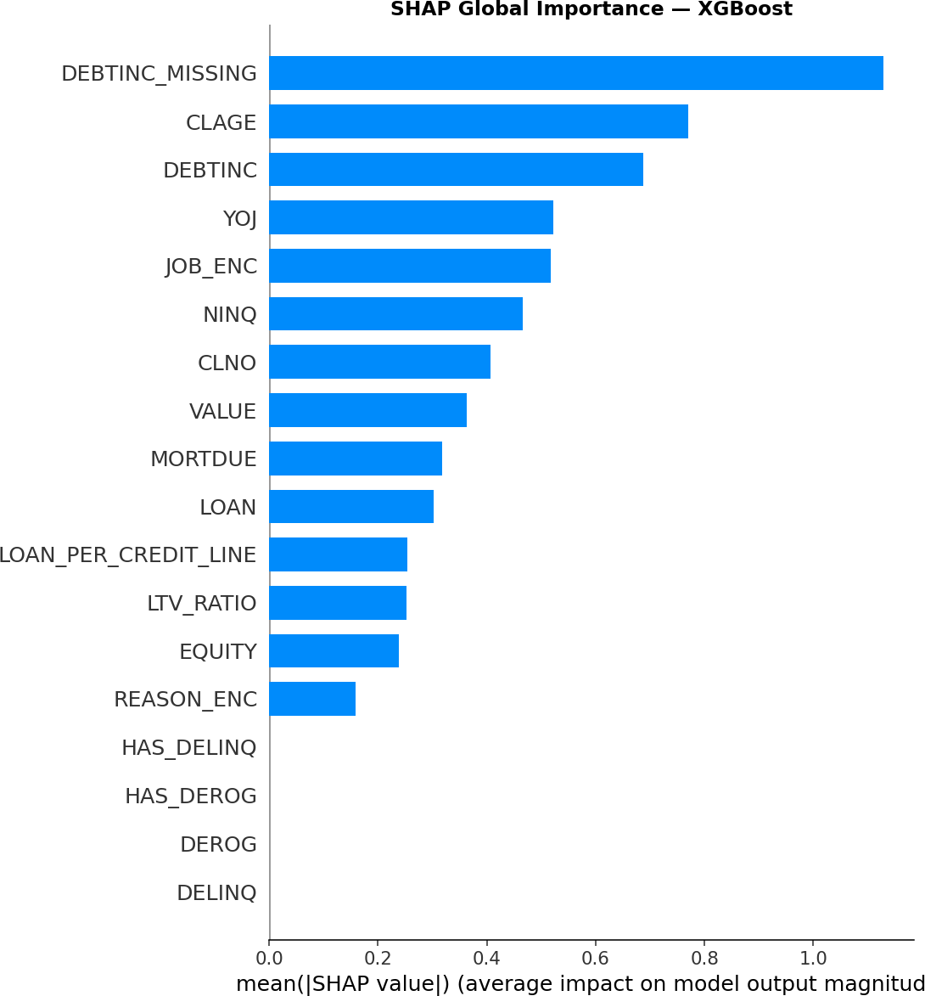
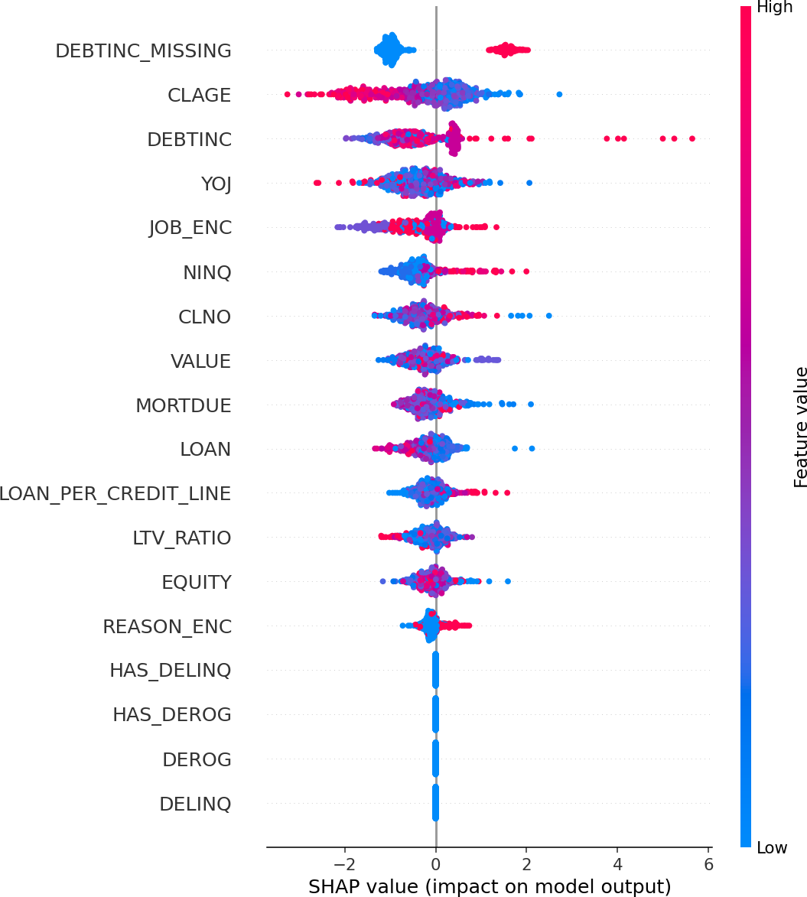
SHAP Value Analysis — Model Interpretability
Global Feature Importance (SHAP)
Individual Prediction Impact (Beeswarm)
EXPLAINABILITY
SHAP analysis
SHAP can support adverse-action reasoning. Compliance also requires fairness testing, governance, human oversight and legal review.
23
Loan Default Prediction | MIT AAIDSP Capstone
Notes:
Source: capstone_final_Notebook_Final_Corrected.html, model interpretation and deployment safeguards.

